Slide 1
Welcome to
Buchheit Logistics, Inc.
Orientation
Scott City, MO Terminal
A company that is proud to state:
“Safety is our Culture”

Slide 2
Important Dates
Today's Date: __19 December 2025__
Your “Hire” Date: Today!
Available Date: 𝑻𝒉𝒆 𝒅𝒂𝒚 𝒂𝒇𝒕𝒆𝒓 𝒄𝒐𝒎𝒑𝒍𝒆𝒕𝒊𝒐𝒏 𝒐𝒇 𝒂𝒍𝒍 𝒐𝒓𝒊𝒆𝒏𝒕𝒂𝒕𝒊𝒐𝒏 𝒓𝒆𝒒𝒖𝒊𝒓𝒆𝒎𝒆𝒏𝒕𝒔.
  This is when we expect to dispatch you on your 1st load!

Slide 3
Welcome to Buchheit!
All Company Drivers and Independent Contractors:
Please be sure to scan the following to Driver Pulse:
Class A CDL.
Current DOT Physical and Long Form.
Employees for I-9 requirements:
  Social Security Card, State issued Birth Certificate, or Passport.

Slide 4
Day 1 Administrative Requirements:
Team Member information sheet (Buchheit TM Discount Program).
ADP – Onboarding Experience.
  1099 Independent Contractors: W-9.
  W-2 Company Employee Drivers: W-4, I-9, & Direct Deposit.
    Employee Benefits info (www.meetalex.com).
    EAP Driver Pulse (www.paseap.com).
(Tenstreet):
  Driver Qualification File (DQF) documents.
  Pre-Orientation Training.
Photos for Driver and HR Profiles .
Receipts for reimbursement of expenses coming to Orientation.
  Turn into your Recruiter – or scan to SHIPS Mobile with 1st trip.

Slide 5
Welcome to Buchheit!
Our Goals and Values:
“Do the Right Thing, even when no one is watching – always.”
Our Mission for Orientation:
Our intent is to provide you the keys to being successful as a driver in today’s industry as well as a productive and valued member of the Buchheit Team!
Our job is to get you on the road making money as soon as possible!
Notes:
What is the INTENT of Orientation?
We want this orientation to be mutually beneficial. I don’t want to lecture you all day nor do I want blank stares while you fall asleep. I want this to be a two-way conversation. My goal is when you leave here you feel like you have all the tools necessary to be successful at Buchheit!
Inform drivers that regardless of experience level, our focus is to enable driver success and provide all the necessary tools for success by basing what we teach on safety, CSA, and what is expected of a driver in today’s industry, not how we conducted business ten, fifteen, or 30 years ago….
Explain to drivers the hiring and orientation process and that we will assist them with hiring issues as best we can.

Slide 6



Career Options
Operating Companies:
Logistics/Trucking Division, Scott City, MO Founded in 1934
  Buchheit Truck Service started with Rudy Buchheit hauling to St. Louis and returning to Biehle with merchandise for the retail store. We expanded our services in early 2000 to include warehousing, hence the rebranding to Buchheit Logistics. Now our business has expanded to travel all across the United States and in Canada with a fleet of more than 100 trucks (both company and owner operator). We haul raw materials and finished goods. Trucking has its own maintenance shop and office located in Scott City; MO. Trucking is comprised of 3 primary fleets:
  Dry-vans (Local and OTR)
  End-dumps (Local and OTR) Hopper-bottoms (Local and OTR)

Slide 7
Career Options
Operating Companies:
Buchheit, Inc. – Corporate Headquarters in Biehle, MO
Retail Division: In our retail division, we sell merchandise such as lumber, building materials, hardware, electrical, plumbing, farm, automotive, power equipment, lawn & garden, pet, horse supplies, vet supplies, sporting goods, clothing, house wares and toys. Customers enjoy shopping with us because of our friendly, knowledgeable staff, and our unique shopping atmosphere. Our Retail division is 18 stores across 4 states:
  Missouri Illinois Arkansas Kentucky
Central States Small Engine Repair in Biehle, MO: Small engine repair and maintenance business.
Buchheit Metals in Advance, MO: Custom metal buildings and barns.
Carriage House Cabinets , in Ste. Genevieve, MO: Custom cabinets shipped to distributors and retailers nationwide.

Slide 8
Career Options
Operating Companies:
Distribution Center, Ste. Genevieve, MO: Established in 1992
  In our Distribution Center, we bring merchandise into a large warehouse and divide it for the retail locations. Our trucking division then delivers the merchandise to the ordering store.
Agricultural Division, Biehle, MO: Founded in 1936
  Referred to as the feed mill, Agri started out as a grind and mix operation selling swine, dairy, beef and poultry feeds. Agri is now established as a regional feed manufacturer selling swine, dairy, beef, poultry, ostrich, sheep, goat and pet feeds. We are one of the area’s largest fescue (grass seed) processors. Agri also has a retail location that sells the items listed above along with vet and farm supplies.

Slide 9
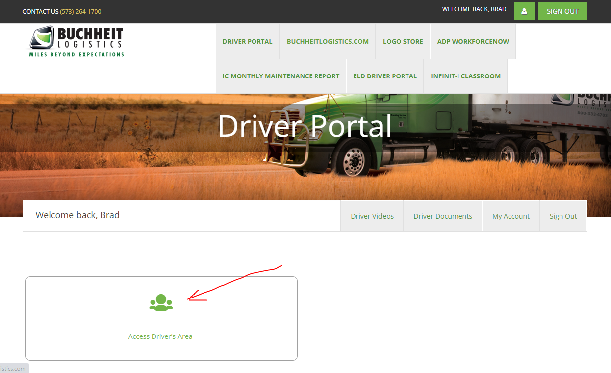
Driver Tools and Apps
Driver.BuchheitLogistics.com
Be sure to add this website to your mobile device Home Screen!
Notes:
Log them into the website with their username and password – should be same as their driver ID: all UPPERCASE for username and all lowercase for password.
Go over each tab and the relevant info on each.
Be sure to add link to webpage to their mobile device home screen and download all app on the apps and tools tab.

Slide 10
Human Resources Department
Corporate Policies:
  Social Media Etiquette:
    Be kind and represent the team in a positive way.
  Business Ethics & Conduct:
    Be professional.
  Workplace Etiquette:
    Positive Work Environment = Respect + Courtesy.
  Unlawful Harassment & Discrimination:
    Don’t be that Team Member.
Notes:
Handbook
Before we begin into the handbook let me explain. IC’s are not employees; however they are still part of the team. This handbook, while it does has a few aspects that cover only employee related topics such as benefits and time & attendance, most of this handbook is for all “Team Members”.
1-81 pages cover corporate policies.
Pages 41-42 cover workplace Etiquette.
What is your definition of a Team?
The definition of a team is a group of 2 or more people that work together to achieve a common goal. This requires EVERYONE to work together to achieve our goals.
In specifics to trucking:
Shipper - must have loads
Dispatcher - Must book loads
Driver (You) - must deliver the load
Receiver - Must receive the load
Accounting - must bill the load to shipper
Payroll - must pay YOU on the load
As you can see there are many aspects that make up the trucking TEAM. Of that team if you want my opinion, the driver is the most important aspect. Without YOU, the driver, there is no reason for me to be here. There is no reason for the dispatchers to be here or accounting or even Jeff Buchheit.
Social Media Etiquette
How many of you use Facebook?
Facebook, and all social media, can be a double edge sword.
Anything you say on social media can and will be used against you (like law and order).
What you say may be misunderstood to be the company’s stance on something.
In fact, we had a driver once go to a shipper. He was stuck at the shipper for an extended period and decided to play on Facebook. He made a post saying the shipper he was at “sucked” then proceeded to tag the shipper in the post. The shipper thought that was the Buchheit’s opinion and our president got a very upset phone call about a post he knew nothing about. After a lot of apologizing to the shipper, the shipper decided to keep doing business with us, but that particular driver was not allowed on any of their facilities across the US. This driver was hired to run a dedicated run for one shipper. Long story short, the driver lost his job all because of his post.
Like and follow our Facebook page and our private group! A lot of great info is posted there!!
53-55 pages: WE ARE the HR Department, so we have to cover this LOL
First and foremost, “Don’t be THAT guy (or gal)”.
Secondly, if you ever witness or are victim of any kind of harassment, we cannot fix something we do not know about.
Worst case scenario, say something does happen, these would be the steps we take:
You went to a supervisor, dispatcher, fleet manager, or management; we would first ask you “Is this a private conversation or does action need to be taken?”
If you say it is a private conversation, assuming no law has been broken, we will listen to the concern then address accordingly if something does need done. If a law has been broken or you need action taken, what we do next would depend on what happened. We give you one guarantee. OUR job is not done until you are 100% satisfied with and feel comfortable with the outcome.

Slide 11
Team Member “Benefits”
W-2 Employees:
  Health/Dental/Vision etc.
    Wellness Program
  401k + company match.
  PTO/Vacation & Paid Holidays
All Team Members:
  EAP (PASS)
  OSHA Boot Program
  www.expertvoice.com
Notes:
59-81 Pages Employee Benefits
We will go over this later in the benefits portion of orientation, but some important things to note are:
401-K. You are eligible to enroll in 401-K benefits TODAY! You can follow the steps listed or go to the driver portal and click on the 401-K link.
Holiday pay- After 180 days you receive pay for the major holidays that we take off for. You only receive this pay if, as mentioned, you’ve worked with us for at least 180 days, and you work your normally scheduled shift before and after the holiday.
Vacation - After your first year of working here you receive 40-hours of PTO to use.
78-81 pages cover team member (so IC and Company) discount programs
All of you have a boot program form inside your folder. If you do not, come see me and we will get you one. What the boot program is, is you can take this form to a Buchheit store and get yourself a pair of boots for 5% over cost. This equals a huge discount.
While in stores, you receive a 10% discount. To get this discount, fill out the forms in front of you. After corporate processes that, you can then take your card, or if you forget your card the store can look you up by name, and you get a 10% discount.
Expert Voice. So, this next one is pretty cool. You can go to this website, and search for your favorite brands. You do some quick learning on the brand, then you can purchase items at a huge discount.

Slide 12

BREAK TIME!

Slide 13
Operations Department:
Customer Service expectations:
  WOW vs Average customer service.
  Customer issues/complaints.
Delivery schedules and service expectations.
Trailers and trailer cleanliness (wash-outs).
Scaling loads – overweight concerns.
Passengers – Passenger Authorization required.
Pet Policy – company OTR drivers only.
Demurrage (Detention, Breakdown & Layover).
Routing and Fuel Solution FYI.
Notes:
Customer Relations, page 82
What is good customer service to you?
So, imagine this, you show up to a shipper. You are not late nor are you early. You are exactly on time. Your load is not over, short, or damaged. It is exactly what they expected. Your truck is not dirty. Just the normal dirt from driving down the road. You do not smell. You look like you’ve probably showered and used deodorant today. Is this good customer service?
Okay, so let me give you a second example. You go out to eat to a nice restaurant. They seat you within a decent time frame of being there. Your waiter takes your order in a decent time frame. Your drink and food are exactly as you order. Your waiter doesn’t stink, he looks clean. Your table and the dishes you were given were clean. Did you receive good customer service? Or did you get exactly what you paid for?
We want to be above and beyond in everything we do for our customers. The customers will never see me. If they do it’s maybe once, and most likely not for a good reason. However, they will see you guys, the drivers, multiple times. They will know who you are. You are the face they think of when they think of Buchheit Logistics.
The customer is who pays you. I do not have enough money to pay each of you. We rely on the customer to pay us to pay you, so we want to be able to continue to use the customer.
This brings me to customer complaints. We are all one team. That being said. If you can and you are comfortable enough to, you can and please do handle customer complaints. If you do not feel comfortable or it is beyond your control, contact operations. We will take care of it. If we need to, we will go above their head until we get the issue resolved.
On time deliveries - I cannot stress this enough. Be on time! If you cannot, please communicate. Communication is key.
Trip Planning - All of you are experienced drivers. I do not feel like I need to get into specifics on this one but can we all agree trip planning is very important.
Dispatch - If you flip to the back of your handbooks. All contact information is there. There should never be a time you cannot get ahold of someone.
Trailers - Your equipment IS your money maker. Without your equipment you can’t carry the product there yourself. That being said, we cannot fix something we are not aware of. The way to make us aware of it is through communication. Cal the Shop, fill out DVIR, tell your dispatcher.
Washouts of your trailers - CROSS CONTAMINATION is a huge concern for bulk haulers as well as vans.
You HAVE to get a washout after some loads. You cannot haul specific items after other specific items without a washout. GO BEHIND THE WASHOUT PEOPLE AND DOUBLE CHECK. It is on you if you get to a facility and your trailer was not properly washed out.
Scaling Loads, Page 91
80,000 lbs. IS our limit!! There is never a time it is okay to go over 80k.
Being overweight is a LEGAL AND SAFETY issue. It is also 100% on the driver. It goes against YOU if you are overweight.
We have air gages on our trailers for a reason.
You can tie your fuel card with the CAT Scale app.
For company drivers, we will pay for as many scales as it takes you to get it right. There are zero reasons to run illegal.
Passengers
ALL passengers - even in Contractor trucks, need an authorization form.
Must be 12 years old - per insurance.
Company OTR Pet Policy
Increases your escrow by $250.
Demerge, Page 93
Go over demerge book. It is better to send it in and be told no than to have a time you could have been paid and it does not get paid.

Slide 14
Driver Policies & Vehicle Use Agreement
Expectations are a 2-way street.
  Driver’s expectations:
    What makes this a long-term, mutually-beneficial relationship?
  Buchheit’s expectations.
    Are on the next slide…
Notes:
Expectations – the driver has some too – find out what they are, ensure we agree on the terms of our new relationship.
Remind them that should things change, ever, we need to discuss what is new…

Slide 15


FMCSA Regulations & Company Policies
Drive Legal – Drive SAFE
  Practice safe following distance and please do not speed.
Maintain your equipment.
Maintain your license and DOT Physical.
Anyone who drives or rides must wear a seatbelt.
All lights on, both truck and trailer, even during the day.
Hands free cell usage only. NO TEXTING!
Ensure your cargo is properly secured.
No riders without permission (rider slip is required).
Report all violations & citations/warnings to Safety.
  Driver responsible for all fines incurred for illegal operations.
Report all incidents and any OS&D concerns to Safety.
Company drivers – follow dispatched route and fuel solution.
Be sure you park in a legal and safe parking place.
IC Monthly Maintenance Reports are due every month.
Notes:
OUR expectations of the driver: no surprise, IF the driver is accustomed to doing the right thing, even when no one is watching…
Driver Policies Page 94 (this one will be long so if they need a break do it before this one) we will be covering every bullet point. If you have questions, ask. This is to make sure the driver completely understand what we expect.
Please as a driver always be safe and legal. Point blank.
Please take care of your equipment. As we mentioned, your equipment is your money maker.
Please make sure your license is legal and up to date. This includes your DOT medical certificate, etc.
Seatbelts!! DO NOT BE THE GUY THAT GETS A VIOLATION FOR NOT HAVING YOUR SEATBELT ON.
Lights! When you are in motion, your lights need to be on. This is not because we think you can’t see, but in a worst case scenario, this will always say there was no reason they should not have seen you.
Cell phones. Bluetooth or handsfree devices only. This means you can operate it with no more than one button to push to call or dial. NOT PHONE UP TO EAR.
Anything over one click IS texting.
Also keep in mind types of conversations. A heated conversation is also a distraction. A conversation with lots of excitement is also a distraction. Please pull over for those.
Tickets and Citations - MVR must be pulled annually. Insurance pulls your MVR also. Do not put us in a situation to explain something to the insurance company we are not aware of. We need to be informed of anything that would show up on your MVR. Personal or Commercial.
OS&D
Hugely important that you let us know of any OS&D concerns. Inform Ops and Safety. Take pictures and get it documented on the BOL. It may never be a claim, but it is better to be proactive than reactive.
Also, Maintenance Reports for IC.
Due end of the month, every month for all units on the lease, trucks and trailers, but we offer a 14-day “grace-period” until the 15th of the following month.

Slide 16
Accidents
The driver’s Supervisor and the Safety Department shall be notified immediately of any and all accidents/incidents in which the driver is involved.
Drivers are expected to follow established reporting procedures when there is an incident/accident. Use the Report Accident (On-Duty) button on the ISAAS tablet.
Pictures must be taken at the scene of any accident/incident, anytime there is damage to any property, and a BL employee or I/C was involved.
The definition of a DOT Recordable accident:
A fatality.
An Injury requiring treatment away from the scene.
Any vehicle involved being towed from the scene due to disabling damage.
Do you know the difference between Preventable & At-fault?
Notes:
Accidents:
You are going to have an accident. It will happen. When you do. We hope it is very minor and no one got hurt.
What to know when you get in an accident.
Firstly, I have yet to meet a driver who had an accident on purpose. There is a reason it is called an accident.
So, when the time comes, and you are in an accident, what steps need taken?
What makes an accident a DOT recordable accident?
Hearse
Nurse
Tow
Bonus points, who knows when a post-accident drug test has to be done?
Hearse - Someone dies.
Nurse (someone leaves the scene in an ambulance) or Tow (someone, you or the other party is towed) and YOU, the driver of the CMV receives a citation. Does not matter if the other person received a citation.
If you are hurt, I don’t care what all the books say, let’s take care of you first.
Assuming you are okay, who knows the first steps to take?
Remember this order because it will be testable later:
Set your brakes!
Turn on your 4-way flashers.
Then triangles – get them out on the ground, even if not yet properly placed.
Then assess if someone else is hurt and call 911. Even if no one is injured, this will become a lawsuit of some kind later… we want a police report.
Pictures of everything.
This does not mean one picture of the damages. We want to see everything. The where, the how, etc. We are not there, so give us the story of what happened.
They say a picture is worth 1000 words. A video is worth 1000 pictures.
However, please do not take pictures of anything you know you should not take pictures of – someone injured, etc.
Call Safety and operations – make sure we know what is going on.
Call insurance and file the initial claim.
They are going to want to talk to you anyway and what best time to talk to them about it than when it is fresh in your mind. So, call the number on the insurance card in your Permit Book, before you leave the scene.

Slide 17
When to notify Safety:
Accidents/Incidents that involve flashing lights:
  Law enforcement, ambulance or wrecker.
Load is compromised, damaged, or may involve an OS&D claim.
Theft, Sabotage, or Hijacking incident.
  *Call local authorities first – Dial 911.
Citations or Roadside Inspections – with violations.
  Equipment is placed OOS for more than temporary repairs.
  Driver is placed OOS and is unable to continue driving.
Hazardous materials incident or spill.
Work related or personal injuries (off-job at home) to include:
  Unable to continue working or requires immediate treatment.
Notes:
What is the difference between Preventable and at-fault?
Preventable – if the driver could change anything and the outcome would be different then it is preventable.
At-fault - YOU are to blame.
You can have a preventable accident that you were not at fault for.

Slide 18
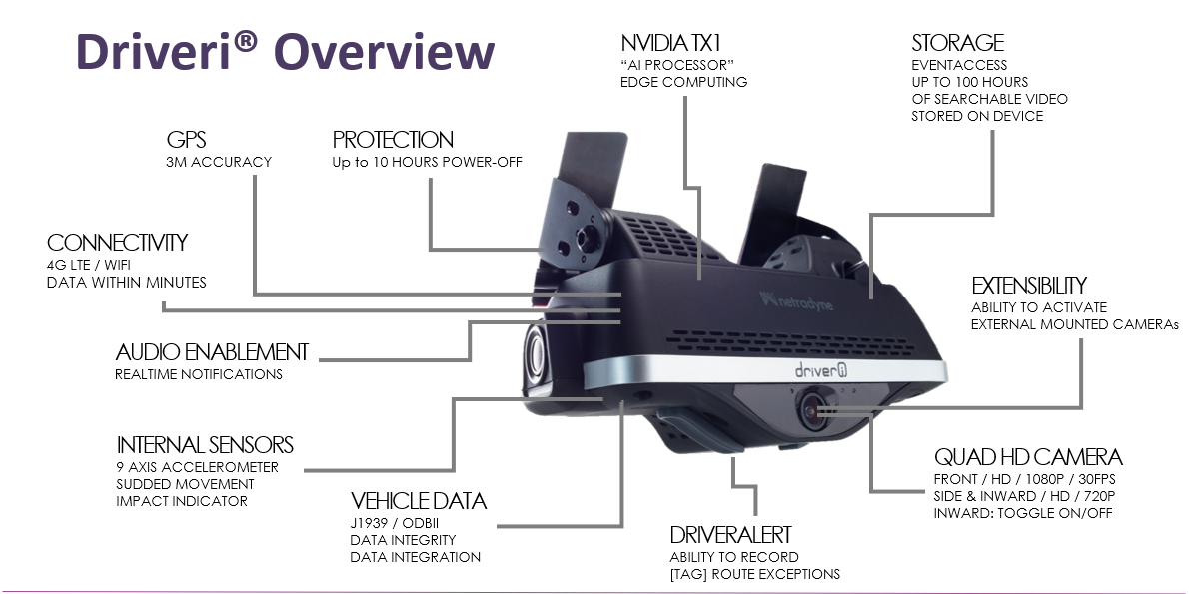
What is Netradyne Driver•i?
Notes:
Be sure to discuss how the camera works, show the Netradyne back-office dashboard and explain the driver facing camera and that it is off, currently, but can be earned on or requested to be turned on.
Show video examples of different types of alerts and how alerts are generated.
Do not forget to cover the driver initiate button or panic button under the camera body.

Slide 19
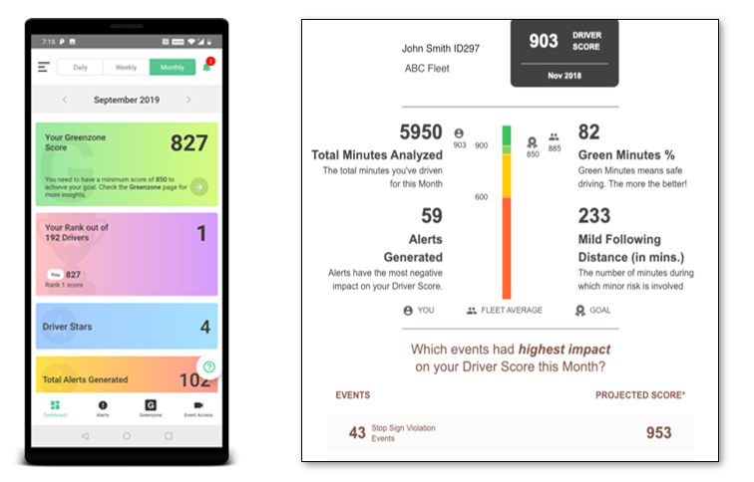
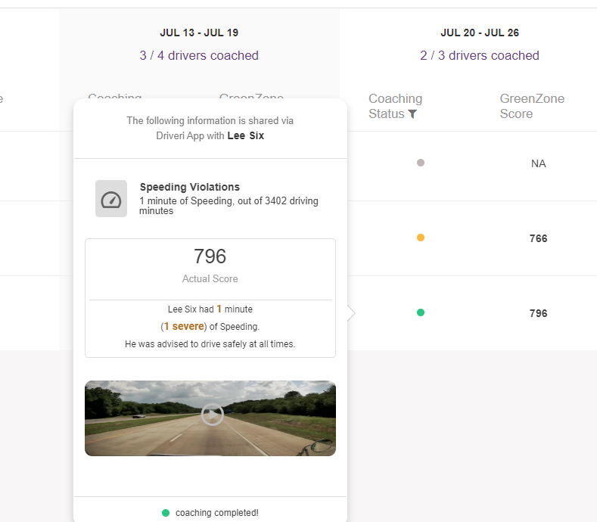
Driver Expectations:
What does this mean to me?
Drive Legal – Drive Safe – nothing new!
Use the Driveri Mobile App: The App is your scorecard uses “Gamification” for GreenZone scores to let you know how you are doing and shows the driver’s score above and below you:
    900-points is considered performing well.
    Below 850-points is considered risky driving.
Heed In-cab Alerts for Following distance & Speeding to improve GreenZone scores.
Complete weekly coaching: The “AI” identifies and assigns Virtual Coaching Sessions on Monday for previous week’s “risky” events.
The Driver-facing camera will be turned OFF and for your comfort a lens cap will be provided.
  However, a driver can “earn” having the interior camera turned on by risky driving behavior, falling below the company’s minimum threshold expectations or by having an “at-fault” accident that results in a claim.
Notes:
Explain Driveri app, how to monitor daily/weekly scores for bonus, how to monitor incoming alerts and complete weekly reviews.
Make sure they log into their app.

Slide 20
What is a GreenZone Score?
GreenZone® Score is safe driving behavior in data form and is calculated based on:
  The Driver’s General Events,
  Alerts (risk factors),
  DriverStars.
Alerts that impact the GreenZone Score:
  Hard Braking is based on how often the vehicle is subjected to excessive braking force.
  Following Distance is how often a driver follows the vehicle in front too closely vs. how often they maintain enough gap.
  All other factors (traffic lights, stop signs, acceleration, turns, U-turns, and speeding) are based on how often the driver generates alerts of that type.
  In-Cab Audio Alerts do not impact the GreenZone Score.
  The DriverStar is a bonus that depends on the number of DriverStar events that the driver generates throughout a period of driving.
Note: The Alerts that impact GreenZone Scoring is not configurable.

Slide 21

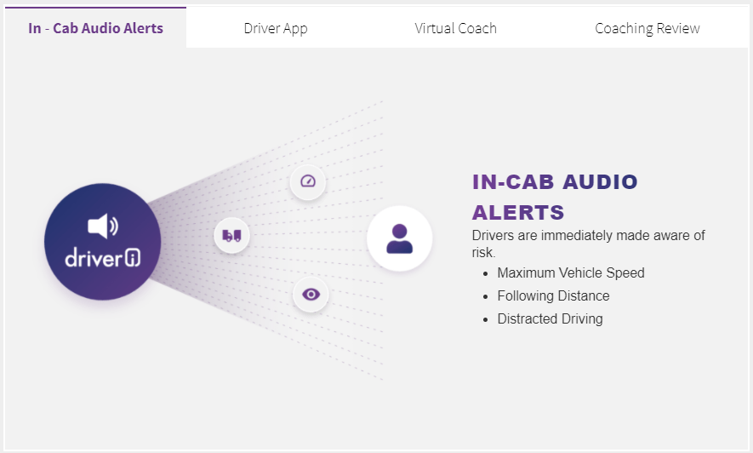
What “Triggers” an Alert?
DriverStars* - which is good driving!
Speeding.
Following too close.
Traffic Light and Stop Sign violations.
High-G force such as a collision.
Hard Braking or Acceleration.
Hard Turns.

Slide 22
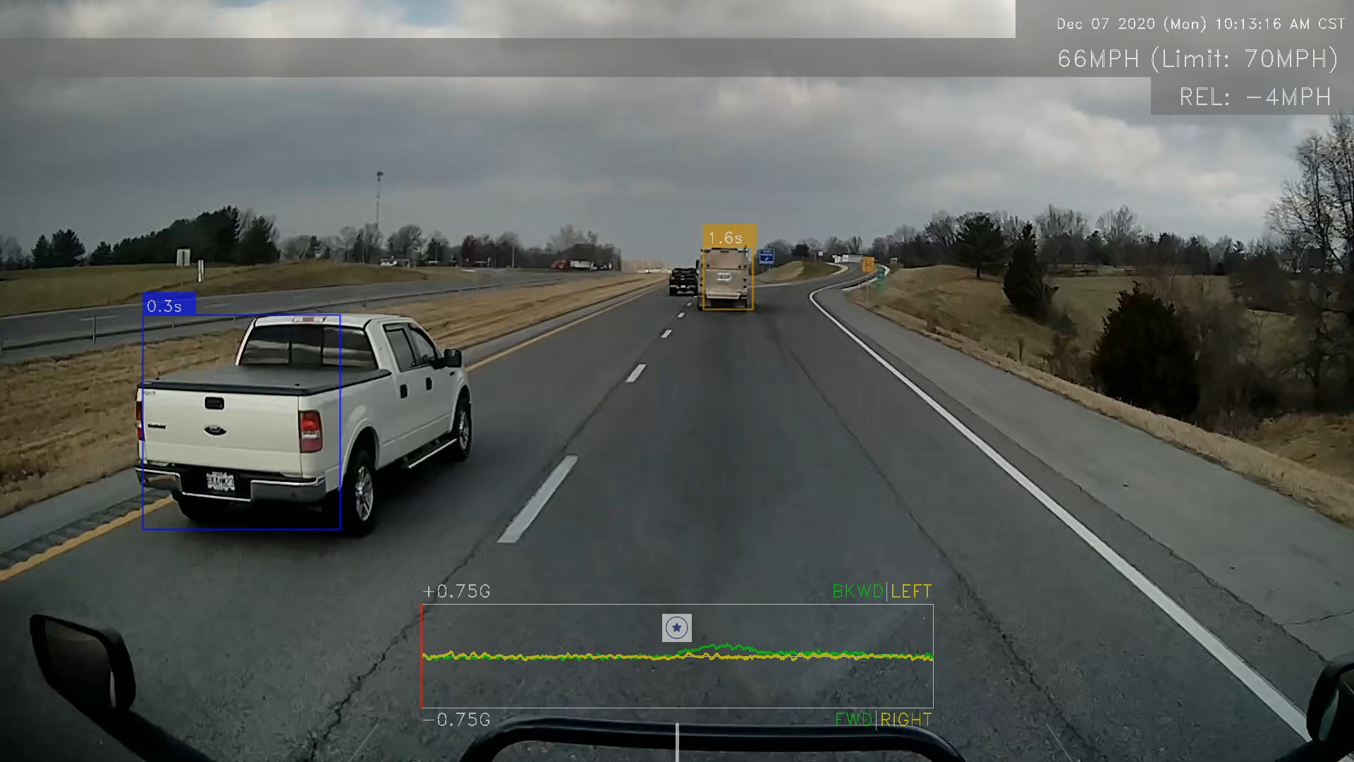
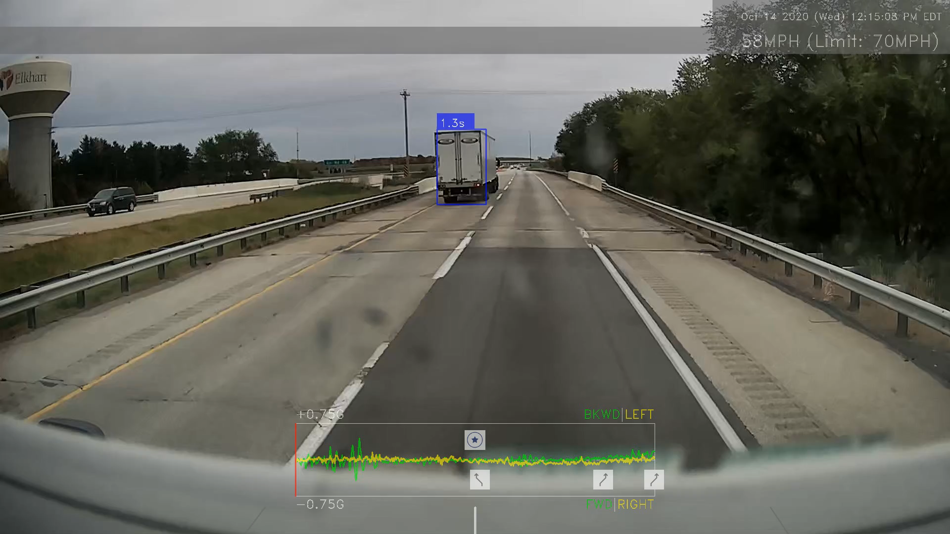
What is a DriverStar* ?
DriverStars are awarded to drivers in recognition of great driver performance and are intended to encourage drivers to practice safe driving behavior.
Driveri recognizes certain driver actions that mitigate or prevent unsafe driving situations. When this occurs, Driveri automatically raises a DriverStar and captures video to show everyone how it is done!
Created Separation by Slowing Down
This DriverStar is raised when a driver slows down and creates a safety buffer after another vehicle attempts to merge into the same lane.
Created space for Vehicle on Shoulder
A DriverStar is generated when there is a vehicle parked on the shoulder and the driver creates a safety buffer by moving over to another lane to avoid a possible accident and comply with applicable laws.
Safety Manager Initiated DriverStar
Sometimes the Driveri device raises an alert, and the Safety Manager/Fleet Managers sees it differently. In these instances, the manager can convert the alert to a DriverStar. Our best customers make frequent use of the Safety Manager Initiated DriverStar events to convert a negative into a positive.

Slide 23
Netradyne (Driveri)
Netradyne Driveri website:
  https://idms.netradyne.com/console/#/login
  Cover alerts and scoring.
Driver app & Coaching
  In-cab notifications
  Weekly Reviews
  Managed coaching
Weekly Safety Bonus
Notes:
Cover GreenZone score and how to achieve weekly safety bonus.
Be sure that the VER Policy is covered.

Slide 24

Lunch with Safety!

Slide 25
Safety Department
General Safety:
  Buchheit is committed to operating a safe and legal fleet. Due to this commitment, we have created policies to help ensure compliance with the DOT/FMCSA rules and regulations and the safety of our drivers, our equipment and the motoring public.
  All drivers are expected to comply with federal, state, and local laws/regulations, as well as company policy.
Progressive Discipline / Progressive Breach Policy.
  Don’t be the repeat offender.
Road Testing.
  It’s a great opportunity for a shake-down cruise.
FMCSR (eRegs) & Hazmat Compliance apps on tablet.
  ERG – is a required book.
Report Safety issues/concerns.

Slide 26
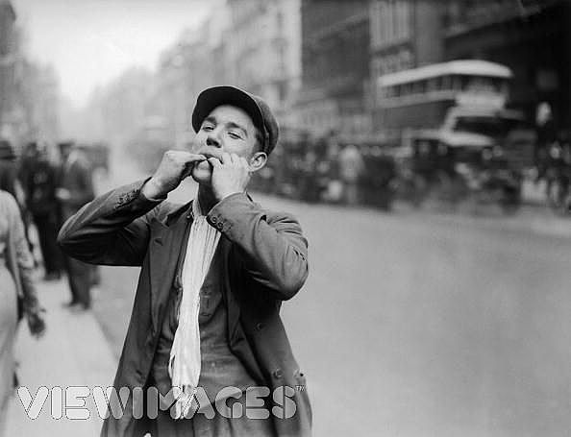
Whistle Blowers Act
Know Your Rights!
Notes:
Whistle Blower Protection Act
You can refuse ANY job that is unsafe. Your employer cannot retaliate against you for it. Legally.

Slide 27
Whistle Blowers Act
Employees have the right to question the safety practices of an employer without the risk of losing a job or being subject to reprisals.
OSHA ( Occupational Safety & Health Administration) is authorized to investigate employee complaints of employer discrimination against employees involved in safety and health activities.

Slide 28

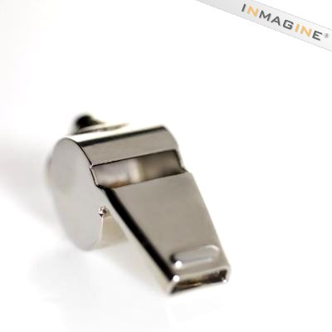
Whistle Blowers Act
Examples of discrimination are as follows:
Firing
Demotion or transfer
Layoff
Lost opportunity
Denial of benefits
Damaging credit
Reducing pay or hours

Slide 29
Whistle Blower Protection
Your right to refuse to do a job is protected if all of the following conditions are met:
You asked your employer to eliminate the danger and he did not.
You refused to work in “Good Faith”
A reasonable person would agree that there is a danger
There isn’t enough time to fix the problem through normal channels.

Slide 30
Whistle Blower Protection
When the conditions are met, you may take the following steps:
Ask your employer to correct the problem and pursue the issue through the established Chain of Command.
  Fleet Manager
  Operations Manager
  Safety Director
  President

Slide 31
Alcohol, Drugs and Intoxicating Substances
DOT/FMCSA Testing and company policies:
  Pre-employment Drug Test (Alcohol is optional).
  Random Testing.
    Company policy +5% and testing done monthly.
  Post-Accident Testing.
  Reasonable Suspicion Testing.
  Return-to-Duty & Follow-up Testing.
What constitutes a positive result?
  What happens to the driver who has a positive result?
FMCSA Drug & Alcohol Clearinghouse.
Notes:
Cover DOT regs for drug and alcohol testing.
Discuss our DOT Random selection process.
Be sure to include information about what is a positive result and what happens if a driver tests positive.
Discuss DOT DACH and how that affects a driver’s CDL.

Slide 32

Motorist Complaints
It is understood that not all complaints received are legitimate and that not always is the CMV driver “at-fault”, however; in the interest of public safety, all Motorist Complaints are documented as received and followed up on with a phone call to the driver of the CMV to verify the validity of the complaint and provide the CMV driver an opportunity to refute the complaint.
Don’t forget the “panic” button on your dash-cam – it might help in showing what really happened!
Notes:
Motorist complaints
A motorist will call in. They will complain about you and your driving behavior. When that happens, we will completely listen to what they tell us. We may even apologize on the company’s behalf. Our next step will be to call you for the “rest of the story”.

Slide 33
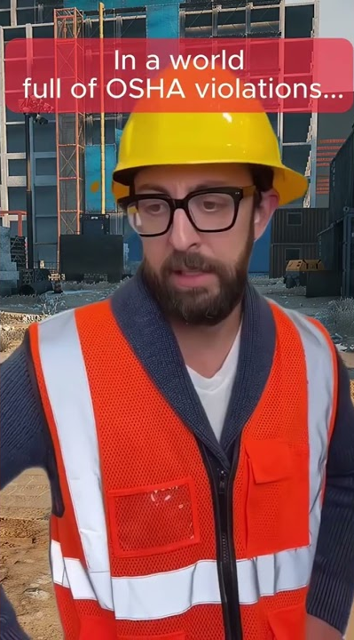
Customer Policies, Footwear & PPE:
Adhere to OSHA regulations.
Adhere to MSHA regulations.
  At applicable customer locations.
Wear your PPE.
  Proper footwear with hard toe, Hardhat, Safety glasses, Reflective vest & gloves.
Be aware of Job Specific Hazards.
  Mississippi Lime – lime burns.
  Allergies to Grain, Poultry or Preservatives?
Report all incidents.
  Including the “near” miss.
Notes:
Footwear and Personal Protective Equipment (PPE)
OSHA and MSHA regs
Report even near miss - one near miss could be a disaster for the next person.

Slide 34
Driver Qualifications
License (CDL or non-CDL):
  All CMV drivers are required to have the proper license for the equipment they operate and must be from the state in which the driver resides.
  If a driver moves from one state to another, a new CDL must be obtained per Federal Motor Carrier Regulations within 30 days.
DOT Physicals
  All drivers who operate a CMV in excess of 10,000 lbs., must comply with FMCSA regulations and are required to obtain and maintain a valid Medical Examiner’s Certificate at the driver’s expense.
Conducted by Safety, annually:
  MVR Annual Review.
  FMCSA Drug and Alcohol Clearinghouse annual query.
Notes:
License and physicals
You have to keep an up-to-date valid license. You can only have one license from YOUR state of residence.
Keep your DOT physical up to date.

Slide 35
Training Requirements
Buchheit Logistics, Inc. believes the safety of its employees and Independent Contractors is the single most important part of our business. Without a safe operation, our business would not be successful for a myriad of reasons. We want our employees and our independent partners to work hard and provide for their families, while being healthy enough to enjoy life to the fullest.
For these and other reasons we provide the opportunity for quality safety training to achieve that end (a SAFE working environment). We put our time and resources into this effort because we believe in it, and in the safety of our team members.
Buchheit Logistics driver training is conducted via Driver Pulse.
  Assigned training is required to be completed by the due date.
  Once training is past-due or delinquent, the driver loses all eligible bonuses for each week incomplete and may become a no-dispatch.
Notes:
Training – delinquent training is unacceptable.

Slide 36

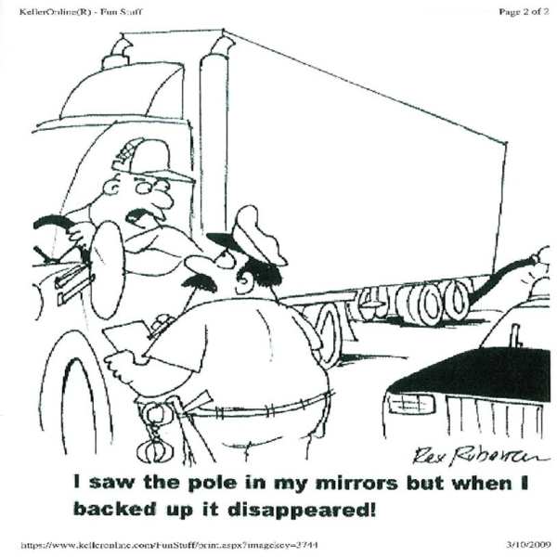
Backing and Low Speed Maneuvering:
Need we say more…?
Backing a truck can be a difficult task. One must be consciously aware of every fixed object, truck/vehicle and person behind and to the sides of the unit while backing up.
Backing accidents and incidents are one of the most common among drivers, most of which could have been avoided if a ground guide was in place.
Always use “G.O.A.L.”: Get Out And Look!
Notes:
G.O.A.L.
I have never met someone that has got out, looked behind their truck, saw the tree behind the truck. Then told me “Oh yeah, I seen that tree, but I backed into it anyway” …

Slide 37

Driver Qualifications
§ 391.41 -Physical qualifications for drivers.
Driver Wellness
Drivers face serious health threats such as heart disease and diabetes.
The DOT suggests that daily physical activities and eating right can improve your health.
  Get some Exercise.
  Eat right!
  Get the proper rest.
Notes:
Driver wellness
FMSA put this out as driver training
Get the proper rest.
Eat right.
Watch your fat, salt and sugar intake.
Do a little exercise.
Stay healthy enough to pass your DOT physical.
We want to remind you also that YOU are part of your pre-trip inspection – if not okay to driver due to fatigue or illness, you have the responsibility of saying so.

Slide 38
What does the DOT say about fatigue?
392.3—Ill or fatigued operator
“No driver shall operate a motor vehicle, and a commercial motor carrier shall not require or permit a driver to operate a commercial motor vehicle, while the driver’s ability or alertness is so impaired, or so likely to become impaired, through fatigue, illness, or any other cause, as to make it unsafe for him/her to begin or continue to operate the commercial motor vehicle.
However, in a case of grave emergency where the hazard to occupants of the commercial motor vehicle or other users of the highway would be increased by compliance with this section, the driver may continue to operate the commercial motor vehicle to the nearest place at which that hazard is removed.”
Remember – YOU are part of your Pre-trip Inspection!
Notes:
38

Slide 39
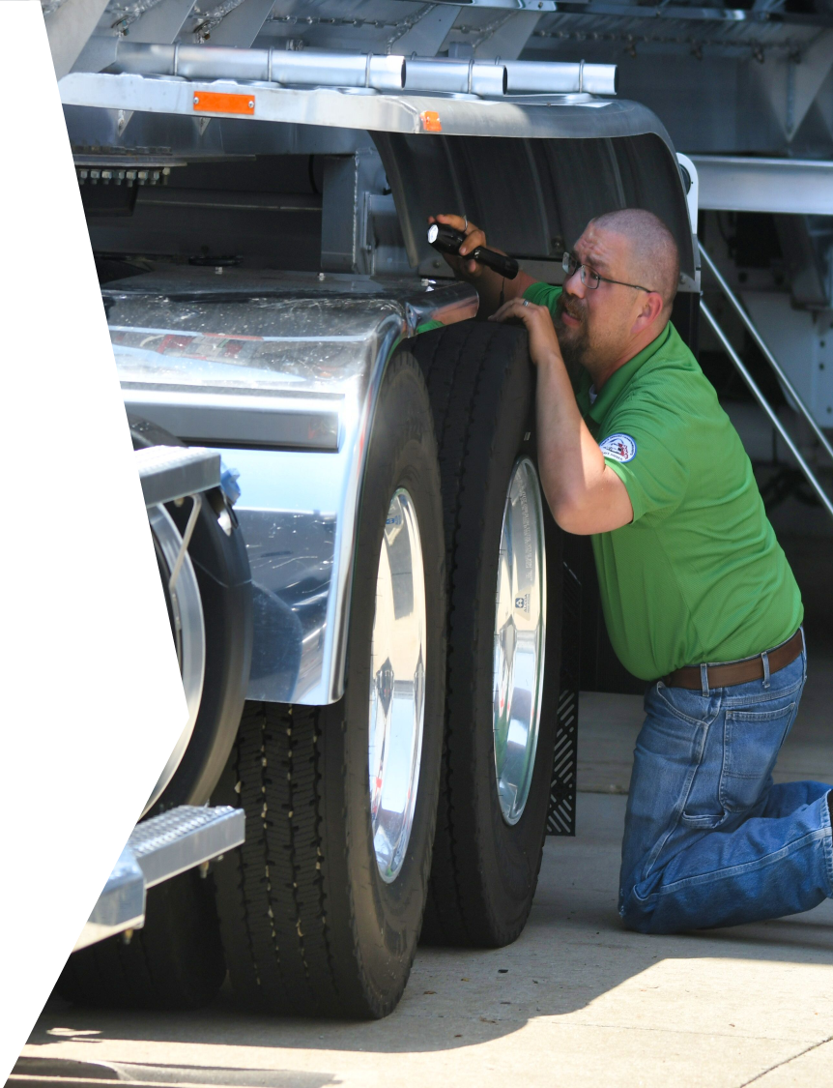
Vehicle Inspections
Pre-Trips/Post-Trips & DVIRs
What do the regulations require?
Notes:
Pre/Post Trips
Do the regulations require both a pre- and post-trip inspection?
What is a proper pre-trip inspection?
What does a post-trip look like?
How long is a pre-trip or post trip required by law to show on your logs?
There is no regulation that states how long a pre or post trip should be. You may have been taught it should be 15 minutes; however, how long does a proper pre-trip actually take?
I am not going to tell you how long a pre- or post-trip should be. This is what we ask of you: do a thorough pre- and post-trip. You don’t have to go all the way through and do a pump down test every single pre and post trip, but make sure your equipment is legal and safe to operate. My family is on the roads. Your family may be on the roads. The person driving next to you may be a mother or father. Be safe for them. More importantly, be safe for yourself. If you find something wrong with your vehicle. Communicate, and definitely submit a DVIR.

Slide 40
Pre-Trip Inspection
FMCSR §396.13 states that before driving a
commercial motor vehicle the driver must:
Be satisfied that the vehicle is in safe operating condition;
Review the last vehicle inspection report (DVIR)
  Sign the report, only if defects or deficiencies were noted by the driver who prepared the report, to acknowledge that the driver has reviewed the report and certified that the repairs needed were performed.

Slide 41
Pre-Trip Inspection
FMCSR §392.7 — Equipment, Inspection and Use
No commercial motor vehicle shall be driven unless the driver hereof shall have satisfied himself/herself that the following parts and accessories are in good working order, nor shall any driver fail to use or make use of such parts and accessories when and as needed:
Frame, Cab and body, steps, bumpers, Horn and Coupling devices.
Fuel tank, battery box and exhaust.
Tires, Wheels and rims.
Steering mechanism, drive shaft, axles, hubs and suspension.
Lighting devices and reflectors.
Service brakes, including trailer brake connections & Parking (hand) brake.
Windshield, wipers and mirrors.
Emergency and specialty equipment.

Slide 42
Post-Trip Inspections and Reporting (DVIR) Process:
Drivers have a responsibility to monitor and report on the condition of every commercial motor vehicle (CMV) and associated equipment they operate each day – this includes both tractors and trailers. Reporting is completed when the driver relinquishes responsibility for that piece of equipment (i.e. drops a trailer) or at the driver’s end-of-shift/end-of-day and is called the Post-Trip Inspection.
This reporting is an indication that the vehicle condition is unsatisfactory, and a need to arrange for repairs is necessary to ensure the continued safe operation of the CMV.

Slide 43
Proper Vehicle Inspections:
Vehicle inspection requirements are probably the most violated mandatory safety rule by the trucking industry today.
Drivers must perform a Pre-Trip and a Post Trip Inspection for every tractor and trailer operated during their shift.
All you have to do is get out and inspect your tractor and trailer for items in need of repair; advise maintenance, and your dispatcher what needs to be done and get it fixed.
  Use §392.7 of the FMCSR as a guideline
  Use the “North American Standard Inspection Procedures” to ensure you are checking the same items the DOT will look at during a Level I or Level II Inspection.
Fix the things you can, note the things you can’t, and never operate an illegal, or unsafe vehicle!

Slide 44
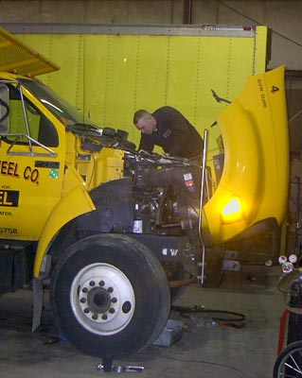
FMCSR §396.7 — Unsafe Operations Forbidden
General — A motor vehicle shall not be operated in such a condition as to likely cause an accident or a breakdown of the vehicle.
Exemption — Any motor vehicle discovered to be in an unsafe condition while being operated on the highway may be continued in operation only to the nearest place where repairs can safely be effected. Such operation shall be conducted only if it is less hazardous to the public than to permit the vehicle to remain on the highway.

Slide 45
Record of Duty Status (RODS) & ELDs:
Hours of Service
FMCSR § 395
Notes:
HOS
What can I teach experienced drivers about HOS? What do you need to know?
You have your 8, 11, 14 and a 60/7 or 70/8.
Do you know how to determine if you are in the 60 or 70?
Is it that local is 60 and OTR is 70?
No, it is an all or nothing. We have our local trucks work on Saturday and some drivers go out over the weekends this makes us a 70/8 carrier. If we closed and everyone went home on Friday, we would be a 60/7 carrier.
Next, what if I am over my 14 or my 70? Can I still legally grab fuel out front, YM to the back of the lot and complete a post trip??
YES. As long as I do not move that truck on line 3 you can. However, ANY drive time over your HOS limits is illegal.

Slide 46
How Can You Stay Legal?
Keep Record of Duty Status current to the:
“last change of duty status!”
Have current RODS plus the previous 7 days in your possession. FMCSR part 395.8 (k) (2)
Do not violate the 8–hour Rest Break Rule, 11-hour Driving rule, 14-hour On-Duty rule, or 70 hours in 8 days rule.
Prevent false RODS by:
“logging it as you do it”.

Slide 47
Off-Duty (Line 1):
Off-Duty (Line 1): Off-Duty time is time when relieved of all duties and responsibilities, by the motor carrier.
Per Part 395, a driver may record these breaks Off-Duty since:
  Driver is relieved of all duty and responsibility for the care and custody of the vehicle by the motor carrier, its accessories, and any cargo it may be carrying.
  During such time the driver is at liberty to pursue activities of his/her own choosing.
The company does relieve a driver from duty for meals and breaks, provided the driver is not required to remain “In-Attendance” of a Hazardous Materials or High Value load.
Examples: Lunch, shower, home time, etc.

Slide 48
Sleeper-Berth (Line 2):
Sleeper Berth (Line 2): FMCSR § 395.2:
Only time spent in a sleeper berth of a CMV may be recorded as Sleeper Berth time on a driver's record of duty status (driver's log) and can be no other location.
Sleeper Berth time may not be recorded as Off-Duty time.
Day-cabs, straight trucks and 1-ton pick-ups do not have the Sleeper-berth option.

Slide 49
Driving (Line 3):
Driving (Line 3): FMCSR § 395.2:
All time spent at the controls of a CMV in operation.
  Waiting in traffic or stopped due to an accident is driving time. Weather delays, (Having to slow down for road/traffic conditions), is driving time.
  Waiting to get to the fuel island is drive time until you actually park the vehicle and begin the fueling process.
    Can use Yard-move (YM) in this instance.

Slide 50
On-Duty, Not Driving (Line 4):
“On-Duty” Time FMCSR § 395.2:
All time from the time a driver begins to work or is required to be in readiness to work until the time the driver is relieved from work and all responsibility for performing work, that is not actually driving, is considered to be “On-Duty” Time.
As well as actual time behind the wheel, a driver is on duty whenever he/she is required to be ready for work.
All time in the vehicle (except time spent in the Sleeper Berth), not behind the wheel, is considered On-Duty time, even if the driver isn't driving.
  Does not include time resting in a legally parked CMV or the 2-hour “Passenger Rule”.

Slide 51
Per Part 395.2 On-Duty time includes:
RODS should reflect however long it takes for each of the following:
All time at plant, terminal, facility, or other property of a motor carrier or shipper, or on any public property, waiting to be dispatched, unless the driver has been relieved from duty by the motor carrier.
All time inspecting, servicing, or conditioning a CMV.
All time repairing, obtaining assistance, or remaining in attendance of a disabled CMV.
All safety events require a driver to be on duty during the event.
  Accident, DOT inspection, Training, etc.
All time spent providing a breath sample or urine specimen, including travel time to and from the collection site, in order to comply with DOT requirements.
All time in a Commercial Motor Vehicle is considered On-Duty time, except: time spent resting in a parked CMV, time spent in a sleeper berth, or up to two (2) hours riding in the passenger seat of a moving property-carrying CMV, immediately before or after a period of at least eight (8) consecutive hours in the sleeper berth.
All time loading or unloading a commercial motor vehicle, supervising, or assisting in the loading or unloading, attending a commercial motor vehicle being loaded or unloaded, remaining in readiness to operate a commercial motor vehicle, or in giving or receiving receipts for shipments loaded or unloaded.
Performing any work for motor carrier, or any compensated worked for a non-motor carrier.

Slide 52
Hours-of-Service Rules
What creates a violation?
8-hour Rest Break Rule Limit
11-hour Driving Limit
14-hour Limit
60-hour/7-day & 70-hour/8-day Limit
Split-sleeper Berth rule

Slide 53
Required “Rest Break” Rule
Rest Break Rule effective 1 July 2013:
FMCSR § 395.3 (a) (3) (ii), A driver may not drive more than 8 hours without a minimum of 30-minute break, then may complete his 11 hours shift providing he/she does not exceed the 14-hour limit.
Thirty-Minute Break:
FMCSA allows drivers of CMVs to count time spent on-duty, to count toward the break.
Notes:
HOS:
The 8/2 and 7/3 split.
The 30 min rest break. Any break of 30 minutes away from line 3 (drive line) counts toward your break. This would include the 30 minutes it takes you to load/unload.
Short Haul = 150 air miles and limited to a 14-hour shift with at least a 10-hour break between each shift.
Adverse Driving conditions - This allows a driver to use the adverse driving conditions exception to extend the maximum driving window by up to 2 hours.

Slide 54
11-Hour Rule: FMCSR § 395.3 (a) (1)
11-hour driving rule: a driver may not drive more than 11 hours without a full 10-hour break.
A driver may not drive past the 14th hour after coming on duty.
A consecutive 10-hour rest/break period will reset your driving time back to 11 hours.

Slide 55
14-Hour On-Duty Rule:
FMCSR § 395.3 (a) (2)
A driver cannot drive after being on duty for a total of 14 hours (no more than 11 of which can be driving) until he/she has ten consecutive hours of rest.
Note that the 14 hours is consecutive — it includes all “Work” (Driving Line 3 and On-Duty, Not Driving Line 4) and all “Rest/Break” (Off-Duty Line 1 and Sleeper Berth Line 2) time accrued after initially coming on duty, however; per FMCSR § 395.1, a driver may continue to perform non driving activities and not be in violation of the Hours-of-Service Regulations.
What counts against the 14-hour clock? Everything Except:
10-Hour Rest Period: FMCSR § 395.1 – 10 or more consecutive hours of rest/break will reset the 11 and 14-hour clocks.

Slide 56
70-Hour Clock
What counts against your 70-hour clock?
Everything on Line 3, Driving and Line 4 On-Duty, Not Driving.

Slide 57
34-Hour Restart
34-Hour Restart: FMCSR § 395.3.
Taking 34 or more non-stop hours of rest will restart the 11-hour Driving, 14-hour On-Duty and the 70-hour workweek clocks back to zero.
A 34 Hour Restart is never mandatory, however; it is one of the options available to a driver.
  The other option is to work off of “recap” hours.

Slide 58
Exceptions
Yard Move:
Movement of a CMV not on a public road within a yard or facility.
  Logged as On Duty, Not Driving time.
Personal Conveyance:
Authorized Personal Use of CMV
  Logged as Off Duty time.
  See Personal Conveyance Policy
Adverse Conditions - ?
Notes:
P.C.
PC is for non-work-related activities ONLY.
PC typically should begin and end in the same spot – with no work in the middle.
PC can have a trailer and even be loaded – however, please use PC properly.
How far can I go on PC?
IC drivers. It is your truck. As long as you are using it legitimately. There are no distance restrictions.
Company drivers. 30 miles. There is no reason to need more than 30 miles in a company truck other than to extend your hours.
Page 132 shows guidelines for PC. Review it.
Y.M. – Yard Move
Under 20-mph and NOT on a public road is on-duty line, 4.

Slide 59
Personal Conveyance Defined
The following information is from the interpretation Question 26 for FMCSR § 395.8 Driver's record of duty status:” If a driver is permitted to use a Commercial Motor Vehicle (CMV) for personal reasons, how must the driving time be recorded?”
Guidance: When a driver is relieved from work and all responsibility for performing work, time spent traveling from a driver’s home to his/her terminal (normal work reporting location), or from a driver’s terminal to his/her home, may be considered off-duty time. Similarly, time spent traveling short distances from a driver’s en route lodgings (such as en route terminals or motels) to restaurants in the vicinity of such lodgings may be considered off-duty time.
The driver who uses a motor carrier’s Commercial Motor Vehicle (CMV) for transportation home and is subsequently called by the employing carrier and is then dispatched from home, would be on-duty from the time the driver leaves home. A driver placed out of service for exceeding the requirements of the hours-of-service regulations may not drive a Commercial Motor Vehicle (CMV) to any location to obtain rest.

Slide 60
16-Hour Exception:
Note – this only applies to a local driver who operates under OTR regulations.
Exemption: FMCSR § 395.1
  (o) Property-carrying driver. A property-carrying driver is exempt from the requirements of § 395.3(a)(2) (The 14-hour On-duty Rule) if:
  (1) The driver has returned to the driver's normal work reporting location and the carrier released the driver from duty at that location for the previous five duty tours the driver has worked;
  (2) The driver has returned to the normal work reporting location and the carrier releases the driver from duty within 16 hours after coming on duty following 10 consecutive hours off duty; and
  (3) The driver has not taken this exemption within the previous 6 consecutive days, except when the driver has begun a new 7 - or 8 - consecutive day period with the beginning of any off-duty period of 34, or more, consecutive hours as allowed by FMCSR § 395.3(c).

Slide 61
Team Drivers -
“Passenger” Rule: FMCSR § 395.2
Team drivers may log up to 2 hours in the passenger seat before or after an 8-hour period in the Sleeper Berth, as Off-Duty time, in a moving CMV
  This period cannot exceed 2 hours each 10-hour break.
and to allow drivers resting in a legally parked CMV to count that time as Line 1, Off-Duty.

Slide 62
FMCSR § 395.1(e) Short-haul operations
(1) 150 air-mile radius driver. A driver is exempt from the requirements of §395.8 and §395.11 if:
(i) The driver operates within a 150 air-mile radius of the normal work reporting location;
(ii) The driver, returns to the work reporting location and is released from work within 14 consecutive hours;
(iii)(A) A property-carrying commercial motor vehicle driver has at least 10 consecutive hours off duty separating each 14 hours on duty;
(iv)(A) A property-carrying commercial motor vehicle driver does not exceed the maximum driving time specified in §395.3(a)(3) following 10 consecutive hours off duty; and
(v) The motor carrier that employs the driver maintains and retains for a period of 6 months accurate and true time records showing:
  (A) The time the driver reports for duty each day;
  (B) The total number of hours the driver is on duty each day;
  (C) The time the driver is released from duty each day; and
  (D) The total time for the preceding 7 days in accordance with §395.8(j)(2) for drivers used for the first time or intermittently.

Slide 63
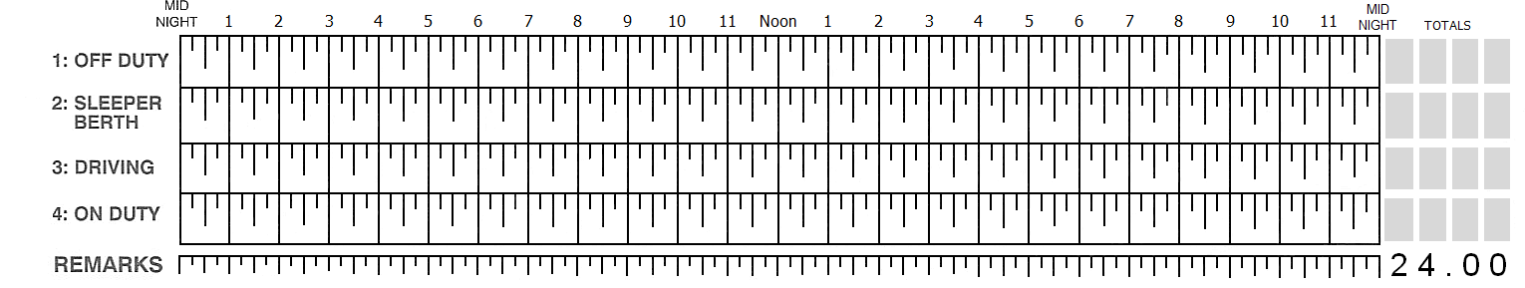
“Rest / Break” versus “Work”
Your Time = Rest or Break
Company Time = Work

Slide 64
Location of Change of Duty Status
Flags on a paper log, require at a minimum, the City and State per FMCSR § 395.8 (c), along with a description of what you are doing if you are on line 4 to be legal.
Location entries on an ELD, per FMCSR § 395.15 (d) (1) require at a minimum the name of the nearest city or town, with State abbreviation.
Company policy: All On-duty, Line 4 entries are required to include a “description” of the driver’s activity. i.e. Pre-trip Inspection, Load/Unload, etc.

Slide 65
ELD and Hours of Service (HOS)
The Mobilecomm Device (ELD) serves (2) purposes for the driver:
Primary means of communication with the company.
Driver’s Record of Duty Status (Electronic Logging Device (ELD)).
The ELD produces paperless driver logs that comply fully with the Hours-of-Service regulations. Drivers need to know how to:
View/change your current status.
View Cycle Summary of your RODS.
Certify/Edit and Annotate your RODS.
Reconcile Unidentified Driving Time and ELD Conflicts.
Add/Remove Trailers.
Data Transfer RODS to an inspector or highway patrol officer.
Complete Trips & submit trip paperwork via Workflow.
Notes:
65
Qualcomm Transportation Services Driver Training

Slide 66
Electronic Logging Device(ELD)
To log into the ELD system:
  Name: Driver ID
  Password: Driver ID in all CAPS + last 4-digits of SSN
Active vs. Inactive Driver:
The ELD assumes the “Active Driver” to be “working” unless otherwise noted by the driver. When the truck starts rolling, the “Active Driver” is assigned the drive time and moved to Line 3 automatically and will place the driver on Line 4 (On-Duty), when the truck is stopped.
  If the driver should be on Line 1, Off-Duty, or on Line 2, Sleeper Berth, then the driver must correct the status.
  Drivers must remember to log off the ELD when bringing equipment in for maintenance or leaving the equipment for any extended period of time (home-time, vacation, etc.).
Notes:
Please make sure what you input is accurate. This includes shipment info, trailer info, etc.
All working activity shall be on duty. This includes logging shipment info, sending in paperwork, etc.
At the same time, If you are not working do not show on duty. If you are resting and the vehicle is legal parked at a shipper or receiver. You are on line one. Unless you have a sleeper berth and are physically in the sleeper, then you are on line 2.
All supporting documents MUST be submitted.
Because ELDs are minute by minute time date and location and can be tied to you and your truck while on an on-duty function; tolls and other drive time documents are no longer considered a supporting document. We still need them to complete IFTA if you did not use PrePass, but it is not needed to support your logs.
Supporting docs needed would be BOLs, Fuel receipts (if you did not use our EFS card), scale tickets, etc.

Slide 67
ELD RODS Review, Edit, and Approval
The regulation requires that anyone operating an ELD equipped CMV, or making edits to an ELD record have a unique login ID.
  All company-employed drivers, independent contractors, and Maintenance and Safety Department personnel shall have unique login IDs and be responsible for their duty status approvals.
The regulations allow limited edits of an ELD record. Drivers may edit, enter missing information, and annotate the ELD records but the original record shall be retained. A motor carrier may request edits to a driver’s RODS to ensure accuracy, however; for the carrier-proposed changes, the driver must confirm, certify and submit the updated RODS.
  A driver may edit their Record of Duty Status for Lines 1, 2, and 4, however; the ELD automatically records CMV movement for Line 3 time.
  FMCSR § 395.30(c)(2) requires all edits, whether made by a driver or the motor carrier, be annotated to document the reason for the change.
Drivers and individuals utilizing an ELD have access to their own ELD records online and are able to review the ELD record and determine if unauthorized edits/annotations have been entered, as well as print their RODS records.

Slide 68
ELD Tips
Approve your RODS daily. Approving your ELD is similar to signing a paper log and should be completed at least once per day.
Do not violate any Hours-of-Service Regulations. Remember the ELD system warns you before you become in violation of your 8, 11, 14, or 70-hour rules.
Remember the driver is required to have the DOT Quick Reference Card for the ELD, and a minimum of 8 blank paper logs to complete the trip/load, on the truck in the event the ELD stops working and the driver is required to utilize a paper log.
  Note the driver must reconstruct the record of duty status for the current day and the previous seven days, less any days for which the driver has records in their possession.
Remember to change your duty status to Off-duty when parking the truck for short periods of time, and to log completely off the ELD when parking the truck for extended periods of time.
Do not tamper with the ELD, as it could result in equipment failure, missing records of duty status, and may result in termination of employment or contract/lease!
Falsified RODS, altered receipts, or otherwise attempting to disguise HOS violations shall result in disciplinary action, up to and including termination of employment, contract/lease.

Slide 69
Egregious violations of driving-time limits:
49 CFR part 395: Effective 27 Feb 2012
Do Not violate any Hours-of-Service Regulations.
A driver who exceeds, and a motor carrier that requires or permits a driver to exceed, by more than 3 hours, the driving-time limit shall be deemed to have committed an egregious driving-time violation and are subject to the maximum penalties permitted by law.
§392.3—Ill or fatigued operator: “No driver shall operate a motor vehicle, and a commercial motor carrier shall not require or permit a driver to operate a commercial motor vehicle, while the driver’s ability or alertness is so impaired, or so likely to become impaired, through fatigue, illness, or any other cause, as to make it unsafe for him/her to begin or continue to operate the vehicle”.

Slide 70

BREAK TIME!

Slide 71
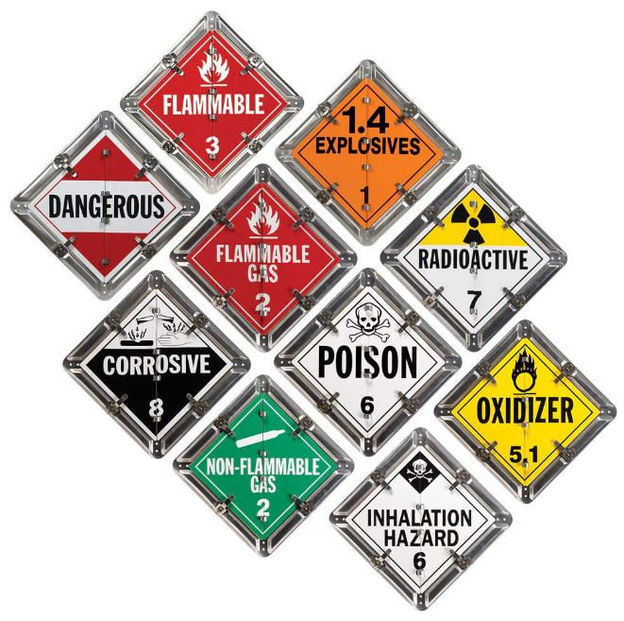
Hazardous Materials
According to the U. S. Department of Transportation (DOT), a hazardous material is "A substance or material, including a hazardous substance, which has been determined by the Secretary of Transportation to be capable of posing an unreasonable risk to health, safety, and property when transported in commerce, and which has been so designated”.
Federal law dictates that each company whose drivers haul Hazardous Materials must be trained and certified by that company in the rules and regulations concerning the transportation of Hazardous Materials.
The regulation requires recertification every 3 years.
The rules regarding Hazardous Materials are found in both the Hazardous Materials Compliance Book as well as in the Federal Motor Carriers Safety Regulations pocketbook.
The penalties for violating a requirement can range up to $175,000 for each violation.

Slide 72
Hazardous Materials
All OTR drivers are encouraged to have their HME and Tank within 90-days of hire. We will reimburse the cost of getting the endorsement - turn in your receipts.
Driver Portal info in orientation: https://driver.buchheitlogistics.com/driver-documents/ under the Hazardous Materials tab.
Issue ELDT HM if needed – due 30-days from hire date. https://pulse.tenstreet.com
Pre-enroll for your criminal background check via TSA and Homeland Security: https://www.tsa.gov/for-industry/hazmat-endorsement
Visit an application center to complete enrollment and get fingerprinting done:
  Provide required documentation and fingerprints.
  Pay a non-refundable fee valid for five years.
    New and renewing applicant: $85.25
    New and renewing applicant reduced rate with TWIC: $41.00*
At 30-days, verify ELDT completed.
At 60-days, verify fingerprints and background completed.
At 90-days have HME complete.

Slide 73
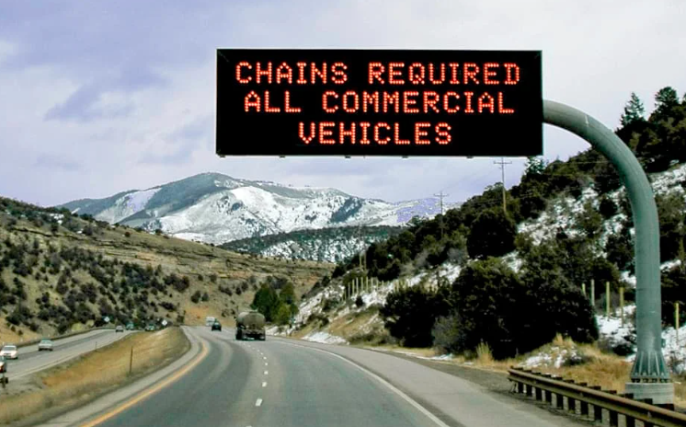
Winter Chain Laws
There are “chain laws” in certain states that require a CMV to be equipped with traction devices when the conditions demand it and stipulate that you must carry them during certain times of year, regardless of the current road conditions.
  There are additional rules concerning which axles(s) must be chained.
  Unfortunately, several states dictate cables are not acceptable and you must have chains.
States that have “chain laws”: CA, OR, WA, NV, CO, UT, MT, WY.
  If traveling in these states between September 1 and May 31, you are required to carry the required number of chains for the state you are operating in.
  Our shop issues 3 bags of chains to a company owned OTR truck with 2 chains in each bag.
Comfort Zone
  DO NOT drive beyond your ability to do so SAFELY.
  The decision to stop driving is yours.
  Nothing we haul is worth anyone getting hurt.

Slide 74
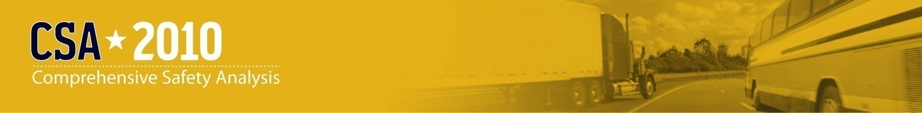

CSA
Compliance, Safety, Accountability
Driver Handbook: Page 115
Revised 2018
Notes:
CSA
Pull up CSA website and cover each BASIC.
Unsafe Driving
Crash
Hours-of-Service
Vehicle Maintenance
Controlled Substance/Alcohol
Hazardous Materials
Driver Fitness
PSP
Make sure the driver is aware they can pull up their recent PSP (the one we pulled) on their Driver Pulse app.
Go over how long items stay on your record and severity
0-12 months=X3
12-24 months=X2
24-36 months= X1
Example: speeding 6-10 over is 4 points
In 0-12 months = 12 points
12-24 months = 8 points
24-36 months = 4 points
Cover NAV inspection bonu$.
Roadside Inspections - There are 8 types of inspections.
Level I – Full inspection.
Level II – equipment only.
Level III – driver only.
Level IV – Item specific.
Level V – Driver not available or survey related.
Level VI – Radioactive Shipment inspection.
Level VII – Jurisdictional.
Level VIII – electronic Level III
DVIR process
All roadside inspection violations must be submitted on your DVIR the same day.
Be sure to mention the MO Driver of the Month program through MOTA and point out the pictures in the lobby.

Slide 75
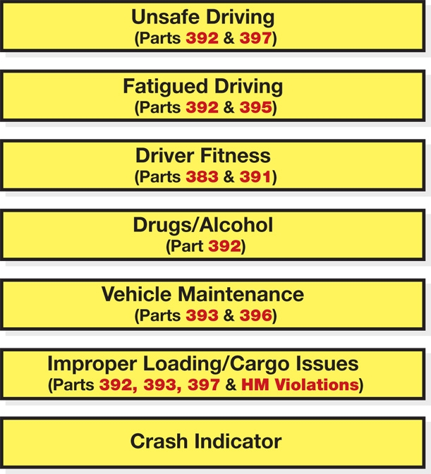
SMS B.A.S.I.C.s
The methodology is designed to weight on-road safety data based on its relationship to crash risk and focuses on behaviors that lead to crash risks.
The data is time-weighted so that it is reflective of current on-road safety performance. If a carrier’s performance improves over time, the safety performance score improves.
Vehicle Maintenance & Cargo/Load Securement
(Parts 392, 393, 396, & 397)
Hazardous Materials (HM)
(HM Violations)
Notes:
This slide lists the seven Behavior Analysis Safety Improvement Categories
The methodology is designed to weight on-road safety data based on its relationship to crash risk and focuses on behaviors that lead to crash risk.
The data is also time-weighted over a 24-month time period so that it is reflective of current on-road safety performance. If a carrier’s performance improves over the time, the safety performance score improves.
HM regulation violations (171, 172, 173, 177, 178, 180) may also be found /included in other BASICs such as driver fitness, but the most concentrated BASIC for these is Cargo Related so they are listed there.

Slide 76
BASIC’s Scores – Point Values
A company and its drivers must continually focus on a reduction in all 7 B.A.S.I.C.’s categories.
Drivers can accrue points for both the company and their self.
An inspection with “no violations found” or “clean inspection” count as positive points for the carrier/driver.
Drivers/Owners receive up to a $100.00 bonus for each clean inspection based on the level of the inspection and if it is a Hazardous Materials related inspection or not. To receive the bonus, send to Safety within 24-hours.
All inspections or tickets/warnings must be sent to Safety within 24 hours.

Slide 77
Pre-employment Screening Program (PSP)
PSP was mandated by Congress under SAFETEA-LU
PSP is NOT a part of CSA
“Driver Profiles” from FMCSA’s Driver Information Resource (DIR) are available to carriers through PSP
Driver Profiles are only released with driver authorization
Drivers are able to obtain their own driver information record.
PSP is available: www.psp.fmcsa.dot.gov
77
Notes:
77

Slide 78
Driver Records
What is the detailed process for a driver or a carrier to contest
information contained in their FMCSA records?
Drivers should use FMCSA’s DataQs system to make a Request for Data Review (RDR) in FMCSA databases. To do this, drivers can go to the DataQs registration page:
https://dataqs.fmcsa.dot.gov/login.asp
then select “Register Online” as a general public user and create a DataQs account profile.
Once registered, drivers can request a review of their data by following detailed instructions in the help menu.

Slide 79
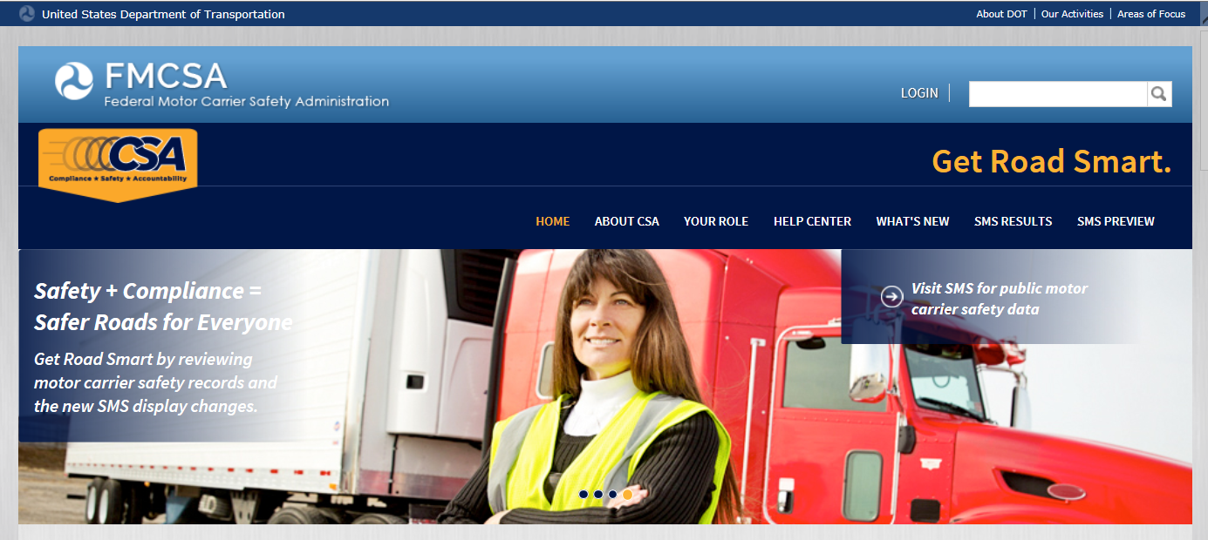
Current SMS ratings for:
D.O.T. # 71052
http://csa.fmcsa.dot.gov

Slide 80
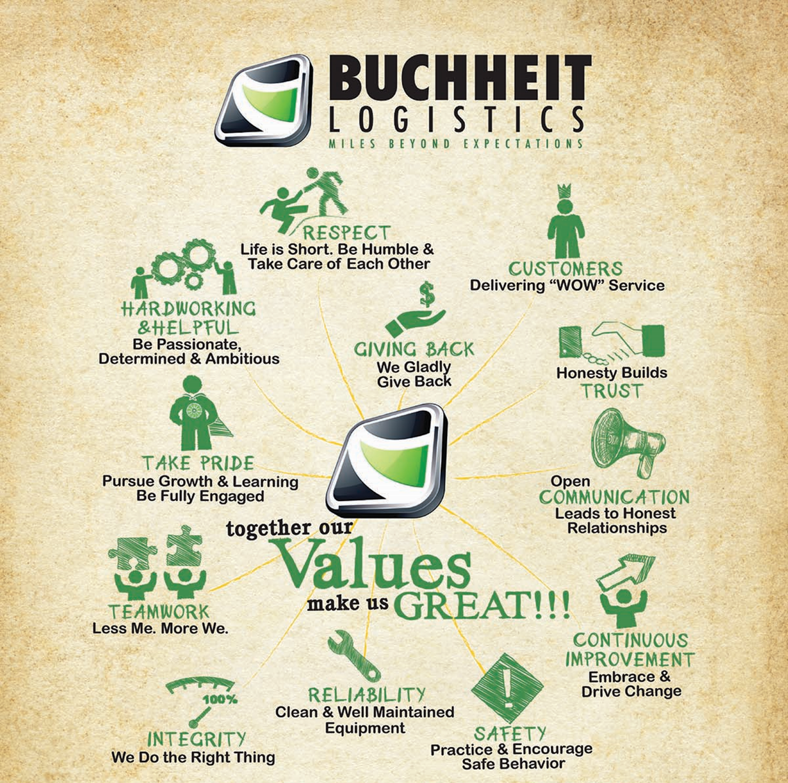
Jeff Buchheit – President

Slide 81

End of Day 1
Start again tomorrow morning at 0800

Slide 82

Day 2 Begins!
Welcome Back!!!
        …Again!

Slide 83
ISAAC ELD Trainer
Add Isaac Connect app to driver’s mobile device.
  Have driver log-in and adjust HOS view.
Add shortcut to driver’s mobile device home screen for InRealTime website.
  Driver log in, adjust preferences and add email notifications for messages.
Provide hands on training for Isaac InControl tablet – demonstrate:
  Log-in/out & Tablet overview,
  CoPilot and routing/fuel solution,
  Messaging,
  Trips & Workflow,
  Documents,
  Pre-trip and Post trip functions and DVIRs,
  Logs & HOS edits, unidentified driving events, conflicts and certifying RODS.
  Other application access.
  Training for Isaac Coach and Isaac Metrics (if applicable company driver).

Slide 84

Money! Money! Money!
$
Driver
PAYROLL

Slide 85

AGENDA
Fleet, Settlements & Payroll
  Pay period cut-off (Sunday – Saturday).
  Statement e-mail – when to expect and what you will see.
  W-2 Employee State Tax (MO / IL).
Per Diem Program
Employee Guaranteed Pay Program .
Bonuses (Safety & Performance).
Demurrage (Detention, breakdown and layover pay).
Advances, Expenses & Reimbursements (tolls/scales etc.).
Escrow (IC & CO Driver)
CAT Scale and Fuel Card apps.
EBE SHIPS Mobile – BOLs & Load/Trip Document Scanning.

Slide 86

Company Employee & Independent Contractor
What fleet; Dry-van, End-dump, Hopper-bottom
Pay period is Sunday – Saturday.
Sunday: Start of pay-period. | Monday: Begin processing driver pay for last week. | Tuesday: Company Employee Pay-day! | Wednesday: Company Employee settlements emailed from previous pay-period. | Thursday: Contractor settlements emailed for last week. | Friday: Contractor settlement direct-deposit from last week. | Saturday: End of pay-period.
If loads are not completed or delivered by Saturday, they will not go on that week’s settlement. *Company employee settlement email does not include taxes, benefits or other deductions reflected on the paycheck stub in ADP.
Sunday | Monday | Tuesday | Wednesday | Thursday | Friday | Saturday
27 | 28 | 29 | 30 | 1 | 2 | 3
4 | 5 | 6 | 7 | 8 | 9 | 10
11 | 12 | 13 | 14 | 15 | 16 | 17
18 | 19 | 20 | 21 | 22 | 23 | 24
25 | 26 | 27 | 28 | 29 | 30 | 31

Slide 87
The Per Diem Program
Per Diem is a daily allowance for living expenses, while traveling in connection with one’s job.
Per Diem is written into the Federal Tax Code.
The Per Diem Program is a part of the company’s pay program.
The company uses Per Diem to increase an OTR driver’s net or take-home pay.
Please pay attention, this benefits you!

Slide 88
The Per Diem Program
All company-employed OTR drivers who are away from home overnight are auto-enrolled in our per diem program.
This provides a non-taxable daily allowance of $50 to cover meals and incidental expenses while on the road. The savings to you will be the payroll tax on the daily per diem amount which we estimate to be approximately $1,000 per driver per year.
You won’t need to submit meal receipts, but accurate logs and duty status records are required.
You’ll have the option to opt out in writing—but once you do, rejoining isn’t allowed.
Please note this doesn’t apply to local drivers or days you are home, off-duty, or not under dispatch.

Slide 89
The Per Diem Program
Before the Per Diem Program:
You receive your regular CPM or % pay, all taxable
With the Per Diem Program:
You receive your regular CPM or % pay, less $50 per day that you are out overnight away from home.
  This income is all taxable.
Then you receive the $50 per day for each day that you are out overnight away from home, tax free!
  There is reimbursement in every paycheck!

Slide 90
Facts about Per Diem
If you are not out overnight, you are not eligible to participate in the company Per Diem program.
The advantage to the driver is paying less Federal and State tax, which increases take home (net) pay.
The advantage to the company is increased driver pay, satisfaction, morale, and retention.
The Common Misconception: the driver thinks they “lose” $50 per day…
The Reality: the driver trades $50 per day TAXED income for $50 per day TAX FREE money!

Slide 91

Company Employee
Guaranteed Pay Program
Buchheit Logistics provides a Guaranteed Pay Program to its company drivers based on the criteria listed below. Since Buchheit pays its drivers weekly, the Guarantee Pay Program is a weekly program and is based on gross earnings, not net pay.
Buchheit cannot apply the guaranteed minimum in instances where there is extreme weather or national emergency. Though the company would not expect a driver to operate in unsafe conditions, it also cannot guarantee a minimum in such extreme circumstances.
To be eligible to receive the minimum guarantee:
All paperwork must be received for the previous week via approved document scanning.
Driver must be available for dispatch a minimum of (5) full shifts during the pay period.
Driver must not turn down any legally dispatched freight regardless of equipment type.
Driver must not have any Late Deliveries or Service Failures.
Driver must not have any past due or delinquent training.
Driver must not have a preventable accident or incident during the pay period.

Slide 92
Driver Bonuses:
Safety & Performance
Company Driver Bonus Programs:
* All bonuses are forfeit if the driver has past due or delinquent training requirements or is currently on probation for accidents/incidents.
** Weekly OTR Van Performance Bonuses are guaranteed for the 1st 2-weeks to allow a driver time to adjust to routes/schedules.
*** Weekly Safety Bonuses are guaranteed for the 1st 2-weeks to enable a driver to learn the GreenZone scoring system.
CO OTR Bulk - Weekly Safety Bonus:
2.0% of revenue, if weekly GreenZone Score = 950 +
CO Local Hourly - Weekly Safety Bonus:
$50.00 flat rate, if weekly GreenZone Score = 950+
CO OTR Van - Weekly Safety Bonus =
$0.050 cpm, if weekly GreenZone Score = 950 +
CO OTR Van - Weekly Performance Bonus =
$0.050 cpm, if weekly miles = 2700+
IC Bulk - Weekly Safety Bonus:
2.0% of revenue, if weekly GreenZone Score = 950 +
IC Van - Weekly Safety Bonus =
1.0% of revenue, if weekly GreenZone Score = 950 +
IC Van - Weekly Performance Bonus =
1.0% of revenue, if weekly miles = 2700+
IC Van - Weekly Safety Bonus =
$0.050 cpm, if weekly GreenZone Score = 950 +
IC Van - Weekly Performance Bonus =
$0.050 cpm, if weekly miles = 2700+

Slide 93
Demurrage:
Detention, Breakdown & Layover
All forms of demurrage pay are based on the premise of the driver’s 14-hour on-duty time and available hours remaining on the driver’s shift. To receive demurrage, the driver must turn in a demurrage ticket with their trip paperwork, via the current trip scanning app being used by the company.
Detention:
This policy is intended to reimburse for extended time incurred due to customer delays.
  OTR drivers – Customer has 2 hours from scheduled loading/unloading appointment.
  Local drivers – Customer has 1 hour from scheduled loading/unloading appointment.
Payable only for hour’s driver has available based on driver’s RODS.
This policy does not reimburse for time in “Off-duty” or “Sleeper-berth” status.
Cancelled Loads and Layover:
Should a customer cancel a load after the driver has been dispatched and is enroute to the shipper, the driver will be reimbursed for the total driving time along with any additional waiting time for another dispatch.
Mechanical Breakdowns:
This policy is intended to cover mechanical breakdowns that occur when the driver is away from the terminal. Scheduled Maintenance (service work) is not covered under this policy.
**Reimbursements will not be made while driver is at home during inclement weather or awaiting dispatch. Nor will reimbursement be made for missing a loading/unloading appointment.
***Contact your dispatcher for questions about demurrage. Be sure to scan demurrage tickets with your BOL and trip paperwork.

Slide 94
Advances, Expenses & Reimbursements
Advances:
$150.00 is on your Comdata Fuel Card weekly (Sunday).
  You do not have to take the advance if you do not need it.
  Though recommended to take the full amount due to the $2.00 charge for each advance, you do not have to take all of it.
    Advances with corresponding reimbursement do not incur the $2 per transaction admin charge.
Expenses & Reimbursements:
Option #1 - Comdata card for most normal expenses.
Option #2 – Call for a Comchek Express Code.
Option #3 – Reimbursement.
  You can pay cash and be reimbursed.
  Be sure to scan receipts via SHIPSMobile under “Reimbursement”
Examples of reimbursable expenses:
  Windshield wipers.
  Lights & fuses.
  Brooms & shovels.
  Trailer Washouts.

Slide 95

Escrow Accounts
Company Employee Drivers:
  Required minimum of $500.00
  Deductions of $25.00 per week until minimum reached.
  You may contribute more if you wish.
    Anything over the $500 minimum is yours whenever you want it.
Independent Contractors:
  Primary Escrow required minimum of $2500.00 per truck.
    Deductions of $150.00 per week until minimum reached.
  Voluntary Escrow is not required.
    Can be used as an expense or maintenance account.
    Has no minimum or maximum amount.

Slide 96

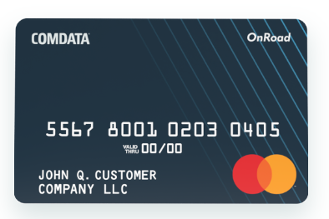
CAT Scale & Fuel Card Apps
Visit the Buchheit Logistics Driver Portal:
www.driver.buchheitlogistics.com
Or go to the Apple App Store or Google Play Store to download the apps.
Remember that all necessary app are on your ISAAC Tablet in the truck – you just need to log into them.
Will need to create your own account then link your fuel card with the app.

Slide 97

EBE SHIPS Mobile:
BOLs & Load/Trip Document Scanning.
Do not throw away paperwork.
Please turn in all originals to the Accounting Department next time you stop in.
Be sure to scan all pages of the BOL and any other documents that go with that trip (including any stamps on the back of a page) – this is important if we want to get paid.
Be sure to send clear images. We must have legible documents to bill our customer for your work.
Without the BOLs and associated paperwork, we (and you) do not get paid.
Scan BOLs
in Workflow as part of the unloading process as soon as you’re unloaded, and they are signed by the consignee!

Slide 98

Thank You
Any questions?
TruckingPayroll@Buchheits.com

Slide 99
Bulk Fleet Specifics
Driver should have a broom, shovel/rake, safety glasses/goggles, Hi-Vis vest, hard-hat and proper footwear, etc.
Check load during loading and prior to tarping to ensure trailer is loaded evenly (not heavy to one side).
Use load gauge on truck and trailer to prevent overloading.
Check BOL for Accuracy/Location, Delivery Time, etc. If the paperwork in incorrect or wrong trailer on the paperwork, do not leave until you have been cleared by dispatch or Fleet Manager.
Any time driver is at customer and there is no scale to weigh it is the responsibility of the driver to either find a place to weigh or contact dispatch/fleet management to find a place to weigh.
Keep tarp closed when moving. Affects fuel mileage and the driver can be cited for “unsecured load”.
Check load after driving in hard rain and be sure to remove wet spots before delivering load.
Before unloading an End-dump, check location for overhead power lines, wind and be sure trailer is on flat, even surface. Ensure load is not heavy to one side before dumping; load may have shifted in transit.
Make sure mud flaps are up and secure, so they don’t get torn off during the dumping process.
Dump air bags/open tarp before unloading to prevent vacuum from caving in bows. Use door locks; they’re important.
Use the vibrator & on a hopper, the knock rails, never hit slopes, address door rollers & cross tube issues.
Clean trailer after each load, no exceptions. Dirty trailers lead to claims and lost business (revenue).
Ropes in the Hopper-bottom trailer are to assist with getting in/out to clean it. Be sure to sweep rails, doors, tracks & hoods.
Excess product goes in a dumpster, not on side of road or on the customer’s parking lot.
Be mindful of cross contamination concerns with fertilizer, meat/bone, landscape rock, industrials before loading feed.
MLC will require a 30 min MSHA training session before you can load for the first time. Wear long sleeves, long pants, gloves & safety goggles to prevent burn hazard.

Slide 100
Maintenance Department
Policies & Info
It is the practice of Buchheit Logistics Inc. to conduct an effective maintenance program at all levels of operation. Maximum use will be made of all manufacturers’ warranty services.
Preventative maintenance services performed by drivers consist of:
  Pre-trip inspections & Post-trip inspections.
  Submission of DVIRs.
  Cleanliness of the unit both inside and out.
All equipment is initially inspected to ensure it meets DOT standards prior to entering the fleet and thereafter is subject to semi-annual DOT inspections.
If a driver receives a roadside vehicle maintenance violation, the driver is expected to immediately notify dispatch and the shop. Repairs shall be made immediately or prior to the next dispatch.
If during any inspection, equipment does not pass DOT standards, then repairs must be made and verified (or re-inspected) prior to that equipment being dispatched.

Slide 101
Orientation Road Test
Remember to inspect your equipment!
Use 3-Points of Contact.
Wear your seatbelt.
Properly adjust & Scan your mirrors.
Obey all traffic laws.
Track your trailer in turns.
Please do not run over a curb.
Notes:
Explain road test process, route and expectations during the test.

Slide 102
Lunch with Operations!

Slide 103
End of Classroom Orientation!
WELCOME to the TEAM!
Remaining items:
Trailer walk-through for Hoppers/Dumps.
WorkSTEPS Testing.
IC Lease Agreement & Insurance/Permits.
Fuel Cards.
Company Driver Wage Rates – see HR.
Once all remaining items completed on checklist – turn over to dispatcher for planning & load assignment.

