Slide 1
Transportation Compliance Training:
Concentrate Truck Drivers
Notes:
Unit Time: 90 minutes
You will need the following to facilitate this module:
For Each Participant:
Handbook
Inspection Form
Written Assessment
Workshop Evaluation Form
Blank Certificate of Training
Flipchart stand and paper
Tape (if not using Post-it flipchart pad)
Markers
Tarp Pieces – examples of holes
Set up the room with tables and chairs, 4 people per table
Review the content of the module:
This PowerPoint
Workbook

Slide 2
Order Penalties
Penalty | Violation
$2,000 violation/day | Failure to comply with: Street cleaning requirements Truck inspection and wash procedures
$4,000 violation/day | Failure to construct vehicle wash stations as specified by the Order
$1,500 violation/day | Failure to submit written monthly monitoring report as required.
$10,000 per violation | Loading a truck that has been Bad Ordered and not repaired. Any release of lead-bearing material from a truck to any non-DRC property.
Notes:
Objective: Provide learners with an understanding of the consequences if Doe Run does not comply with the Order.
Explain to learners.
These are our penalties if we don’t meet the terms of the Order:
$2,000 per violation per day for not complying with:
Street cleaning requirements
Truck inspection and wash procedures
$4,000 per violation per day for not constructing vehicle wash stations as specified.
$1,500 per violation per day for not submitting a written monthly monitoring report in a timely and adequate manner.
$10,000 per violation for:
Any truck driver obtaining a load of lead-bearing material in a truck that was previously rejected for “bad order” and not corrected.
Any release of lead-bearing material from a truck to publicly accessible streets, roads, residential yards, or other non-DRC property.
You can see that the penalties are substantial and could accumulate very quickly if proper procedures are not precisely followed.
This is why it is so important for us to do our jobs as the Order says – this is why we have to inspect and wash every truck. We have to Bad Order (BO) any truck that doesn’t pass inspection.

Slide 3
Concentrate Truck Inspections
The Transportation
Compliance Process
Inspect Truck
Prior to Loading
and Unloading
Load
or Unload
Inspect
Wash
Final
Inspection
Sample
Wipe
Truck
Exits Facility
Notes:
Objective: Provide learners with a clear picture of the loading, unload, and inspection processes.
Explain to learners:
This graphic shows the Transportation compliance process.
You will be inspected before loading or unloading.
You will be inspected again after loading or unloading.
You will be inspected again after the truck wash.
You will not be allowed to load in your truck does not pass inspection.
If you have already loaded when a problem is discovered, you will be asked to unload.
If a problem is discovered after unloading, it will have to be fixed before you can be loaded again.
Ask: Do you have any questions about this process?
Next we will take a look at the inspection form

Slide 4
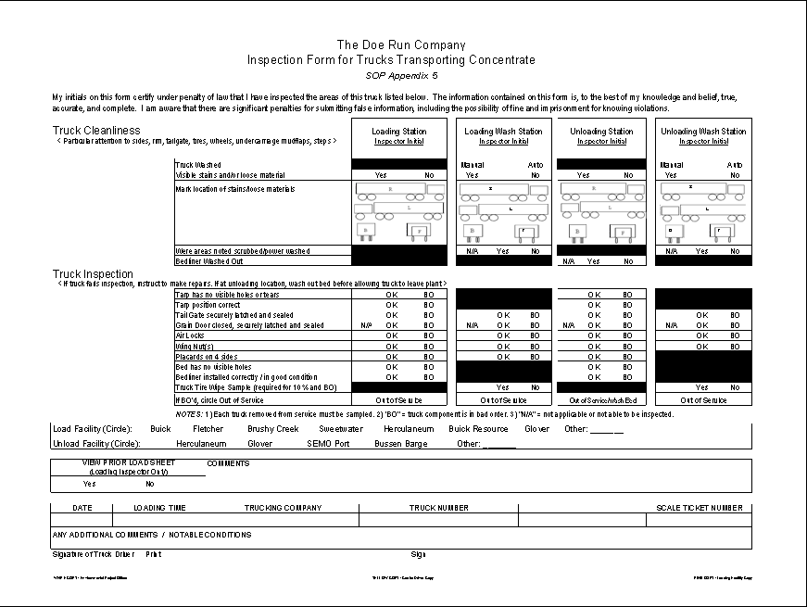
Inspection Form
Notes:
Objective: Review Inspection Form with Truck Drives
Distribute copy of Inspection Form for Truck Transporting Concentrate
Explain to learners:
Truck Drivers will have several inspections during the loading, unloading and truck wash.
Walk learners through:
Loading Station
Loading Wash Station
Unloading Station
Unloading Wash Station
Signatures
Ask: Do you have any questions about this process?
Next we will talk about the inspections. First, the tarp inspection.

Slide 5

Operating Guidelines
Before Loading Inspection
Inspect
Tarp for
Holes
Inspect
Bed liner and Bed For Holes
Inspect for
Placards
Inspect for Holes & Cleanliness
Inspect Tailgate, Air Locks and Permanently Sealed Grain Door
Notes:
Objective: Provide learners with an understanding of the requirements for tarp inspection.
Explain to learners:
This inspection is conducted before loading and unloading.
The attendant will tell the driver where to stop.
We begin by inspecting the tarp. The tarp should be closed.
The inspector will have the best view from the platform ladder.
The inspector will look for the following
1) No holes or tears in tarp – The rule of “thumb”
2) No gaps between tarp and rim
3) Tarp and/or bonnet in place to prevent wind from entering over front edge of the trailer
Ask: What is the rule of “thumb?”
Answer: The hole can be no larger than your thumb, and you as the driver can temporarily patch it for that day only. Repairs must be completed before loading the next day.
Facilitator: Provide photos or examples of acceptable vs. unacceptable tarp inspection.
The inspector will mark his findings on the Inspection Form.

Slide 6
Operating Guidelines
After Loading Inspection
Sweep Off Trailer Rim
Inspect
Tarp Position Correct
Notes:
Objective: Provide learners with an understanding of the requirements for tarp inspection.
Explain to learners:
This inspection is conducted before loading and unloading.
The attendant will tell the driver where to stop.
We begin by inspecting the tarp. The tarp should be closed.
The inspector will have the best view from the platform ladder.
The inspector will look for the following
1) No holes or tears in tarp – The rule of “thumb”
2) No gaps between tarp and rim
3) Tarp and/or bonnet in place to prevent wind from entering over front edge of the trailer
Ask: What is the rule of “thumb?”
Answer: The hole can be no larger than your thumb, and you as the driver can temporarily patch it for that day only. Repairs must be completed before loading the next day.
Facilitator: Provide photos or examples of acceptable vs. unacceptable tarp inspection.
The inspector will mark his findings on the Inspection Form.

Slide 7
Operating Guidelines
After Truck Wash Inspection
Inspect
Wing Nuts
Inspect for
Placards
Inspect for Holes & Cleanliness
Inspect Tailgate, Air Locks and Permanently Sealed Grain Door
Notes:
Objective: Provide learners with an understanding of the requirements for tarp inspection.
Explain to learners:
This inspection is conducted before loading and unloading.
The attendant will tell the driver where to stop.
We begin by inspecting the tarp. The tarp should be closed.
The inspector will have the best view from the platform ladder.
The inspector will look for the following
1) No holes or tears in tarp – The rule of “thumb”
2) No gaps between tarp and rim
3) Tarp and/or bonnet in place to prevent wind from entering over front edge of the trailer
Ask: What is the rule of “thumb?”
Answer: The hole can be no larger than your thumb, and you as the driver can temporarily patch it for that day only. Repairs must be completed before loading the next day.
Facilitator: Provide photos or examples of acceptable vs. unacceptable tarp inspection.
The inspector will mark his findings on the Inspection Form.

Slide 8
Operating Guidelines
Before Unloading Inspection
Inspect
Tarp
Inspect
Wing Nuts
Inspect for
Placards
Inspect for Holes & Cleanliness
Inspect Tailgate and Permanently Sealed Grain Door
Notes:
Objective: Provide learners with an understanding of the requirements for tarp inspection.
Explain to learners:
This inspection is conducted before loading and unloading.
The attendant will tell the driver where to stop.
We begin by inspecting the tarp. The tarp should be closed.
The inspector will have the best view from the platform ladder.
The inspector will look for the following
1) No holes or tears in tarp – The rule of “thumb”
2) No gaps between tarp and rim
3) Tarp and/or bonnet in place to prevent wind from entering over front edge of the trailer
Ask: What is the rule of “thumb?”
Answer: The hole can be no larger than your thumb, and you as the driver can temporarily patch it for that day only. Repairs must be completed before loading the next day.
Facilitator: Provide photos or examples of acceptable vs. unacceptable tarp inspection.
The inspector will mark his findings on the Inspection Form.

Slide 9
Operating Guidelines
After Unloading Inspection
Wash Out Bed
Inspect for Holes & Cleanliness
Inspect Tailgate and Permanently Sealed Grain Door
Notes:
Objective: Provide learners with an understanding of the requirements for tarp inspection.
Explain to learners:
This inspection is conducted before loading and unloading.
The attendant will tell the driver where to stop.
We begin by inspecting the tarp. The tarp should be closed.
The inspector will have the best view from the platform ladder.
The inspector will look for the following
1) No holes or tears in tarp – The rule of “thumb”
2) No gaps between tarp and rim
3) Tarp and/or bonnet in place to prevent wind from entering over front edge of the trailer
Ask: What is the rule of “thumb?”
Answer: The hole can be no larger than your thumb, and you as the driver can temporarily patch it for that day only. Repairs must be completed before loading the next day.
Facilitator: Provide photos or examples of acceptable vs. unacceptable tarp inspection.
The inspector will mark his findings on the Inspection Form.

Slide 10
SEMO Port
Doe Run Truck Unloading SOP

Slide 11
Doe Run employees will inspect incoming trucks according the TAOC requirements
and complete all applicable documentation on inspections.
Before off-loading, Doe Run employees will undo tarp straps, roll the tarp and secure tarp handle in a safe position for dumping.
Doe Run employees will drop and secure swing bows (if equipped) for safe dumping.
Doe Run employees will undo and secure Wing Nuts safely out of the way for dumping.
Truck Driver will open air locks and drop the air bags.

Slide 12
Truck Driver will examine the trailer and make sure that everything on his / her trailer is ready to dump (air locks, air bags, tarp and handle, swing bows, wing nuts). The Truck Driver will verbally let Doe Run employees know that the truck is ready to dump. If the Truck Driver does not specifically state that everything is ready to dump it is the responsibility of the Doe Run employees to ask the Truck Driver if it is ready, thereby making sure this communication has happened.
*Note: The Truck Driver is responsible for his / her own truck. If any Truck Driver wishes to perform items 2, 3 or 4 above, that is their choice. Doe Run employees are performing items 2, 3 and 4 above in the interest of off-loading trucks in a timely manner, however any Truck Driver who wishes to perform items 2, 3 and 4 above have that choice as they are ultimately responsible for their own truck.

Slide 13
Once the Truck Driver has given his / her verbal OK that the truck is ready to dump Doe Run employees will not touch the trailer until after dumping is complete.
Doe Run employees will make one final observation of the trailer just prior to dumping to insure that everything is OK to dump. If anything is observed that would prevent safe dumping of the load Doe Run employees are to stop the Truck Driver from dumping. The Truck Driver will be required to come back to the back of the trailer to correct whatever is preventing the off-loading from proceeding. *Note: Again, the Truck Driver
Is responsible for his / her own truck – Doe Run employees will not touch the trailer once the Truck Driver has verbally given his / her OK that the load is ready to dump.

Slide 14
Once the load has been dumped and the bed cleaned according to TAOC requirements, Doe Run employees will move swing bows (if equipped) back in place, roll and secure the tarp, engage air locks back in a closed position, inflate air bags and lock wing nuts

Slide 15
Bussen Terminal
Drivers are prohibited from arriving on the Bussen Terminal property before 06:30 am.

Slide 16
BRRD
Delivery and Washout Locations

Slide 17
