Slide 1
Hazardous Materials
Certification Training
-and-
Hazardous Materials
Transportation Security Awareness
Driver Handbook: Page 141
Revised 2019

Slide 2
49 CFR Part 172.702
Federal Law dictates that each company involved in the transport of Hazardous Materials must instruct and test its hazmat employees in the rules and regulations concerning the transportation of Hazardous Materials.
  A Hazmat “employee” is any person employed by a hazmat employer or person who is self-employed (an owner-operator or independent contractor of a motor vehicle that transports hazmat), who directly affects hazmat transportation safety.
Training is required within 90-days of being hired, and recertification is required every 3 years.
  Recertification can be completed by Self Study Guide, online training or by attending formal classroom instruction.

Slide 3

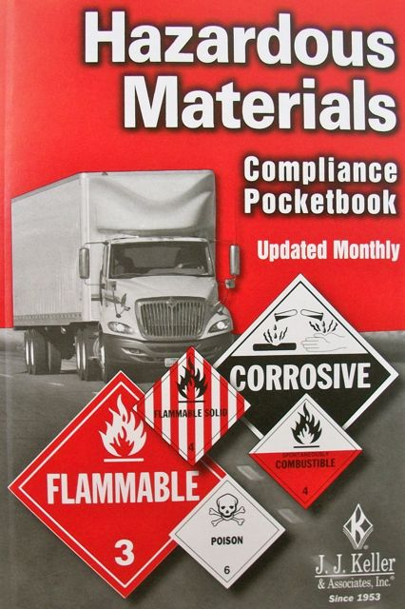
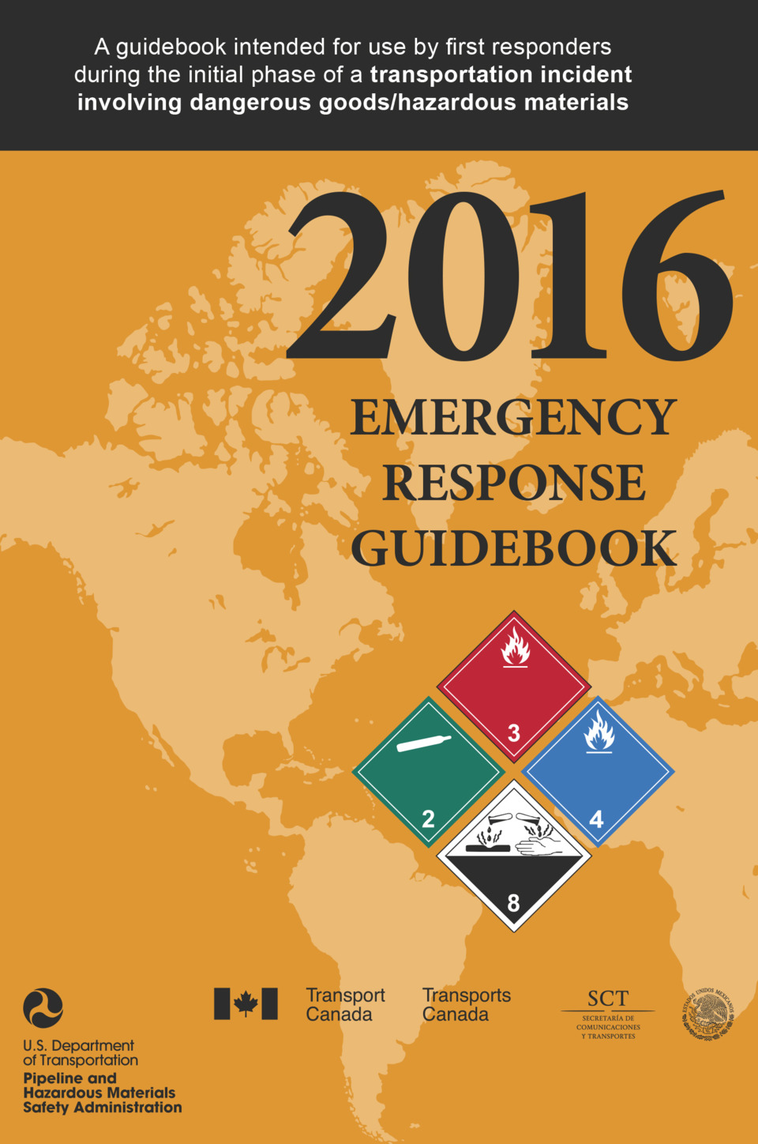
Penalties
The penalties for violating a requirement can be up to $250,000.00 for each violation.

Slide 4
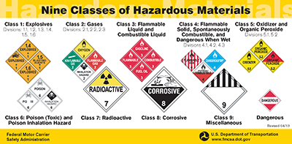
Hazard Classes
Based on Class/Division number:
Classes 1-9 and ORM-D
The rules regarding Hazardous Materials can be found in both the Hazardous Materials Compliance Book as well as in the Federal Motor Carriers Safety Regulations Guide.
Notes:
4
4

Slide 5
Class 1 Divisions
Notes:
5
5

Slide 6
Class 2 Divisions
Notes:
6
6

Slide 7
Class 3 Divisions
Notes:
7
7

Slide 8
Class 4 Divisions
Notes:
8
8

Slide 9
Class 5 Divisions
Notes:
9
9

Slide 10
Class 6 Divisions
Notes:
10
10

Slide 11
Class 7 Division
Notes:
11
11

Slide 12
Class 8 Divisions
Notes:
12
12

Slide 13
Class 9 Divisions
Notes:
13
13

Slide 14
ORM-D
Other Regulated Material
ORM-D from Class 1 through 9 that is eligible for, packaged, and offered for shipment as a Consumer Commodity suitable for retail consumption.
§173.144 Other Regulated Material (ORM)—Definitions.
Until December 31, 2020 and for the purposes of this subchapter, “ORM-D material” means a material such as a Consumer commodity, Cartridges, small arms, Cartridges, power devices (used to project fastening devices), Cartridges for tools, blank, and Cases, cartridge, empty with primer, which, although otherwise subject to the regulations of this subchapter, presents a limited hazard during transportation due to its form, quantity and packaging. The article or substance must be a material for which exceptions are provided in Column (8A) of the §172.101 Hazardous Materials Table. [78 FR 65480, Oct. 31, 2013]
Notes:
14
14

Slide 15
Hazmat Communication
Hazard Communication consists of 5 steps:
  Shipping Paper Description
  Package Marking
  Package Labeling
  Vehicle Placarding
  Emergency Response Guidebook
Information found
in HM Table

Slide 16
The Hazardous Materials
Table
The Hazardous Materials Table contains all hazardous material shipping descriptions and related information
Entries are listed alphabetically in column 2.
Column 1 Symbols
Column 2 Proper shipping names and descriptions
Column 3 Hazard Class or Division
Column 4 Identification Numbers
Column 5 PG (Packing Group)
Column 6 Label Codes
Column 7 Special provisions
Column 8 Packaging (§173.***)
Column 9 Quantity limitations
Column 10 Vessel stowage
\\
  Columns 8, 9 and 10 are in 49 CFR Sec 172.101, and not found not in the “Hazardous Materials Compliance Pocketbook”.
Notes:
16
16

Slide 17
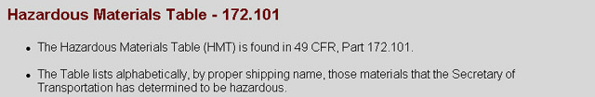
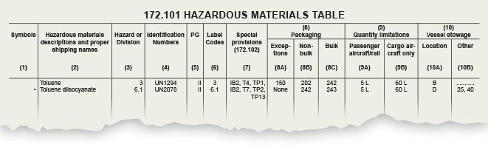
Refer to this table when reviewing your shipping paper and related hazard communication information.
Notes:
17
17
17

Slide 18
Packing Groups
Packing Groups indicate the degree of hazard risk:
        PG I = Great danger
        PG II = Medium danger
        PG III = Minor danger
Notes:
18
18
18

Slide 19
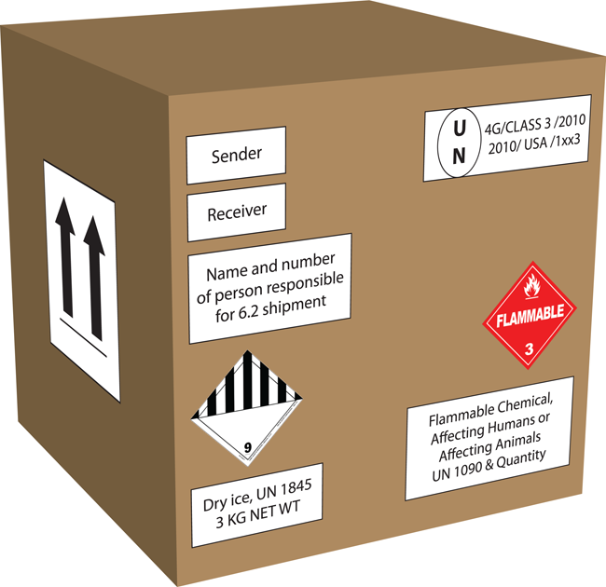
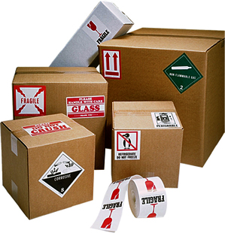
Offering for Shipment:
The Laws
The shipper is responsible for:
classifying,
packaging,
marking,
labeling and,
preparing the materials for shipment.

Slide 20
The Laws §172.204
The shipper is responsible for preparing the proper paperwork for the carrier (driver) to haul the Hazardous Materials.
Every shipment must have a Shipper’s Certification statement signed that states they have met and fulfilled all the requirements for the transportation of the Hazardous Materials.
The two most important aspects involving the transportation of Hazardous Materials for a driver are:
  insuring the shipping papers are correct,
  insuring the placards supplied by the shipper are correct and properly placed on the vehicle.

Slide 21
Shipping Papers §171.2 and §177.817
The carrier (driver) is responsible for:
Ensuring the load is properly labeled, marked, not leaking, broken or otherwise improperly blocked and braced during the loading process.
Per DOT Regulation §177.817:
  Drivers have the responsibility, under D.O.T. regulations, to refuse any Hazardous Materials container that is found to have been damaged, is, or appears to be leaking, or that does not match the shipping papers.
If the load is sealed by the shipper, and the driver is not authorized to break the seal, then the driver must obtain a statement on the BOL, by the shipper, certifying that the load has been properly loaded, and secured for shipment, S.L.C.S. (Shipper Load Count and Secured).

Slide 22






Marking and Labeling
Package marking
Proper Shipping Name (including RQ / technical names if appropriate)
UN/NA Identification number
Special markings (ORM-D, marine pollutant)
Orientation markings
Package labeling
  Label for each hazard listed in Column 6
    First label code is the primary hazard
    Additional codes, if listed, are subsidiary hazards.
Note that quantity and weight are not required on package markings, labels or placards. This information is found on the BOL.
Notes:
22
22
22

Slide 23
Shipping Papers
Shipping Papers must match the following:
  Markings on the packages.
  Labels on the packages.
  Placards that were supplied by the shipper.
3 ways Hazardous Materials can be indicated on a BOL:
  Hazardous Materials are listed first on the BOL.
  Hazardous Materials have an “X” or “RQ” in HM column.
  Hazardous Material items are or marked in a contrasting color.
highlighted
Notes:
23
23

Slide 24
Shipping Papers §172.202
Each Hazardous Material that is offered for transport must be clearly described on the shipping paper using the applicable information from the Hazardous Materials Table. The shipping description must include:
  Identification Number (UN or NA)
  Proper Shipping name
  Hazard Class or Division Number
  Packing Group (PG)

Slide 25
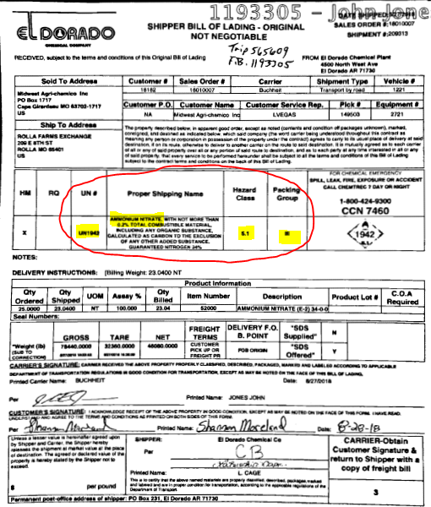

23.0400 ton, UN 1942, Ammonium Nitrate, 5.1, PGIII, 46,080.00 LBS.
I.D. Number
Shipping Name
Hazard Class
Packing Group
Notes:
25
25

Slide 26
Shipping Papers
The carrier (Driver) is responsible for ensuring the Shipping Papers are in order, in your possession and immediately available in case of an emergency.
When at the driving controls, the shipping papers must be within arms reach while restrained by a seatbelt and visible to anyone entering the vehicle.
  The usually preferred option is to place the shipping papers (with the ERG) in the holder on the driver’s door.
When you exit the vehicle, the paperwork stays in the drivers side door pouch or on the drivers side seat with the engine off, doors locked and freight box locked.
When relaying a load, the paperwork should be located in the trailer registration box on the front of the trailer.
  If dropping the trailer at a secure facility, leave the shipping papers with the guard at the gate.

Slide 27
Shipping Papers
Emergency Response Information §172.602
Emergency response information specific to the Hazardous Materials being transported must be presented on the shipping paper or in a separate document in conjunction with the shipping paper such as the Emergency Response Guide (ERG).
Emergency Response information must be treated in the same manner as shipping papers regarding availability and placement in the vehicle.
The following information is required, as a minimum, by Part 172, Subpart G:
- description of the Hazardous Material;
- immediate hazards to health;
- risks of fire or explosion;
- immediate precautions to take in the event of an accident or incident;
- immediate methods for handling small or large fires;
- initial methods for handling spills or leaks in the absence of fire; and
- preliminary first aid measures.
Notes:
27
27

Slide 28
The Emergency Response
Guidebook
The carrier (Driver) must have a recent copy of the Emergency Response Guide available at all times.
It is used for determining the course of action and first aid treatment pertaining to the specific type of Hazardous Material being transported, in the event of an emergency or incident/accident.

Slide 29
Emergency Response Guidebook
The Emergency Response Guidebook is color coded:
  Yellow - ID number is listed numerically.
  Blue - Hazardous Materials listed alphabetically.
  Orange - Guide number.
  Green - Emergency Information.
  You are looking to identify the proper “guide” number.
Once you have found the proper guide number in the Emergency Response Guide, insert your Bill of Lading in that page.
The ERG and paperwork stay in the vehicle, within arms reach, at all times.

Slide 30
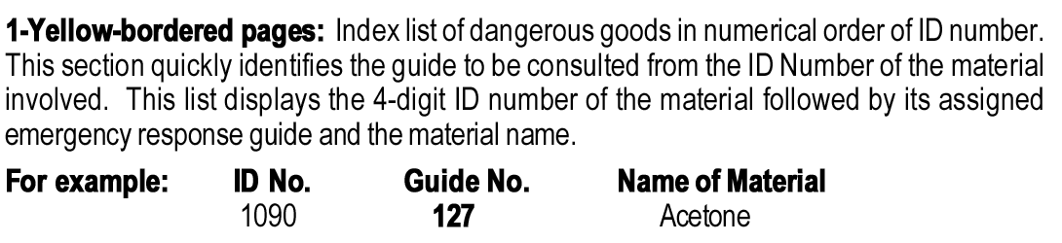
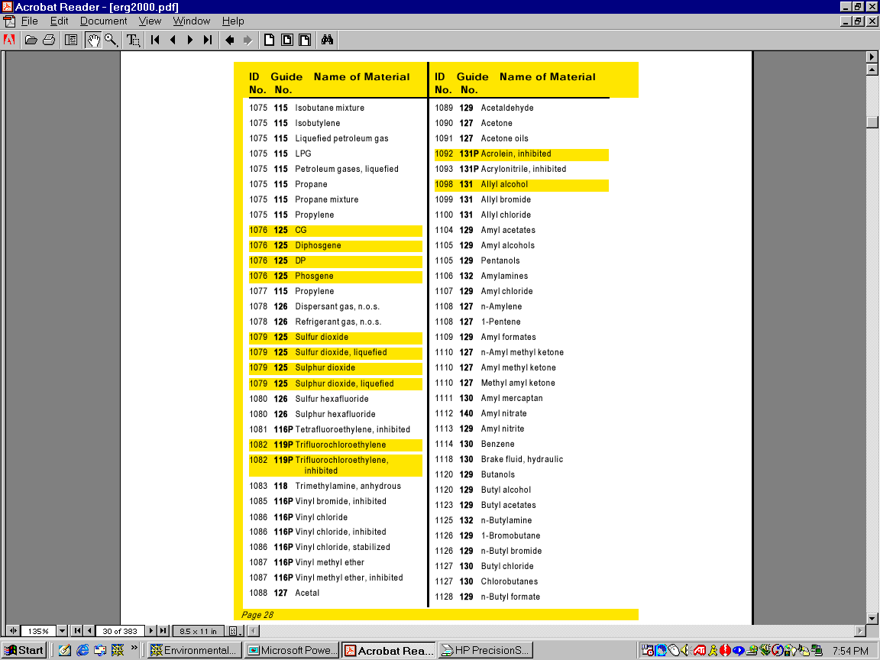
ERG Section One
I.D. Number Listed Numerically
Notes:
30
30
30

Slide 31
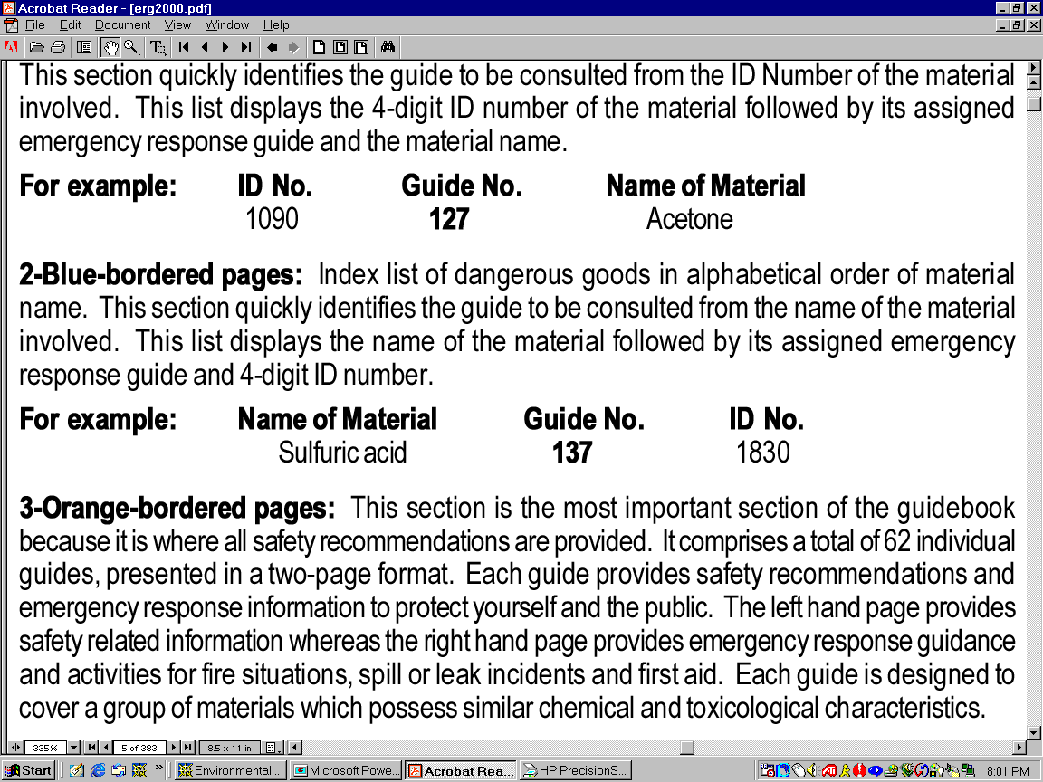
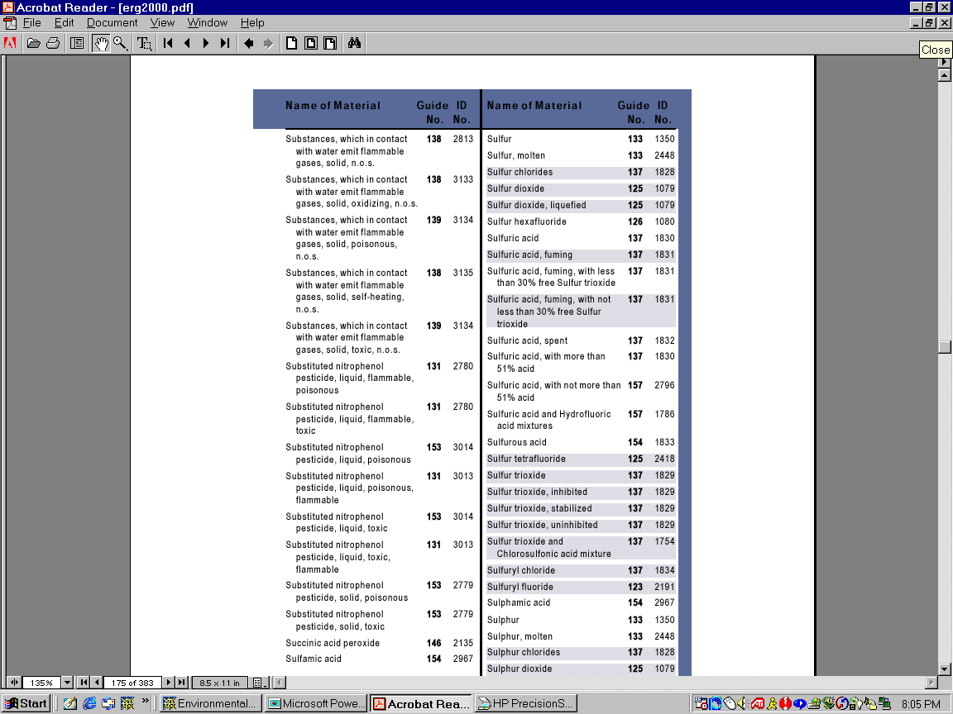
ERG Section Two
Hazmat substance listed alphabetically
Notes:
31
31
31

Slide 32
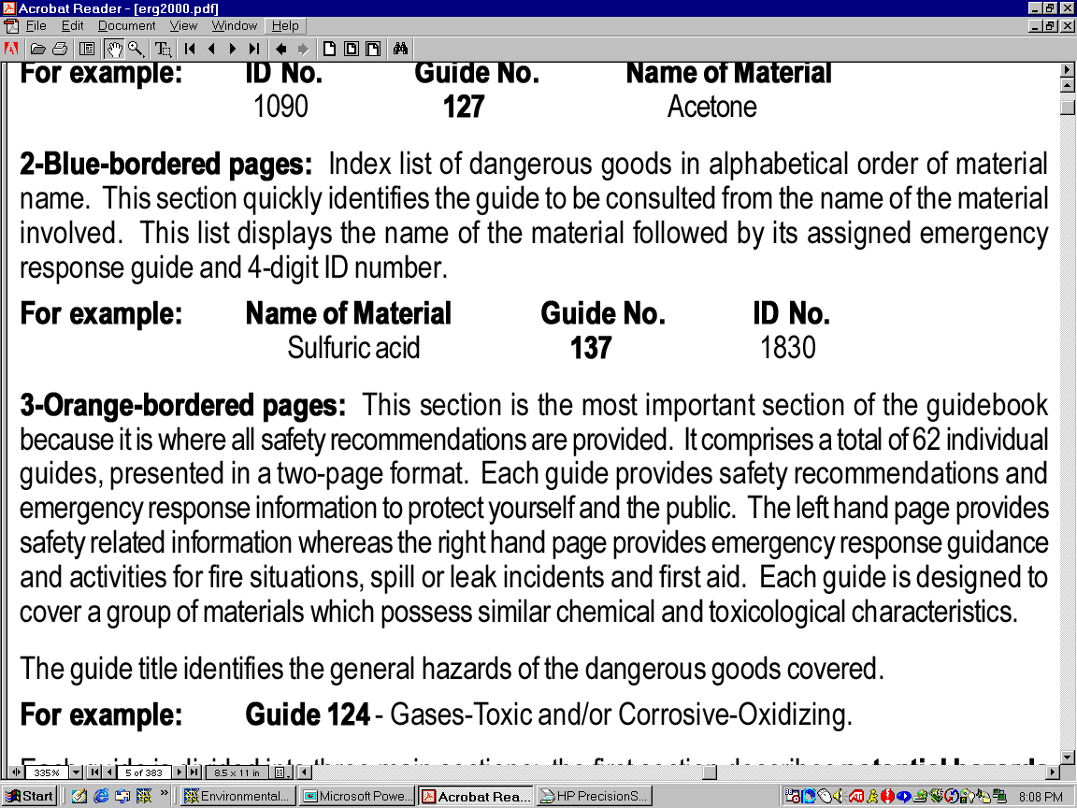
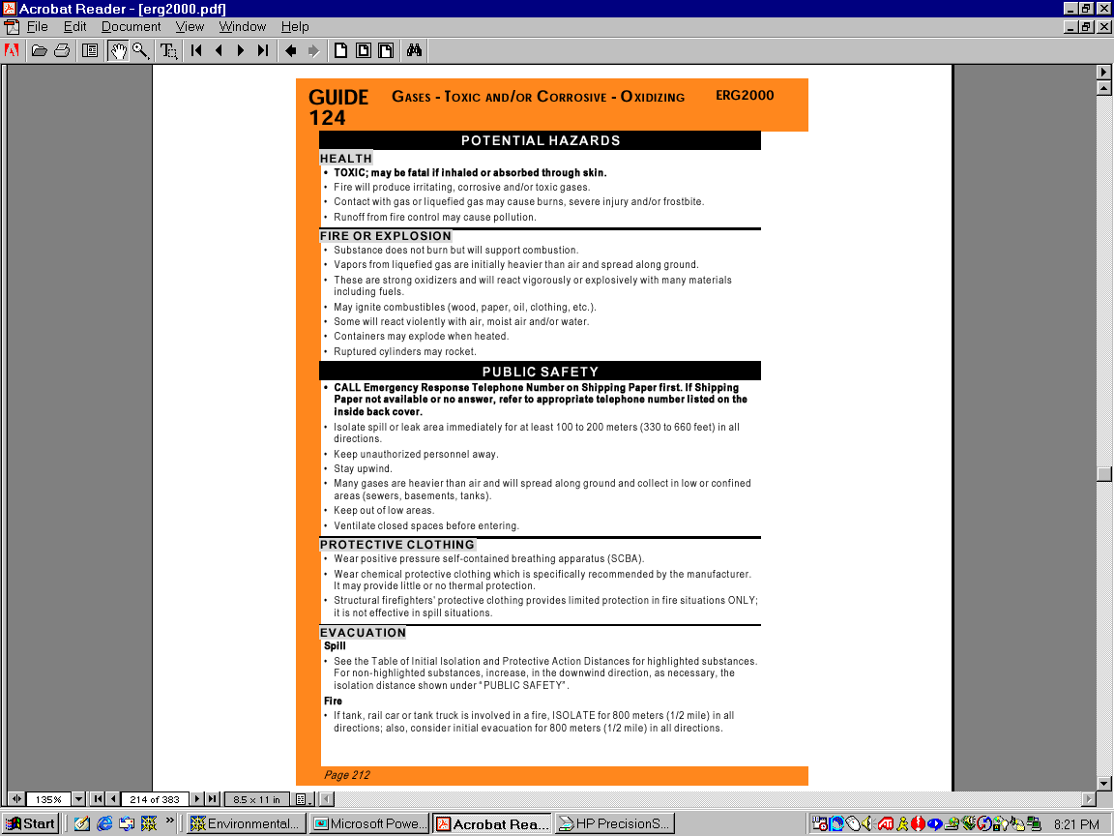
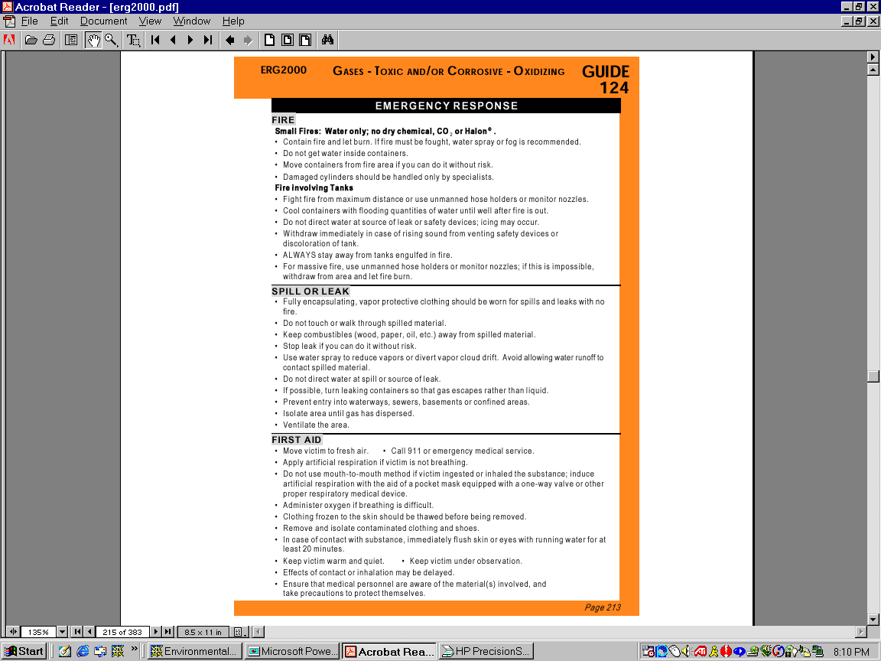
ERG Section Three
Guide Number
Notes:
32
32
32

Slide 33
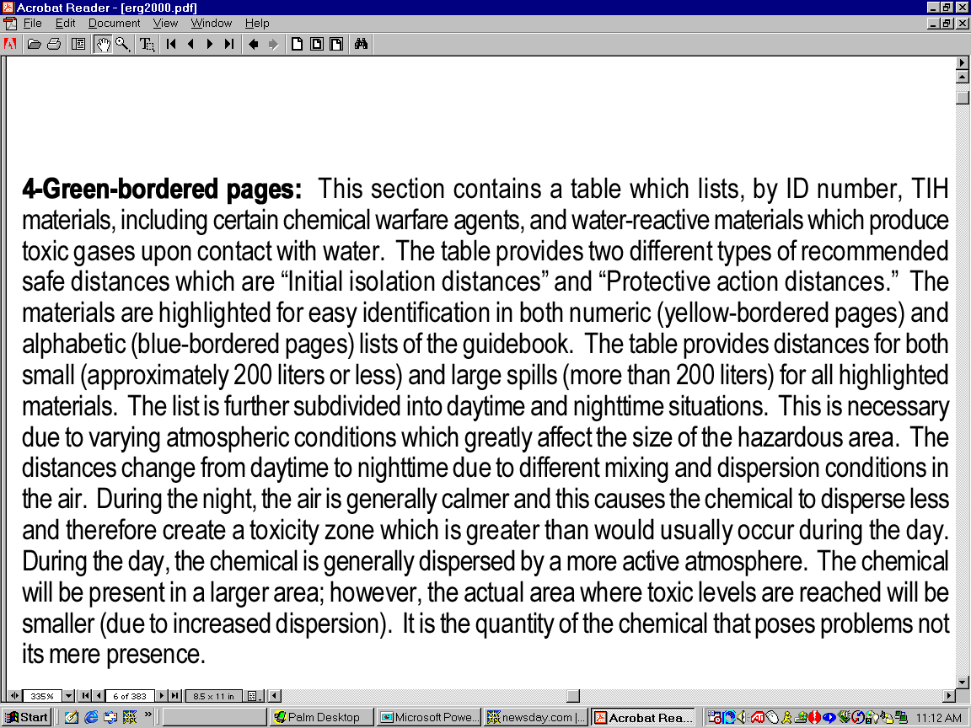
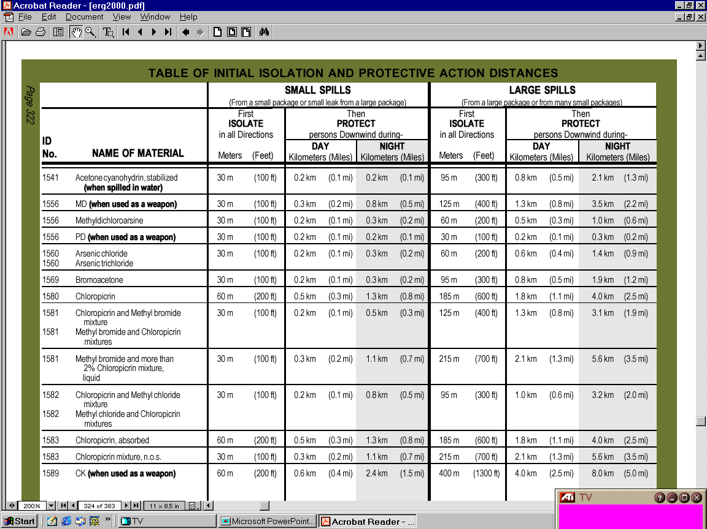
ERG Section Four
Arsenic trichloride
Notes:
33
33
33

Slide 34
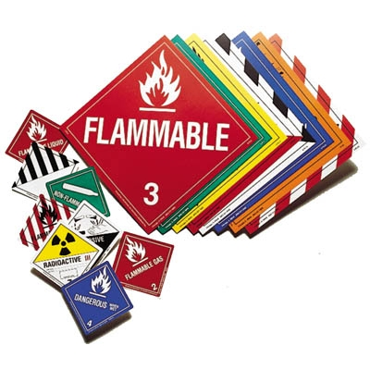
Placards
Placards are used to identify the hazard class of the material being transported.
  Placards are provided to the driver by the shipper.

Slide 35
Placarding
The carrier (Driver) is responsible for ensuring that the proper Placards were provided by the shipper for the Hazardous Material being transported.
The placards must be placed by the driver on all 4 sides of the trailer and can be no closer than 3 inches from any other markings on the trailer.
All placards must be completely removed after delivery of the Hazardous Materials.

Slide 36


Placards
It is the Carriers (Drivers) responsibility to make sure the correct Placards are affixed before the Shipment is transported.
Use the Hazmat Pocketbook to verify you were given the correct Placards.
If they are incorrect:
  do not leave the Shipper until you have the proper placards.
  When in doubt, contact your Fleet Manager or the Safety Department.

Slide 37
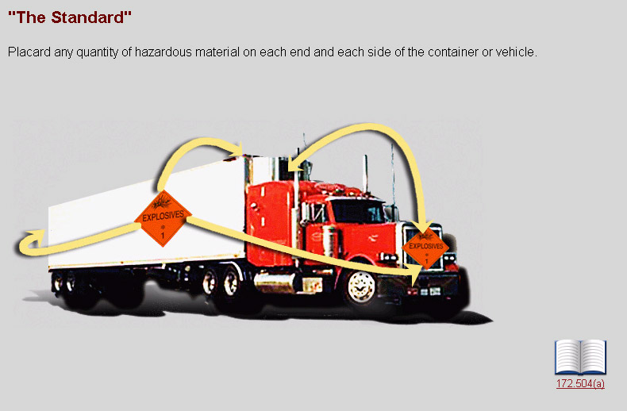
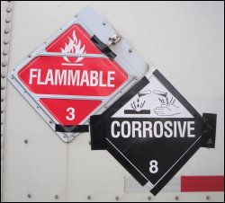
Notes:
37
37

Slide 38
Placards
Any Hazardous Material weighing 1001 lbs. or more must be placarded.
  Any Table 1 Material must be placarded no matter what the weight is.
All Hazmat placards must be printed and displayed:
Horizontally, Square on Point, Reading from left to right.
They must not differentiate in size.
Must identify multiple hazards.
The view must not be obstructed (can not cover the inner border of the placard).
The placard must identify the Hazmat you are hauling.
The placard must attached securely.
The placard must maintained and in good condition.
The placard must clear of all advertising, dirt, etc…
Each side and each end of the vehicle must have a placard.
Remove the placards once the Hazmat has been unloaded.

Slide 39
Restricted Hazmat Shipments
The company does not haul any “Table 1” products, nor any products that are “Placard any Quantity”.
We will not accept the following Classes:
  Class 1.1, 1.2, 1.3, 1.5 (we will accept 1.4 and 1.6 in Less Than Truckload quantities).
  Class 2.1 Flammable Gases, 2.2 Poison Gases or 2.3 Toxic Gases (unless approved by management)
  Class 4.1 Flammable Solid and 4.2 Spontaneously Combustible (unless approved by management).
  Class 5.2 Organic Peroxides (Temperature controlled).
  Class 6.1 Toxics by Inhalation (unless approved by management).
  Class 6.2 Infectious Substances.
  Class 7 Radioactive Materials (unless approved by management).
  Any material which has any of the above as a subsidiary hazard.
Notes:
39

Slide 40

Dangerous Placard
Remember that 1001 lbs. or more of one class requires placards; however, the Dangerous placard may be used as an exception, when two or more Hazardous Classes, with a combined aggregate gross weight (AGW) of all Hazardous Material Classes is more than 1000 lbs.
1001 pound rule (Dangerous Placard Exception):
  300 lbs Corrosive combined with 600 lbs Flammable:
  = No placard
  1050 lbs Flammable and no other Hazardous Material:
  = Flammable placard
  1300 lbs Corrosive plus 600 lbs Flammable: = Dangerous placard

Slide 41
2205 Rule
When carrying 2 or more Classes of Hazardous Materials, and any Class of Hazardous Material is 2205 lbs or more, that Class requires its own placard.
3 Examples:
1300 lbs Corrosive plus 2600 lbs Flammable = 2 Separate Placard Types
  Dangerous placard for the 1300 lbs + Flammable placard for the 2600 lbs
2800 lbs Flammable + 500 lbs Oxidizer
  = Flammable and Dangerous placards
4300 lbs Corrosive + 2600 lbs Flammable = 2 Hazard Placards
= Corrosive placard (AGW over 2205) + Flammable placard (AGW over 2205)
The DANGEROUS Placard is not an option!

Slide 42



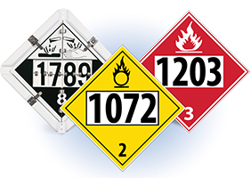

Large Quantity / Bulk Shipments
When there is one item, non-bulk packaging, loaded at one facility and weighing over 8820 pounds, the shipment is considered to be a Large Quantity Shipment, and may contain no other material, Hazardous or otherwise.
A common example of this would be a truckload shipment of flammable paint in drums and/ or pails.
The Placard provided would have a 4 digit UN or NA number on it that identifies the product being transported and is a Bulk Shipment.

Slide 43
Equipment, Tire and Freight Checks §397.17-Tires
Federal laws require the driver to inspect each tire of the both units when transporting Hazardous Materials.
  The law states tire checks must be done when first picking up the load and every time the vehicle stops. Flat, leaking, or improperly inflated tires must be replaced at the nearest safe place to perform repairs.
    Overheated tires must be removed and placed away from vehicle immediately. Vehicle must not be moved until the cause for overheating is resolved.
Each time you stop or park, you must inspect your equipment. Examine tires, brakes, freight (if not sealed).

Slide 44
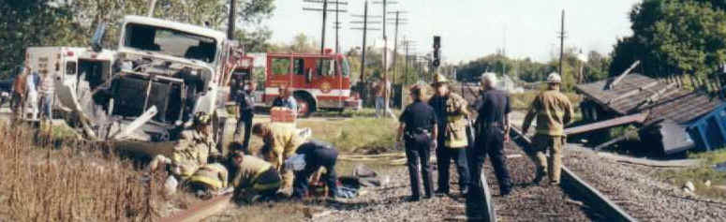
Part 392: Driving of CMVs
§392.10 —Railroad Grade Crossings; Stopping Required
the driver of a commercial motor vehicle which, in accordance with the regulations of the Department of Transportation, is required to be marked or placarded shall not cross a railroad track or tracks at grade unless he/she first: Stops the commercial motor vehicle within 50 feet of, and not closer than 15 feet to, the tracks; thereafter listens and looks in each direction along the tracks for an approaching train; and ascertains that no train is approaching. When it is safe to do so, the driver may drive the commercial motor vehicle across the tracks in a gear that permits the commercial motor vehicle to complete the crossing without a change of gears. The driver must not shift gears while crossing the tracks.
There are 4 exceptions pertaining to railroad crossings:
  If the crossing is clearly marked exempt,
  If it is marked by an arterial traffic light and it is green,
  If the crossing is controlled by an emergency official,
  If a streetcar crossing or switching tracks within a business district.
Notes:
44
44
44

Slide 45
Part 397: Transportation of Hazardous Materials
§397.15 — Fueling
When a motor vehicle which contains Hazardous Materials is being fueled —
Its engine must not be operating; and
A person must be in control of the fueling process at the point where the fuel tank is filled.
  This means a driver cannot conduct a vehicle inspection during the fueling process or leave the fueling process unattended for any reason.
Notes:
45
45

Slide 46
Part 397: Transportation of Hazardous Materials
§397.13 — Smoking
No person may smoke or carry a lighted cigarette, cigar, or pipe on or within 25 feet of:
(a) A motor vehicle which contains Class 1 materials, Class 5 materials, or flammable materials classified as Division 2.1, Class 3, Divisions 4.1 and 4.2; or
(b) An empty tank motor vehicle which has been used to transport Class 3, flammable materials, or Division 2.1 flammable gases, which, when so used, was required to be marked or placarded in accordance with the rules in §177.823 of this title.
This rule applies to time in the sleeper too…
Any time “on” or within 25 feet of the CMV.
Notes:
46
46

Slide 47
Part 397: Transportation of Hazardous Materials
§397.11 — Fires
A motor vehicle containing Hazardous Materials must not be operated near an open fire unless its driver has first taken precautions to ascertain that the vehicle can safely pass the fire without stopping.
A motor vehicle containing Hazardous Materials must not be parked within 300 feet of an open fire.
Notes:
47
47

Slide 48
Security of Hazmat Load
The driver must be in attendance of the vehicle at all times when transporting Hazardous Materials.
  Attendance is defined as: on the vehicle awake, (not in the sleeper berth), or within 100 feet with an unobstructed view of the vehicle at all times.
  Never leave the vehicle unattended on or near a public street unless performing necessary duties
  Secure the trailer with a padlock on every hazmat load.
  For further guidance on en route security, refer to your driver handbook or your Fleet Manager.

Slide 49
Hazardous Materials Transportation Security Awareness
Plan Statement and Objective:
The events of 9/11 make it clear that all Americans have a responsibility to be diligent in protecting our homeland from attack. There are 800,000 hazardous materials loads moved daily in the United States and 95% are moved by truck.
Your responsibility is to protect hazardous cargo from theft, sabotage, and hijacking at all times.
Suspicious Activity and Suspicious Activity Reporting
Procedures:
Team members are expected to use common sense and good judgment when assessing the threat potential of any suspicious activity.
Team members are expected to report observed suspicious activity to their immediate supervisor, manager, or local law enforcement and/or fire department.

Slide 50
Hazardous Materials Security Plan
All employees are expected to be familiar with the company’s Hazardous Materials Security Plan.
  See the Driver’s Handbook
You will be expected to follow these directives and, under no circumstances, deviate from them.

Slide 51
Hazmat En Route Standard Security Operating Procedures
Drivers should prepare and execute a trip plan for all hazmat movements that include:
  Routing schedules that avoid highly populated areas, bridges, and tunnels when possible.
  Fueling and break locations (including dates and times for same).
  Dates and times of daily/routine check calls.
  Estimated times of arrival to any extra stops and final destination.
  For all hazardous materials movements, drivers should minimize stops en route.
Remember, on all Hazardous Materials loads you must follow company and local routing instructions.
  If you are detoured, notify your Fleet Manager, with the specifics of where you are being detoured.

Slide 52
Hazardous Materials Transportation Security Plan
Operations shall make every effort to arrange hazardous materials delivery schedules that minimize in-transit down time.
  While in transit, drivers are prohibited from discussing information related to their load, route, or delivery schedule with any unauthorized person(s).
Drivers are expected to take all reasonable and responsible precautions to prevent damage to company vehicles and theft of hazardous material(s) cargo while in transit.
  For personal protection and safety, and the security of the cargo, drivers are expected to park in safe, well-lit, designated truck parking locations only.
  Drivers shall lock their vehicles and have all windows closed at all times while in transit.
When possible, dispatch shall contact receivers for arranging secure overnight or after hours parking for drivers who can safely and legally arrive at the destination ahead of schedule.
Upon arrival at the destination or stop off, drivers shall check in with the responsible receiving person(s) to notify them of arrival and receive unloading instructions.
The driver, along with a responsible receiving employee, shall verify delivery, inspect the trailer seal(s), match the seal number(s) with those on the shipping papers prior to breaking the seal(s); then open and secure the trailer doors, and inspect the cargo.

Slide 53
Hazardous Materials Spills
The driver’s responsibility in the case of a spill:
remain with the vehicle,
keep unauthorized persons away,
notify local authorities and,
to prevent the spill from spreading (if safe).
When A Hazardous Material Spill Occurs – think G.I.N.:
  Gather your information and get away,
  Isolate the area (150 feet minimum),
  Notify the authorities (911),
    Call your employer/company immediately!

Slide 54
Hazardous Materials Tips
Be proactive.
Always do a proper Pre/Post Trip Inspection.
Use common sense.
Most Hazmat problems can be identified through sight, sound and smell.
Do not do anything that you are unsure of:
  When in doubt – communicate!
  Call your Fleet Manager or the Safety Department.

Slide 55
QUESTIONS?
UN2056, Tetrahydrofuran, 3, PGII
UN1179, Ethyl Borate, 3, PGII
UN3066, Paint, 8, PGII

Slide 56
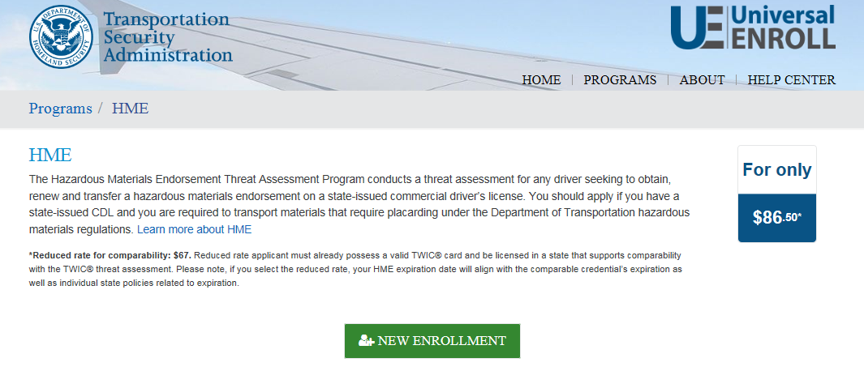
To begin the process for obtaining your Hazardous Materials Endorsement (HME)
https://universalenroll.dhs.gov/

Slide 57
Hazardous Materials Certification Test

