Slide 1
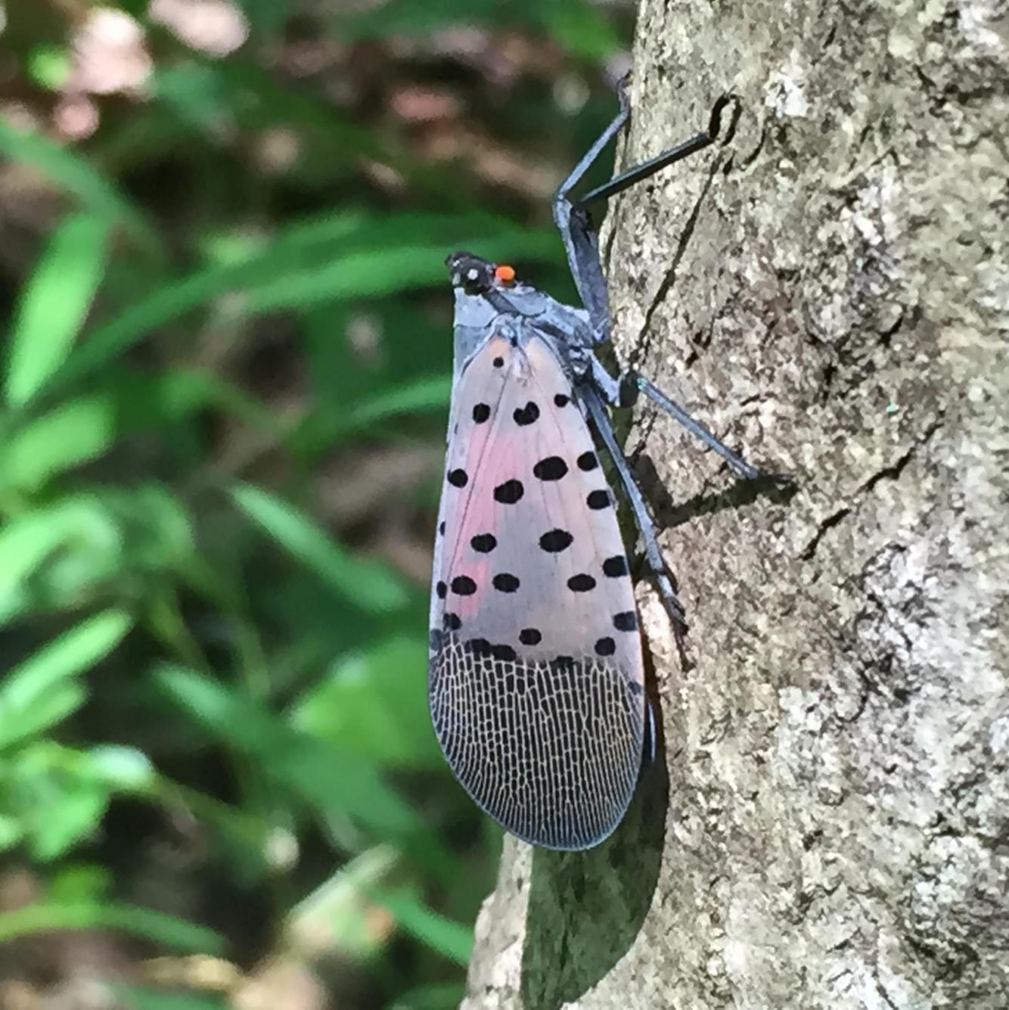
Spotted Lanternfly Permit Training
Part 5: Controlling Spotted Lanternfly on Your Property

Slide 2
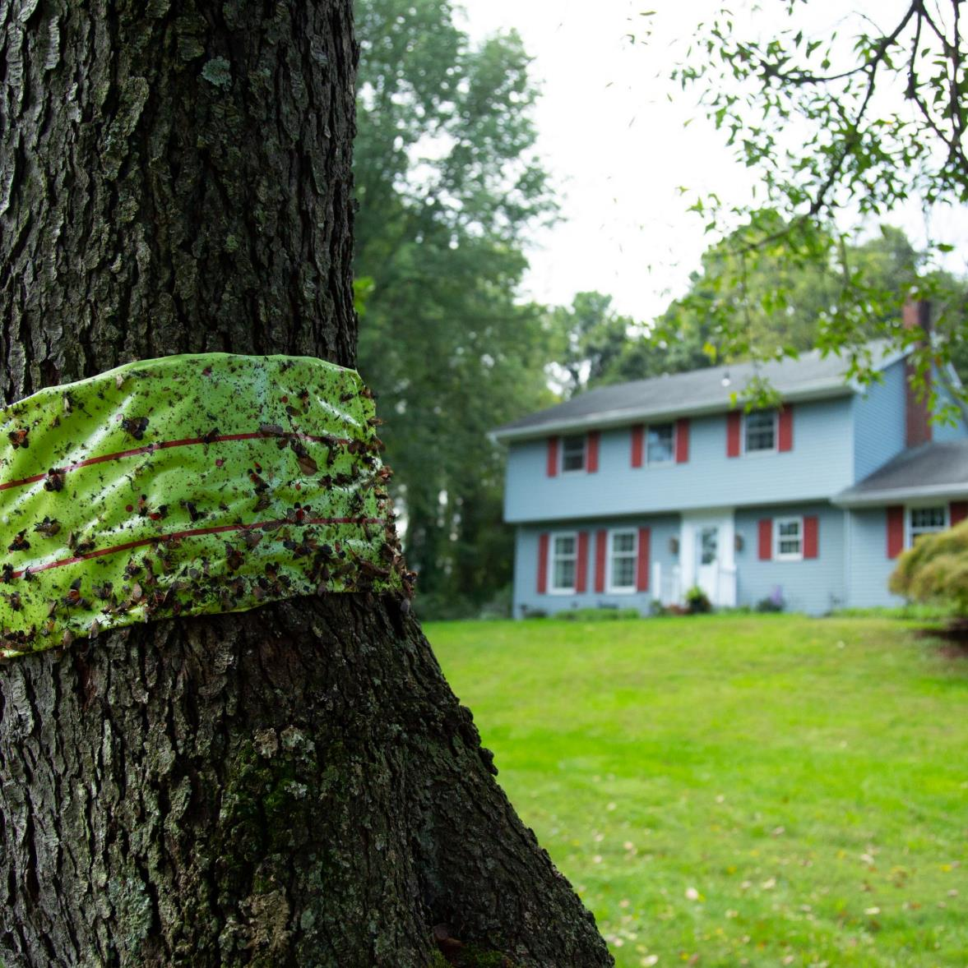
Spotted Lanternfly Management
Trap tree method using Ailanthus (tree-of-heaven)
Tree banding
Insecticides
Notes:
There are several methods you can use to manage SLF.

Slide 3
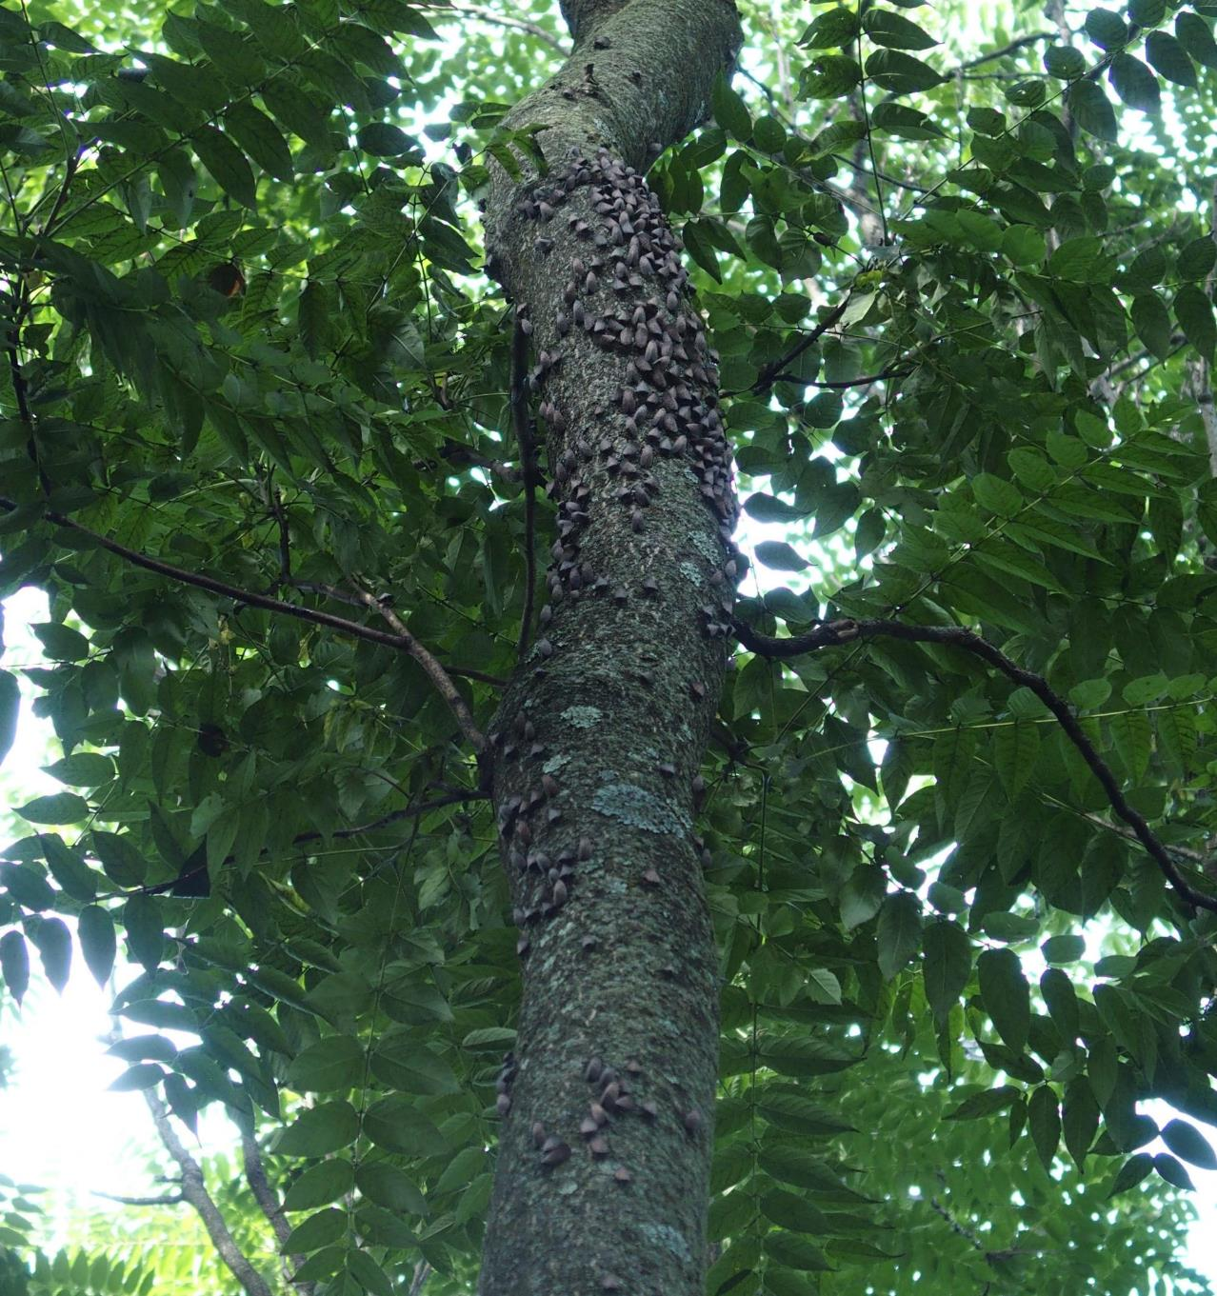
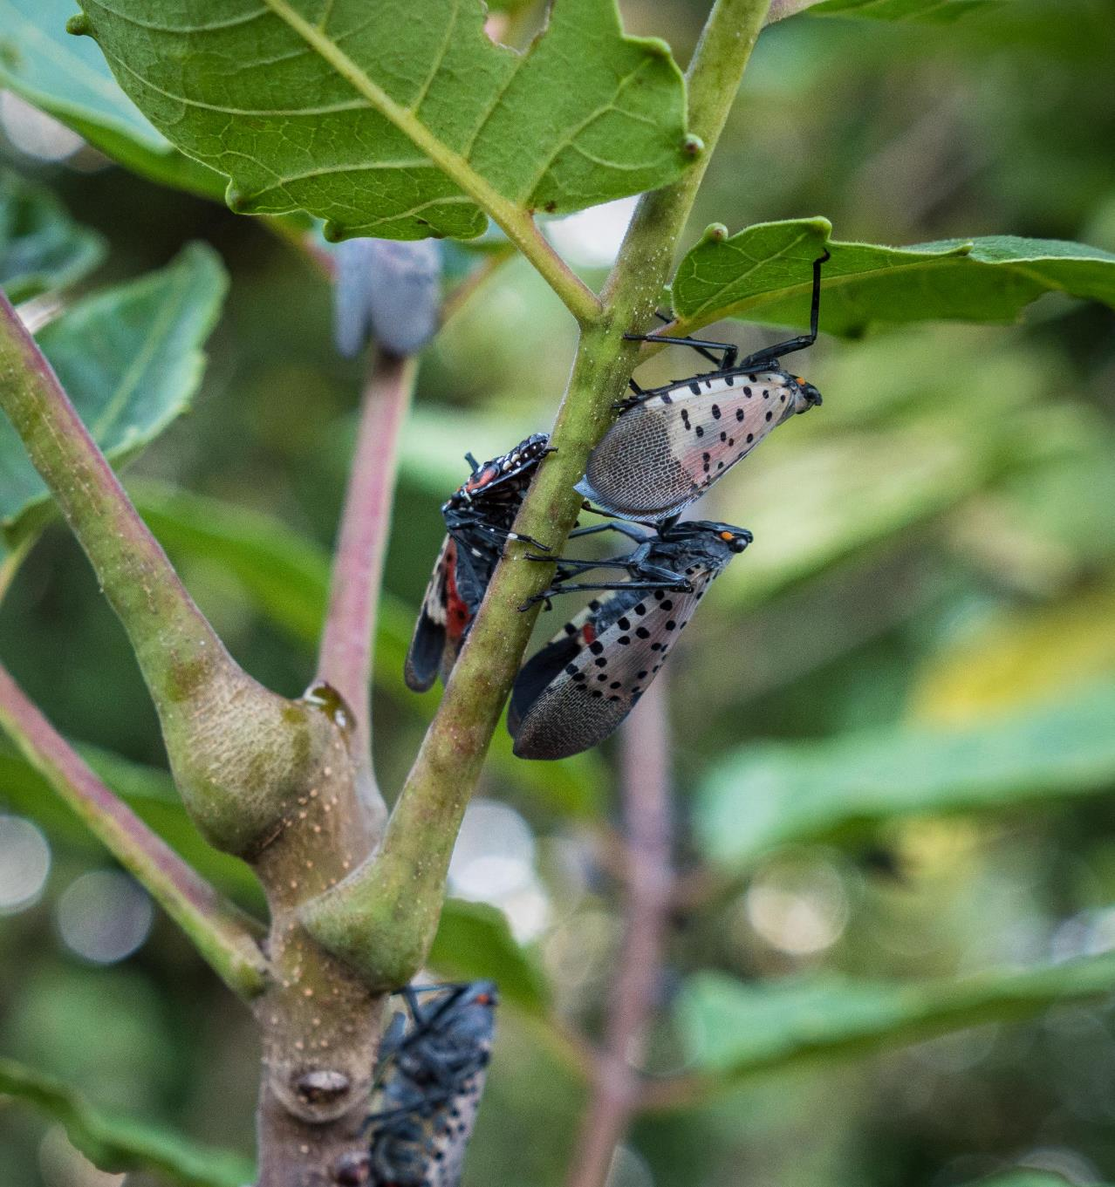
Spotted lanternfly and ailanthus (tree-of-heaven)
Notes:
Spotted lanternfly's favorite food, especially in the adult life stage, is the invasive tree Ailanthus altissima, also called tree-of-heaven.
If this tree is available, spotted lanternflies will preferentially feed on it.
We can use this attraction to our advantage by using tree-of-heaven as a “trap tree.”

Slide 4
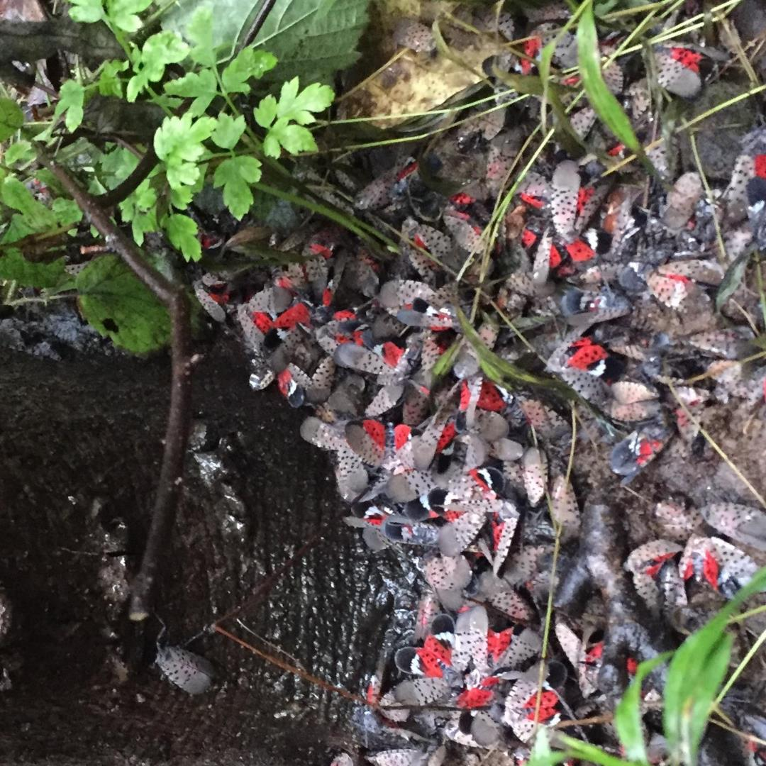
Spotted Lanternfly Management: Trap Tree Method
1. Kill most tree-of-heaven on
the property.
2. Treat remaining tree-of
heaven (the traps trees)
with systemic pesticide.
3. Spotted lanternfly feed on
the trap trees and die.
Visit https://extension.psu.edu/spotted-lanternfly for information on identifying tree-of-heaven and using the trap tree method.
Notes:
To follow this method, you must first kill most of your Ailanthus (that is, tree-of-heaven) trees, leaving just a few to serve as trap trees.
Tree-of-heaven trees can be male or female. Try to leave only male trees. Female trees prolifically produce seeds (several hundred thousand each year!) so prioritize killing female trees.
Then apply a systematic insecticide to the remaining Ailanthus trees. A systemic insecticide is absorbed into the living tissue of the plant.
In the late summer and fall, the adult spotted lanternflies will move to the trap trees.
When the spotted lanternflies feed on the trees, they ingest the insecticide and die.

Slide 5
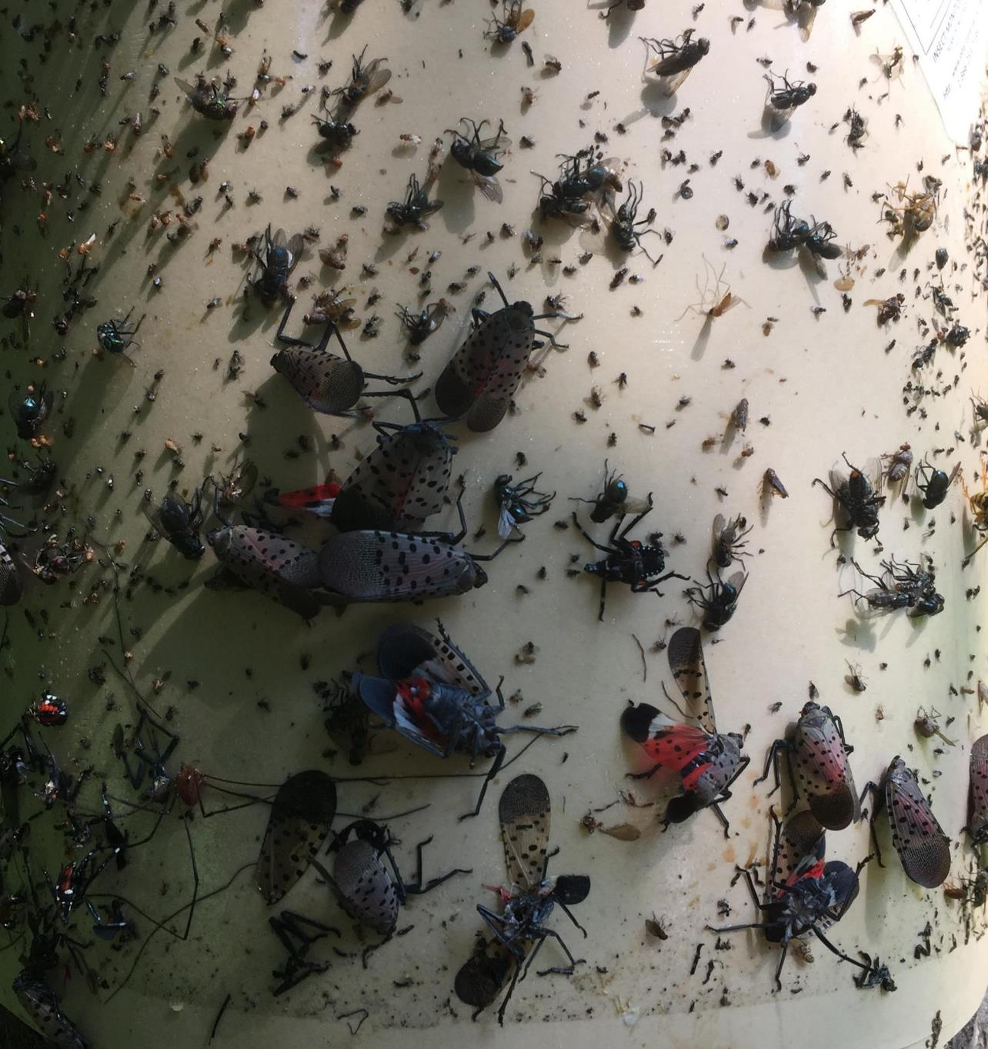
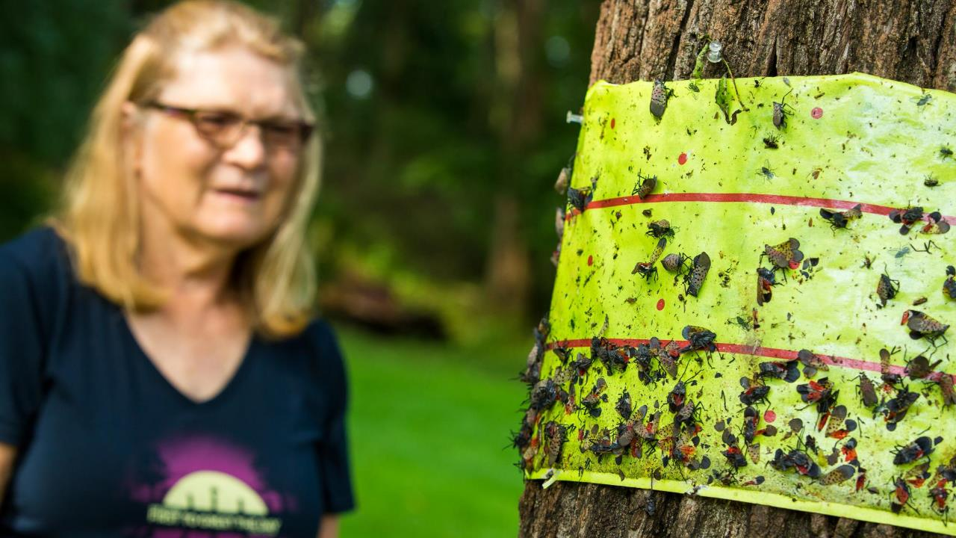
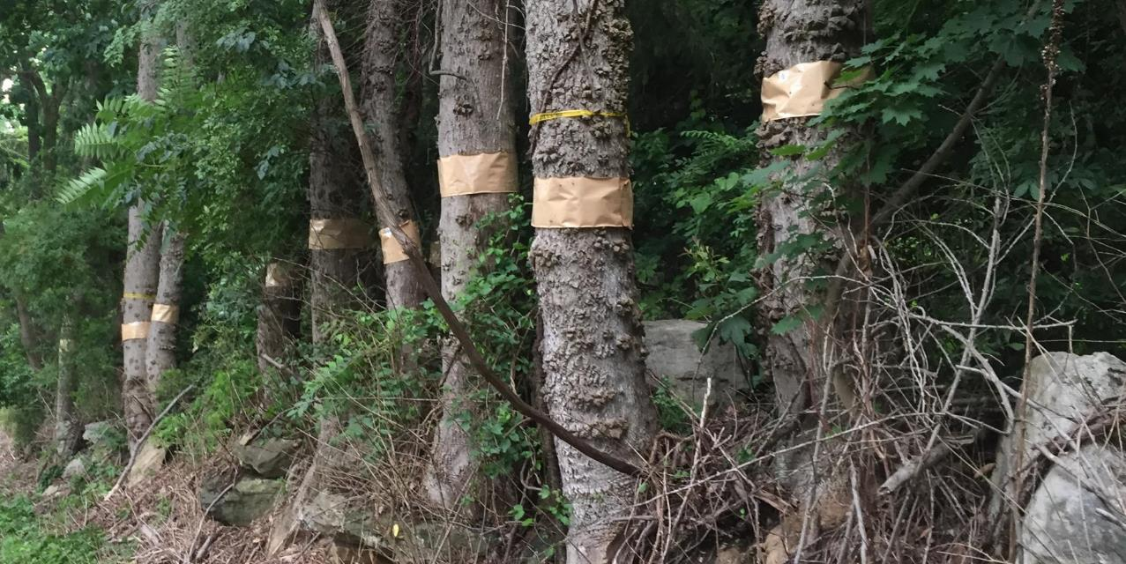
Spotted Lanternfly Management: Tree Banding
Notes:
Bands of sticky tape bands on trees can trap spotted lanternflies and are especially effective in trapping the immature nymphs.
Using sticky bands is a chemical-free way of killing these invaders. However, they can also capture other creatures, including beneficial insects and occasionally a bird or small mammal.
You can purchase sticky bands from several commercial sources, or you can make your own bands.

Slide 6
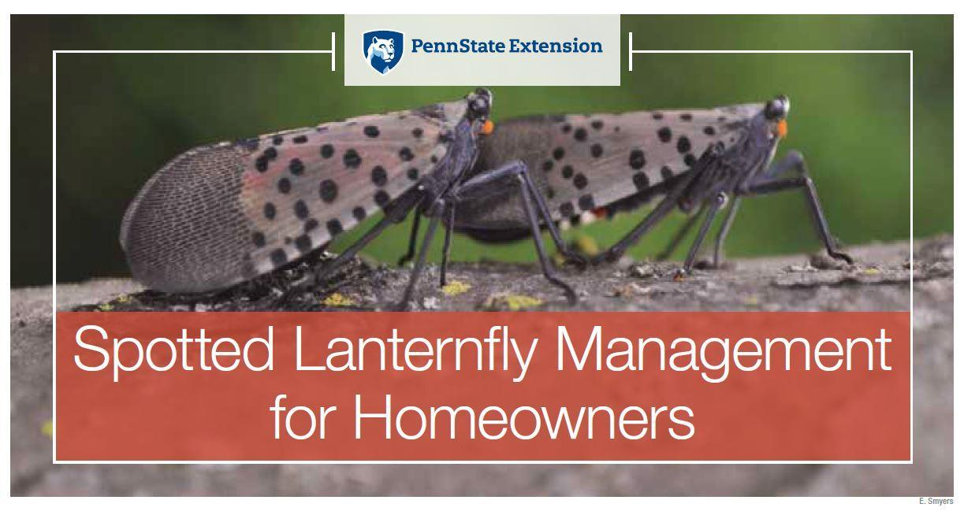
Spotted Lanternfly Management: Insecticide
Recommendations are in this publication on the Penn State Extension website. Read the label first!
Notes:
Insecticide recommendations can be found in our SLF homeowner management guide online and at your local extension office. Always read the label before applying any insecticide.
Insecticides—check with Penn State Extension Website.
Insecticide recommendations can be found in our SLF homeowner management guide online and at your local extension office. Always read the label before applying any insecticide.
There are systemic and contact options for insecticides. Contact insecticides kill SLF when they come into contact with it (directly sprayed on them, or on a surface they are exposed to). A systemic insecticide gets taken up into the tree. Systemic insecticides kill SLF when they feed on a host that has been treated with a systemic insecticide.

Slide 7
Image Credits
Unless otherwise noted, all images are courtesy of Penn State.
3.2. "20180830-APHIS-LSC-0272" by United States Department of Agriculture / usdagov on flickr.com has been modified (cropped) and is in the public domain

