Slide 1
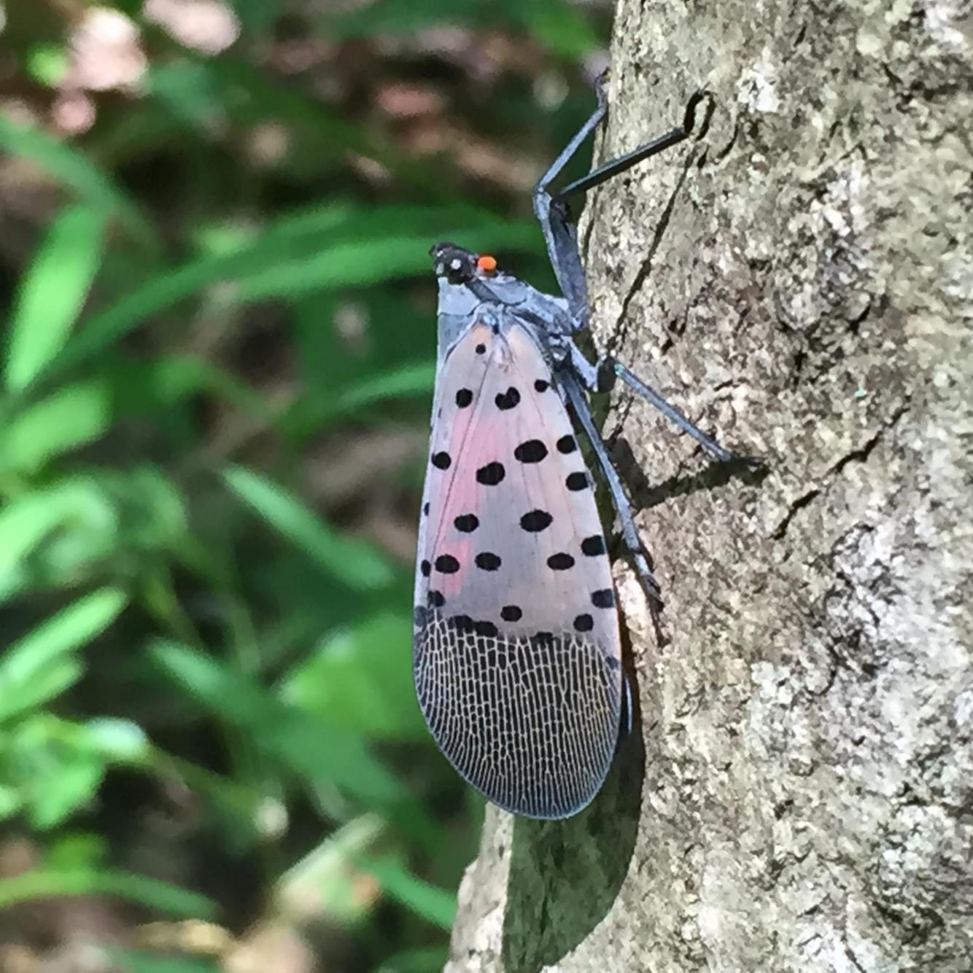
Spotted Lanternfly Permit Training
Part 4: Search For and Destroy Egg Masses

Slide 2
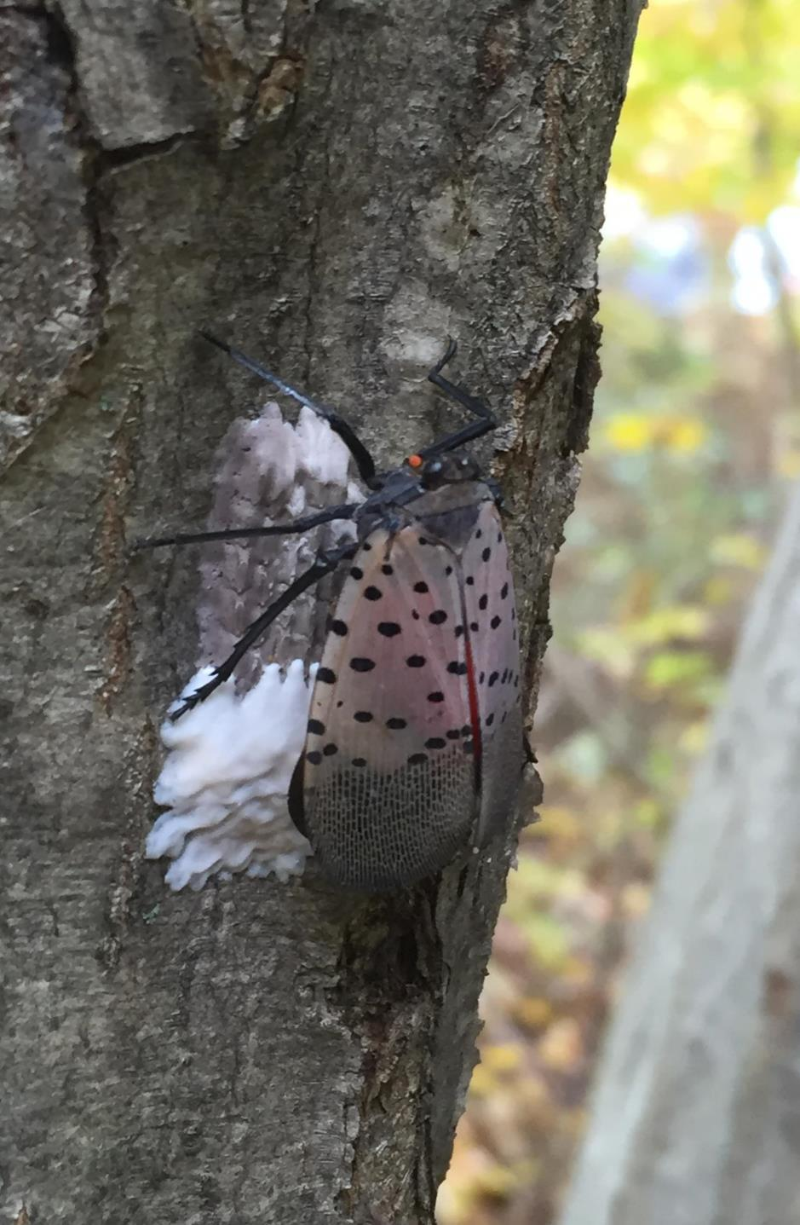
Egg Masses
Columns of eggs
30 – 50 eggs per mass
Overall length: usually about
an inch
Notes:
The spotted lanternfly lays columns of eggs side by side. There can be as many as 30 to 50 eggs per mass. The overall length of an egg mass is usually about 1 inch.

Slide 3
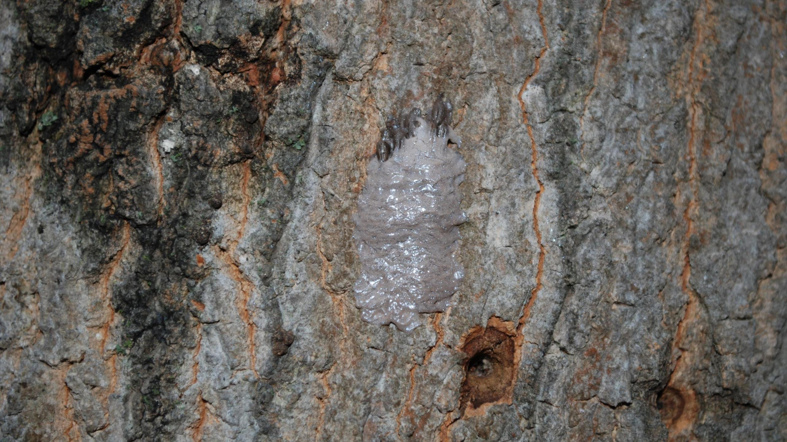
Egg mass coverings start out shiny gray and putty-like.
Notes:
The female covers the eggs in a grey putty-like covering. At first the covering is shiny.

Slide 4
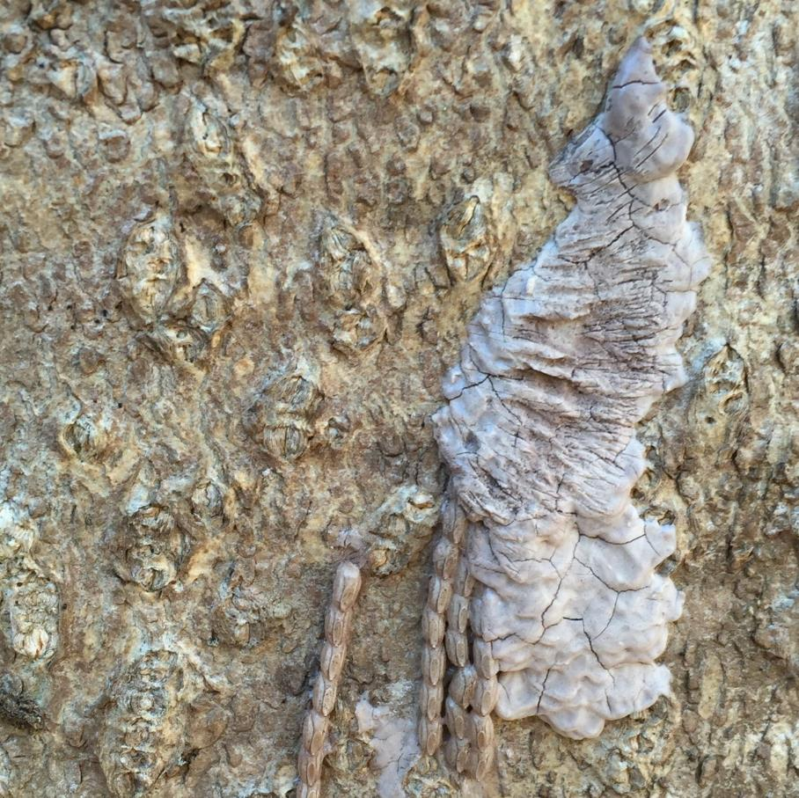
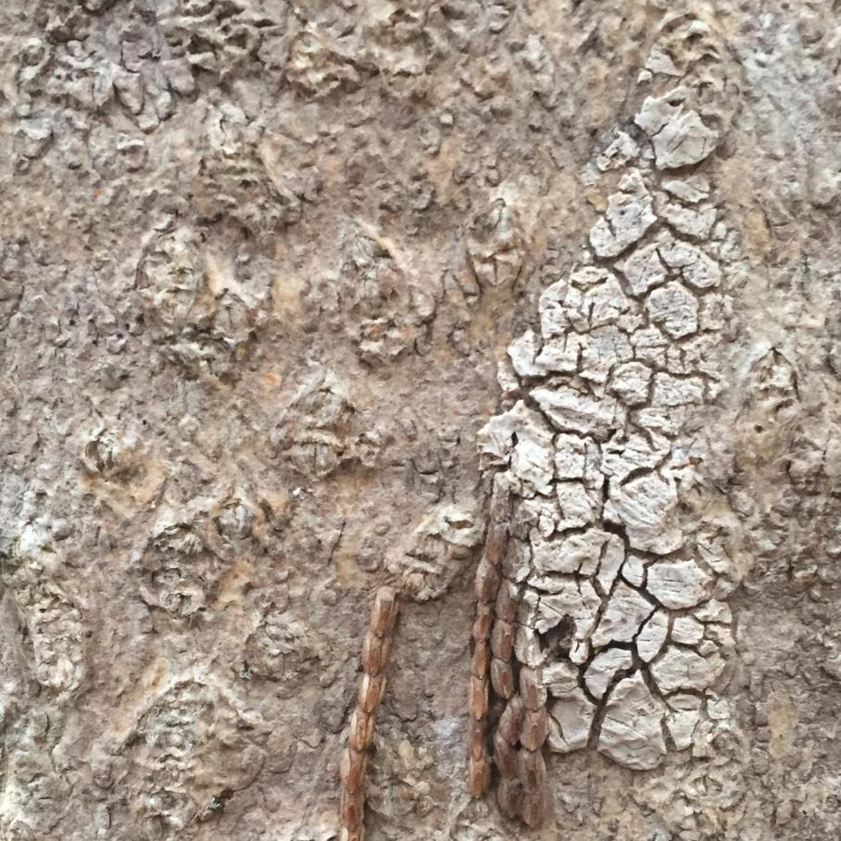
Egg Mass Covering
Dries and cracks over time.
Notes:
The covering gradually dries out and cracks over time. These two photos show the same egg mass taken four months apart. You can see how the covering has deteriorated.

Slide 5
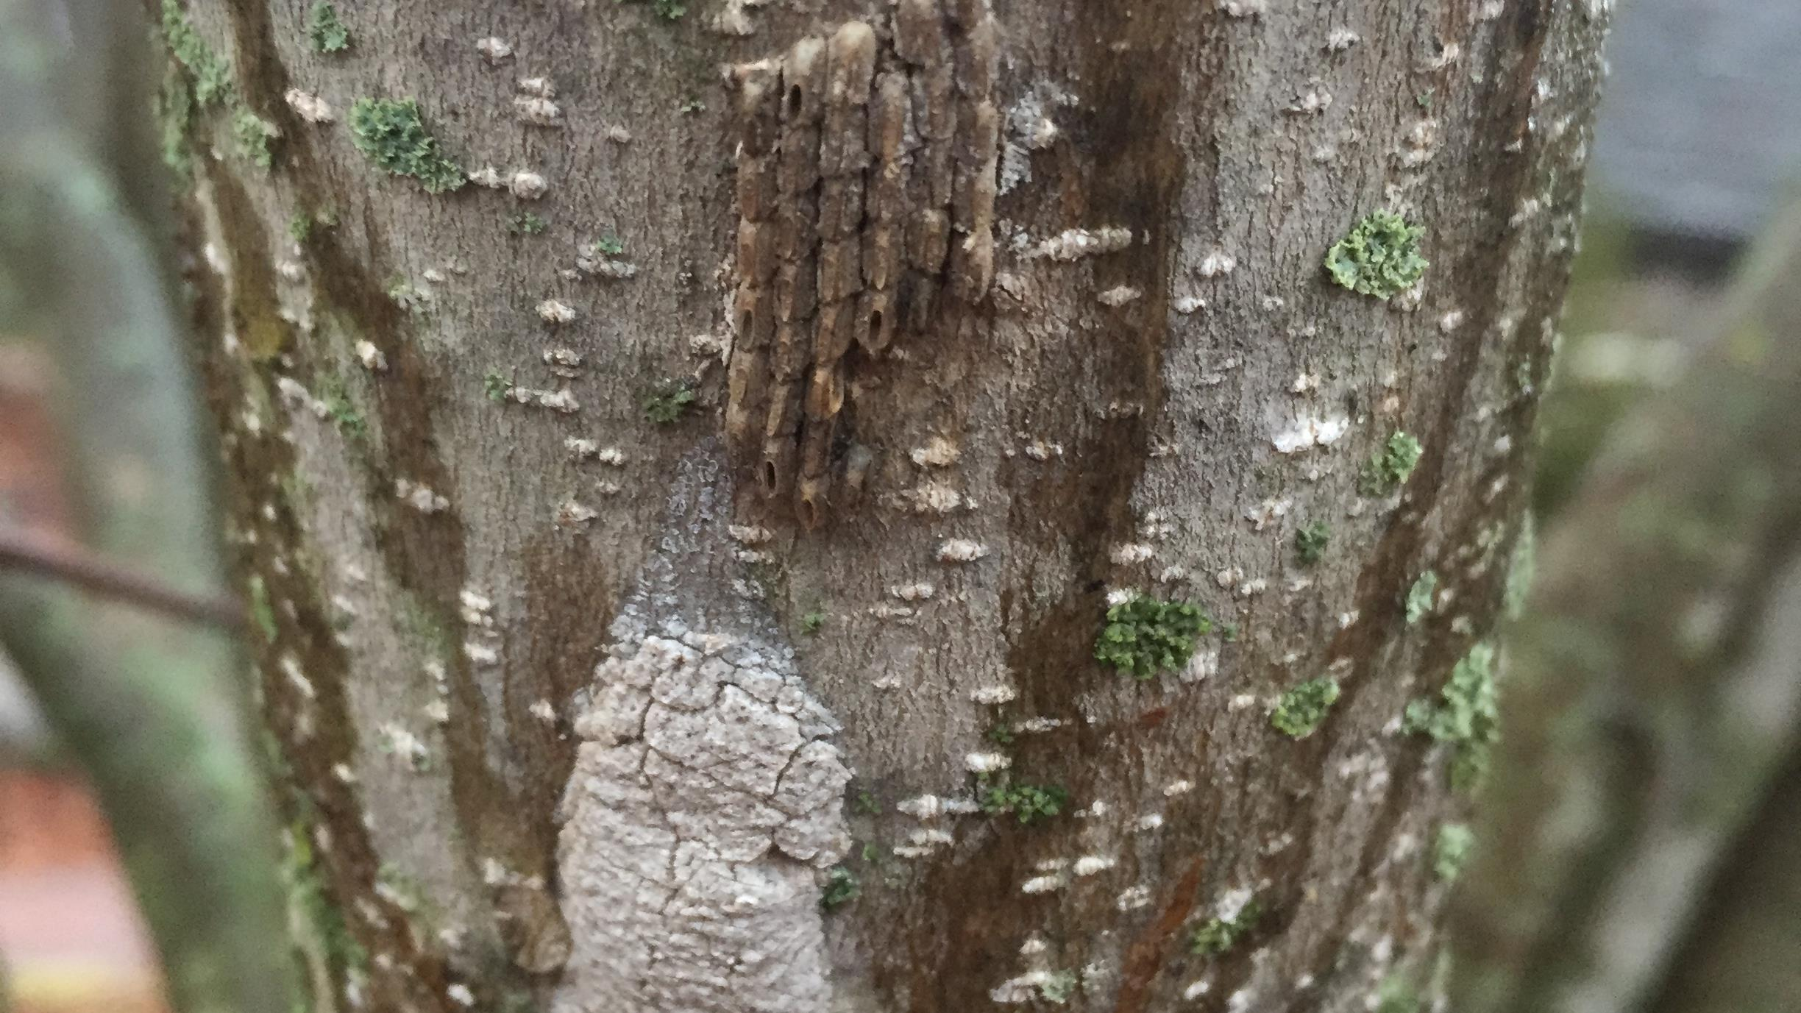
Covered and Uncovered Egg Masses
Notes:
Females may not cover all the eggs, as you can see in these two egg masses.

Slide 6
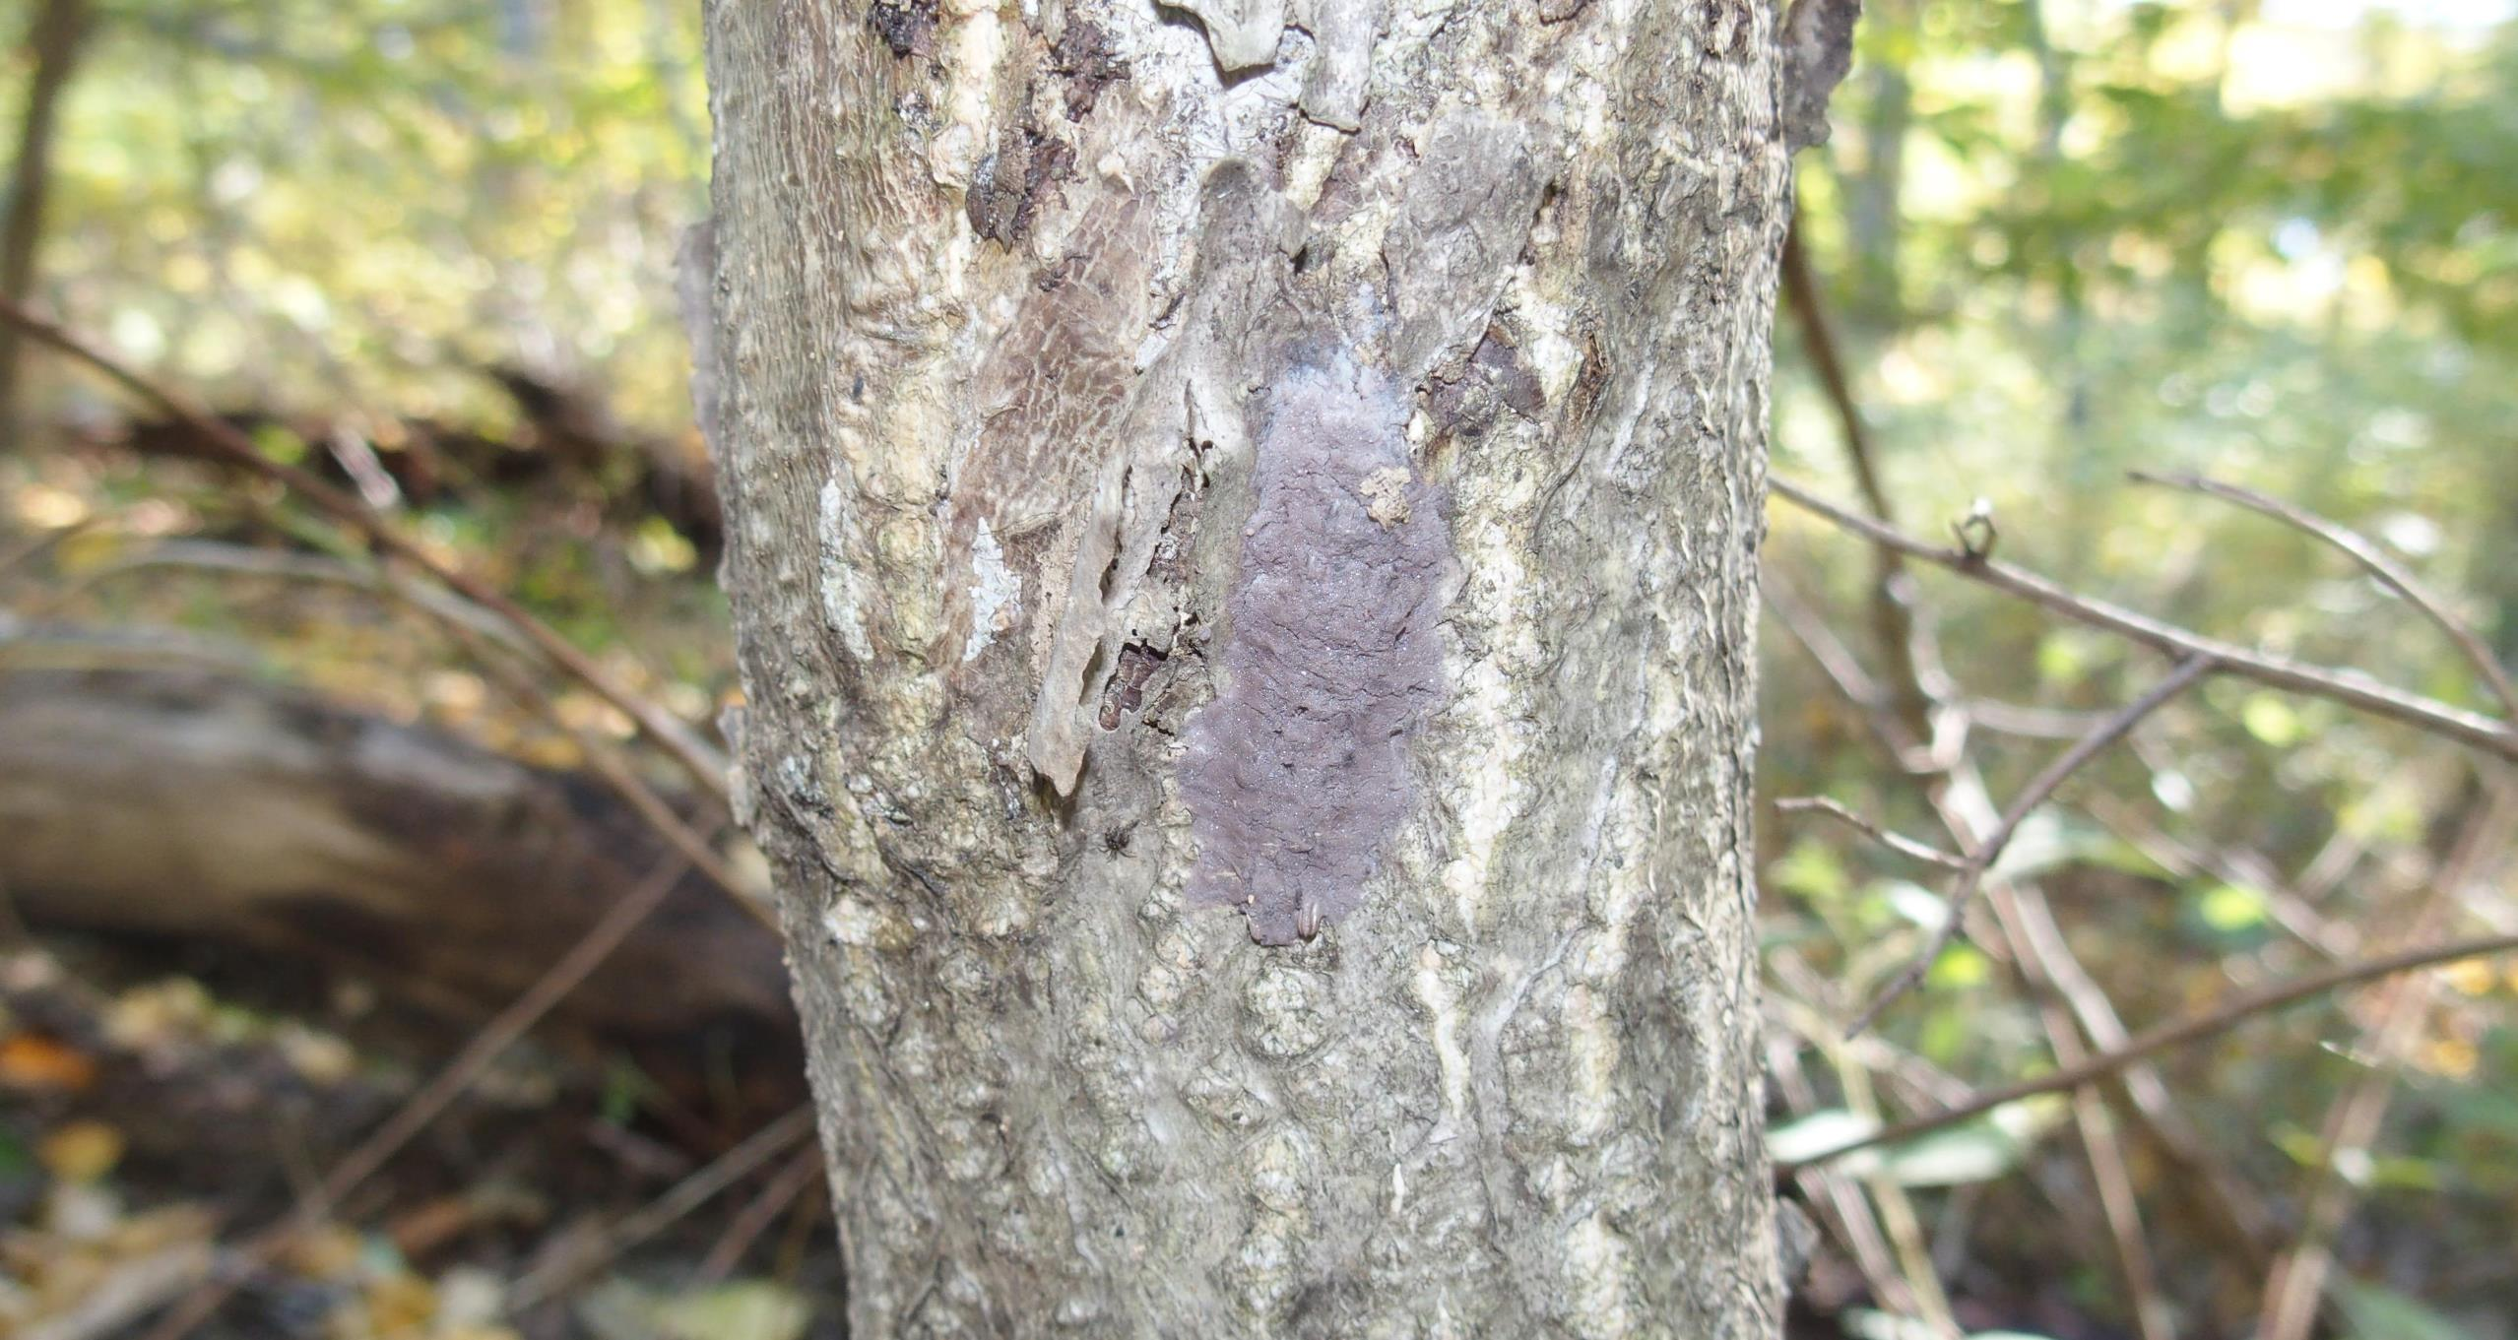
Find the egg mass.
Notes:
Can you see it?

Slide 7
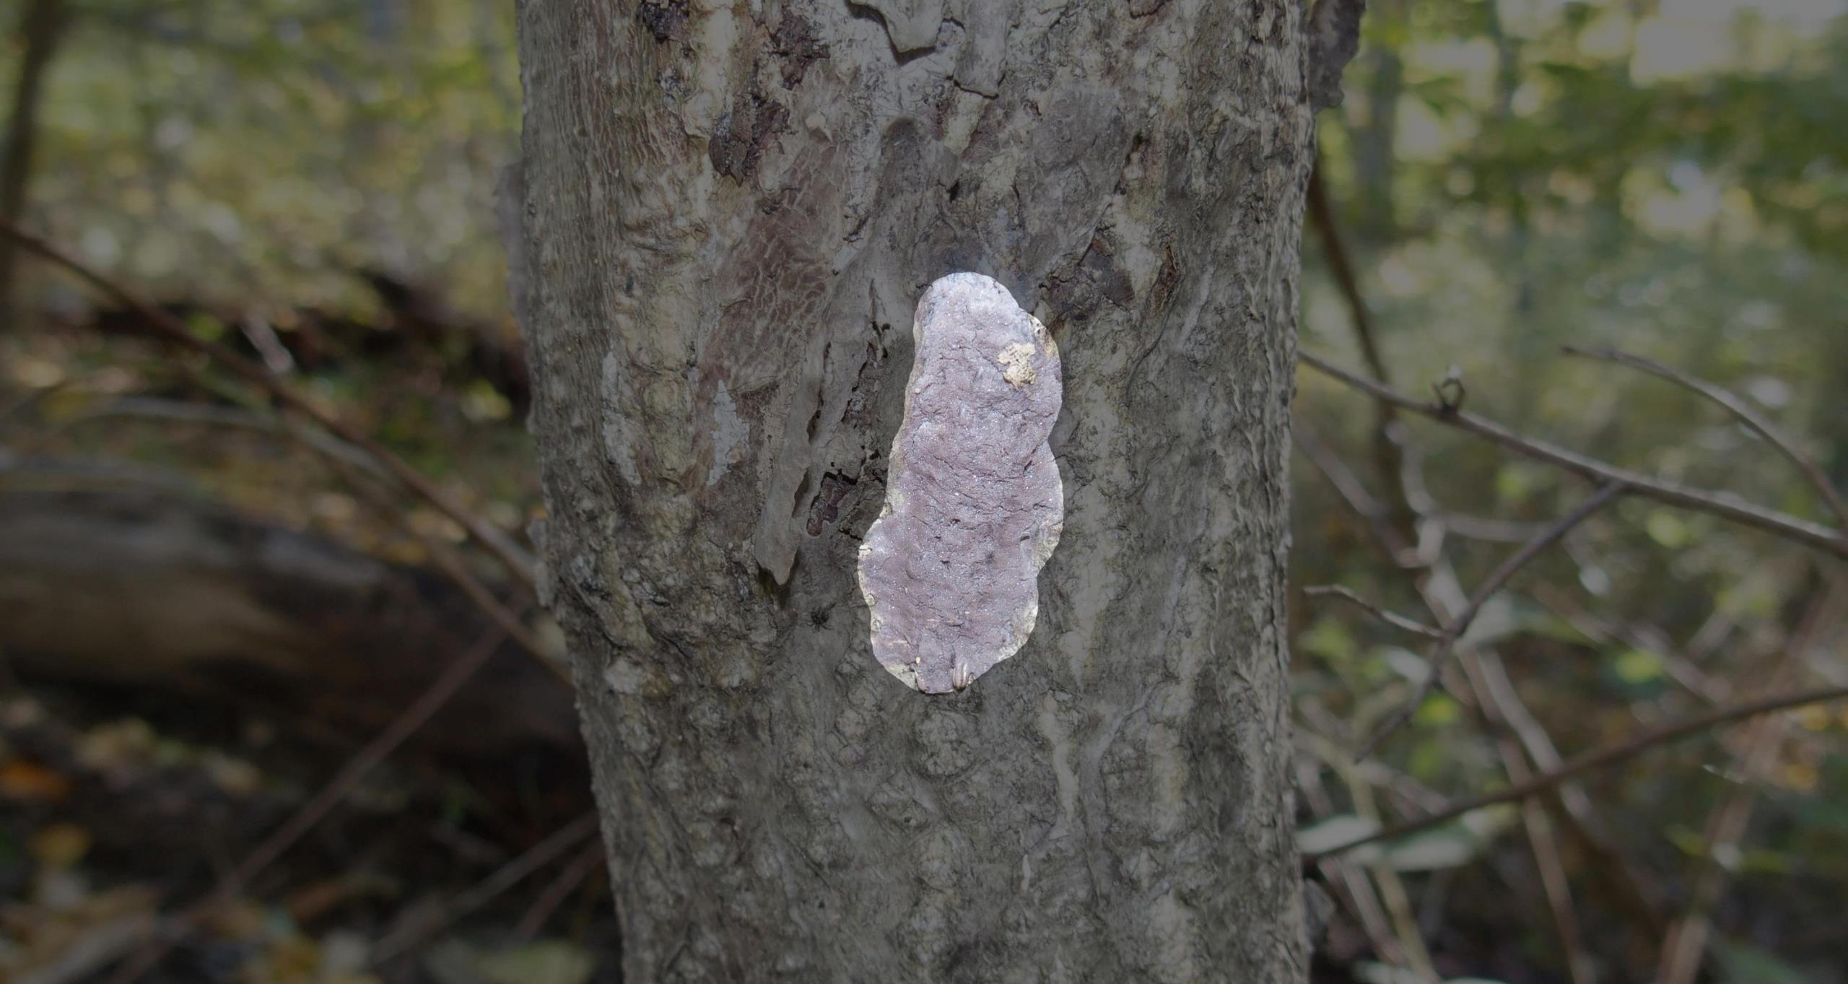
Find the egg mass.

Slide 8
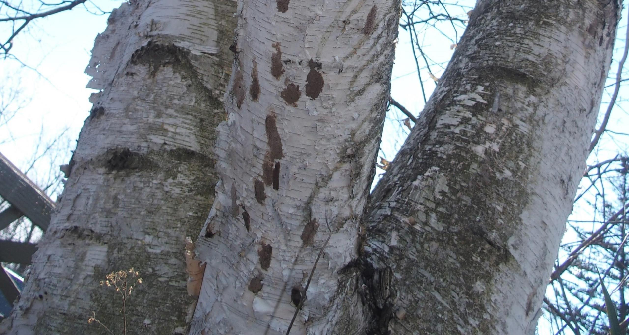
Find the egg masses.
Notes:
Can you see them?

Slide 9
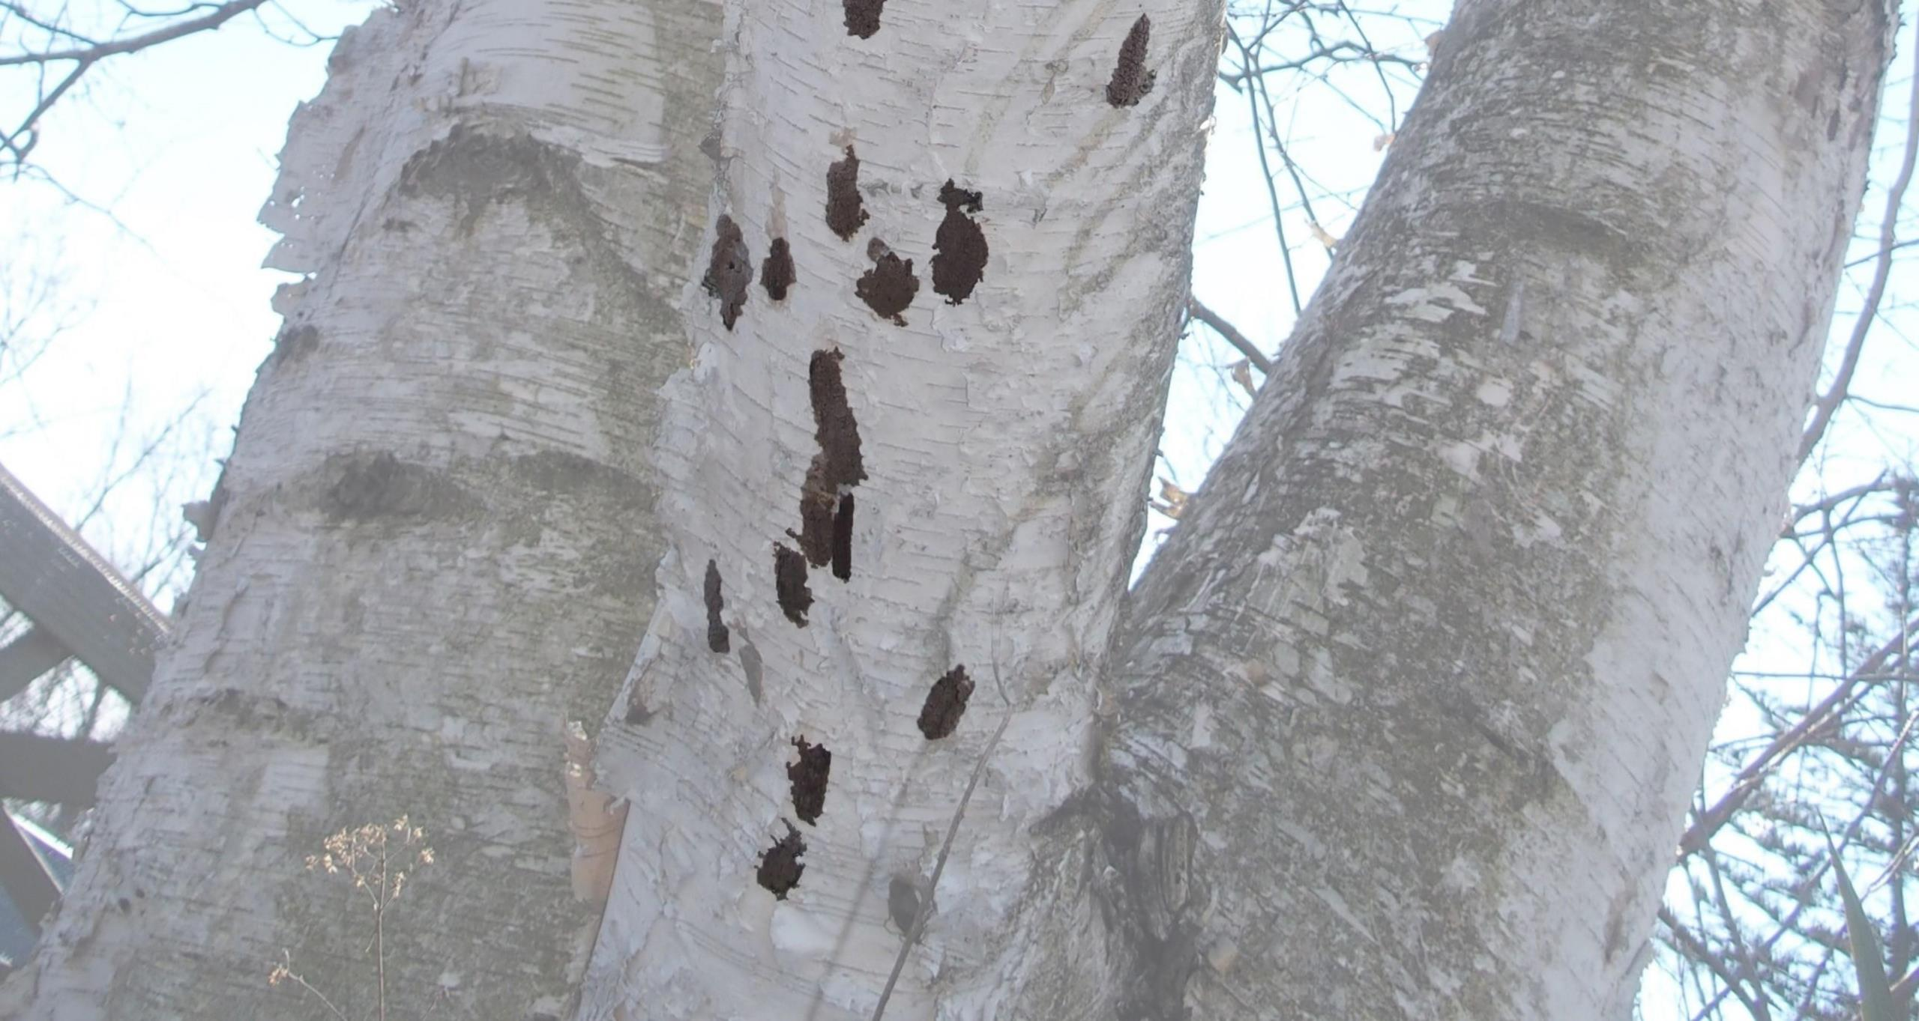
Find the egg masses.

Slide 10
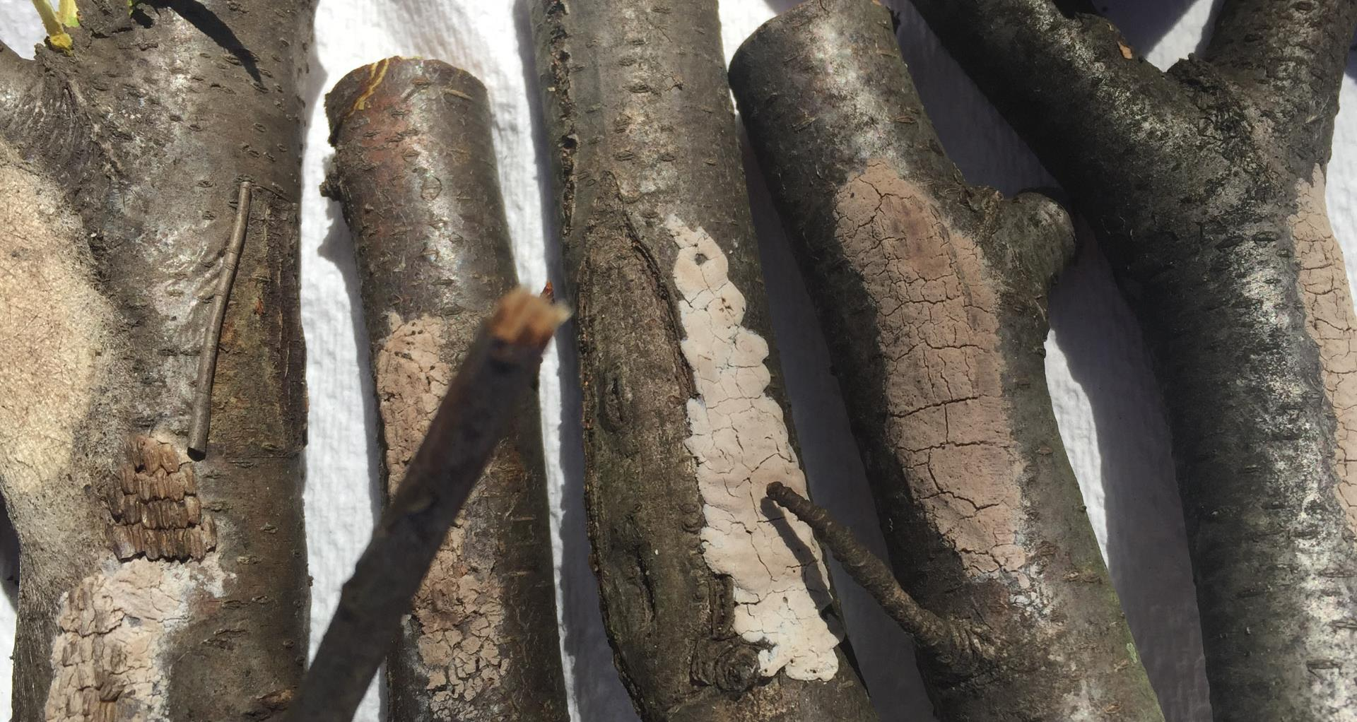
Find the egg masses.
Notes:
Can you see them?

Slide 11
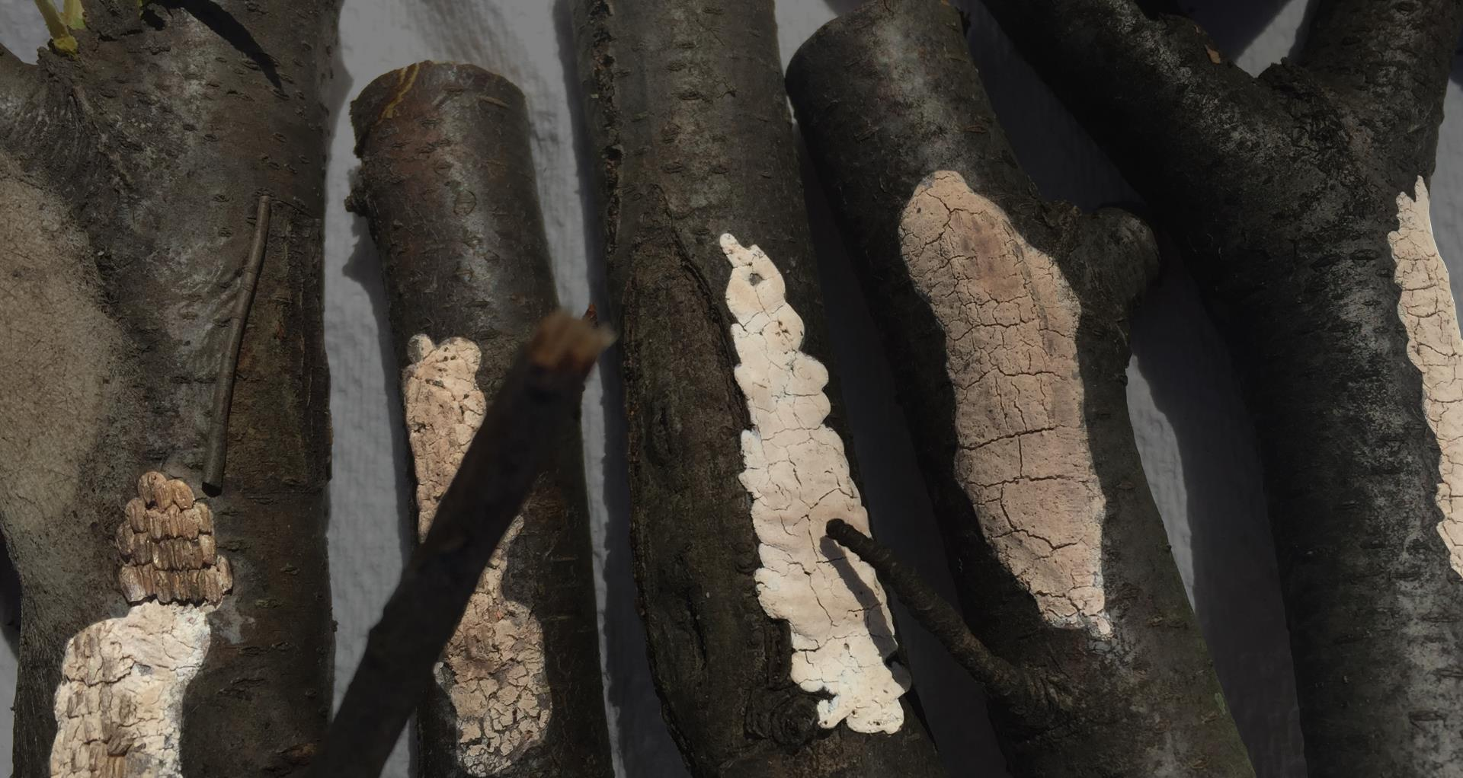
Find the egg masses.

Slide 12
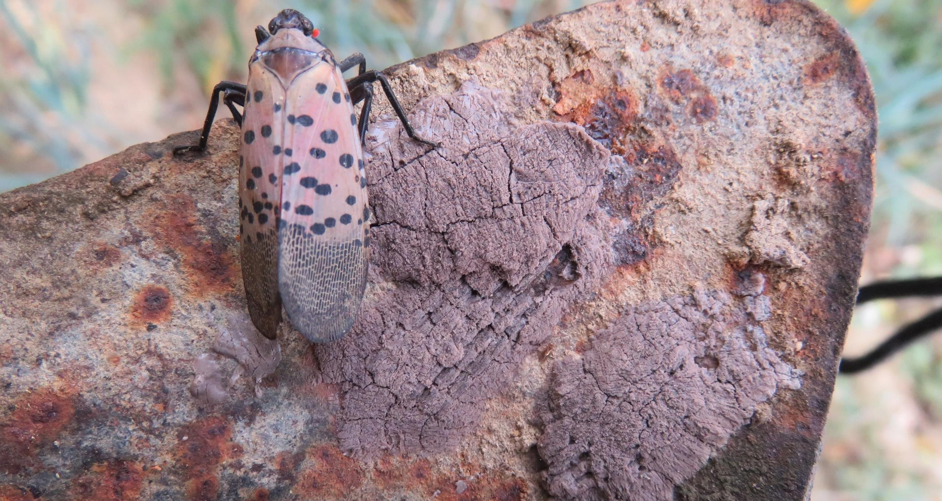
Find the egg masses.
Notes:
Can you see them?

Slide 13
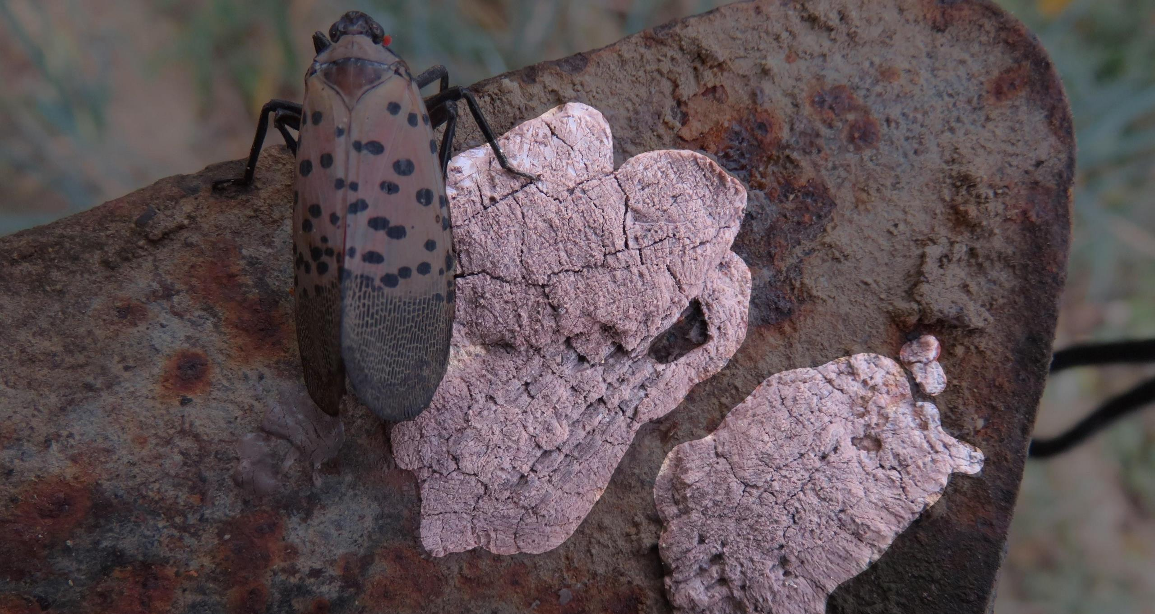
Find the egg masses.

Slide 14
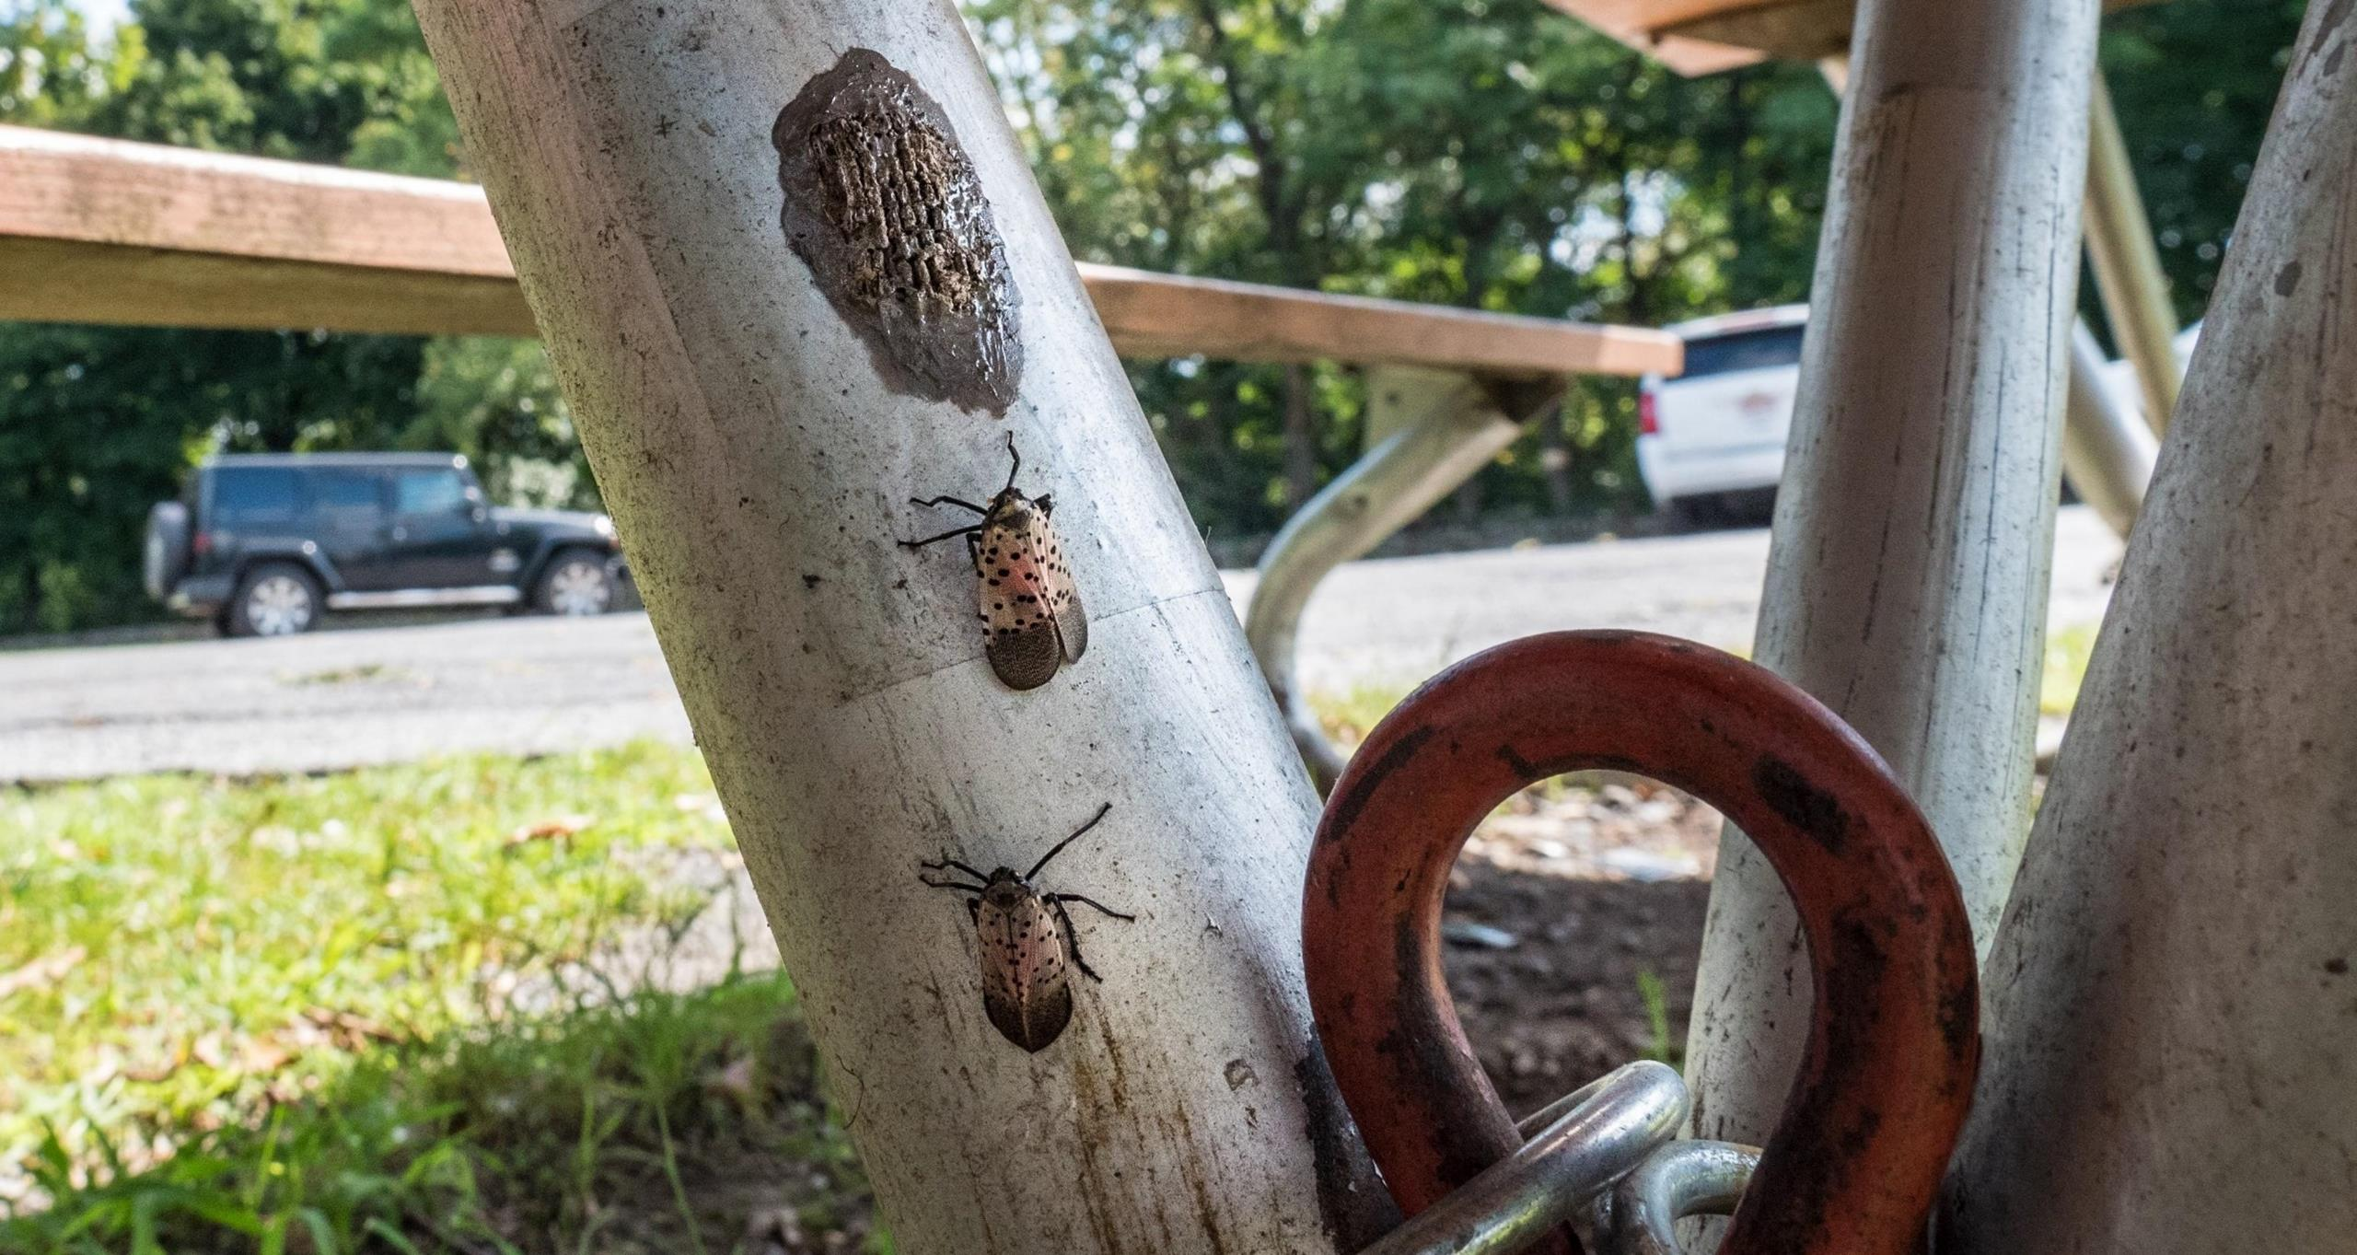
Find the egg mass.
Notes:
Can you see it?

Slide 15
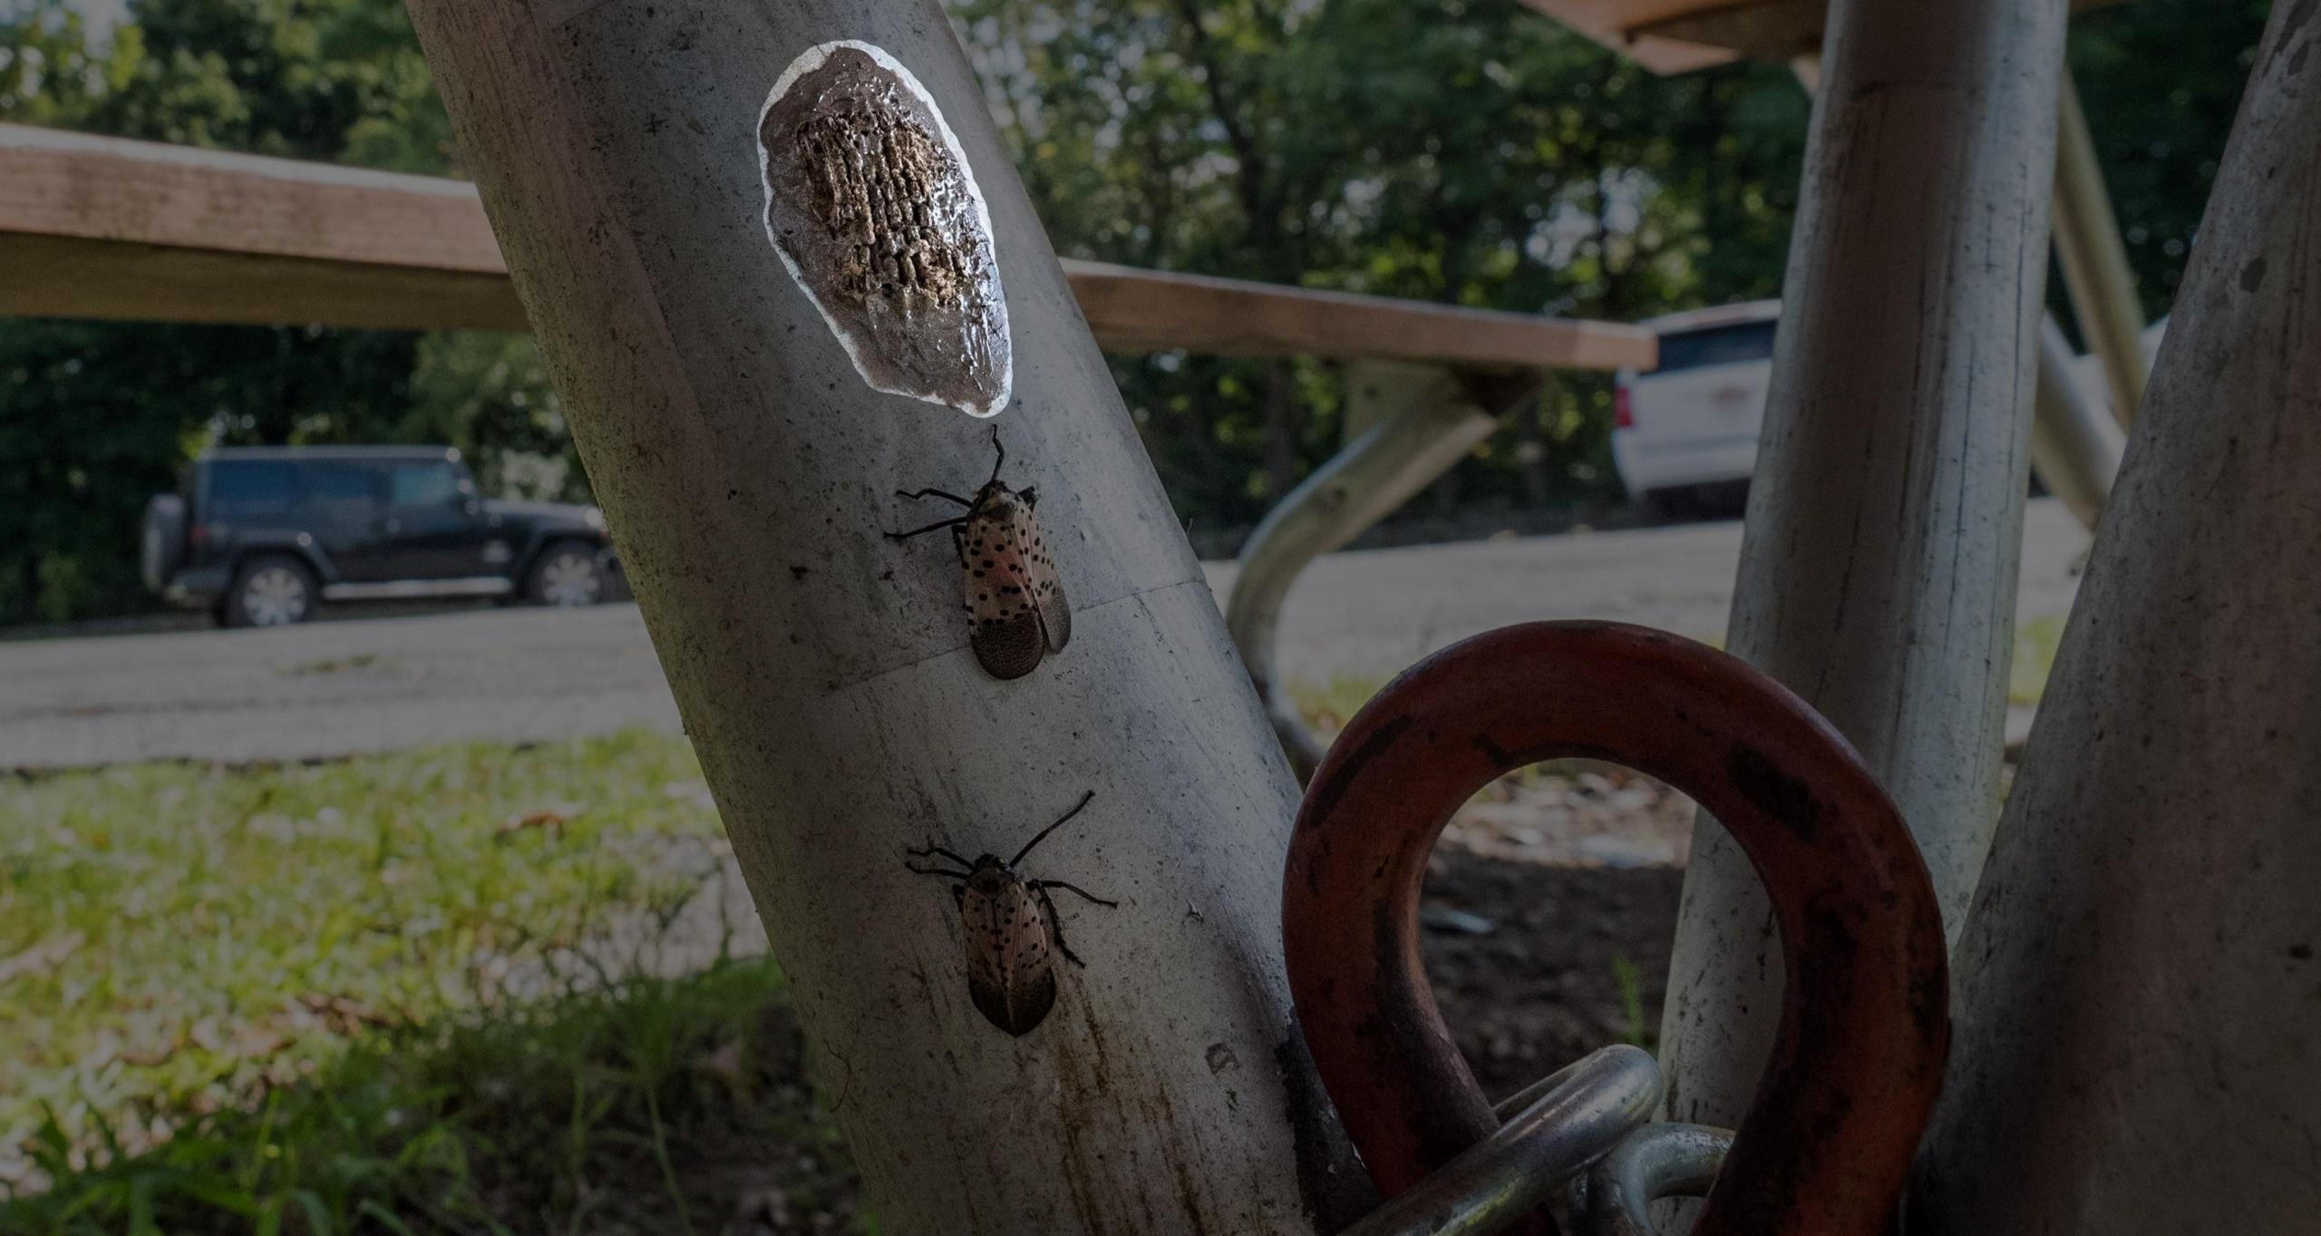
Find the egg mass.

Slide 16
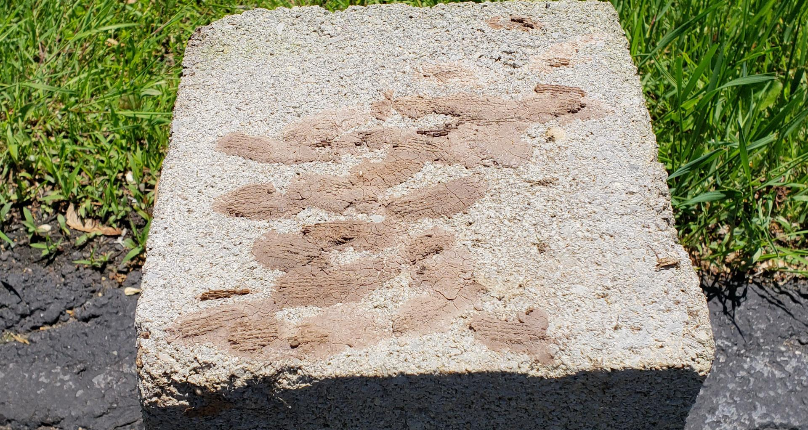
Find the egg masses.
Notes:
Can you see them?

Slide 17
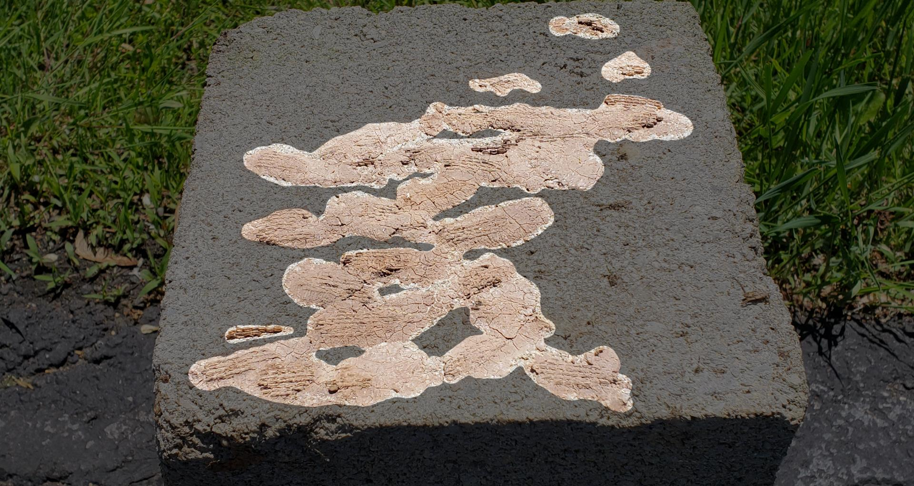
Find the egg masses.

Slide 18
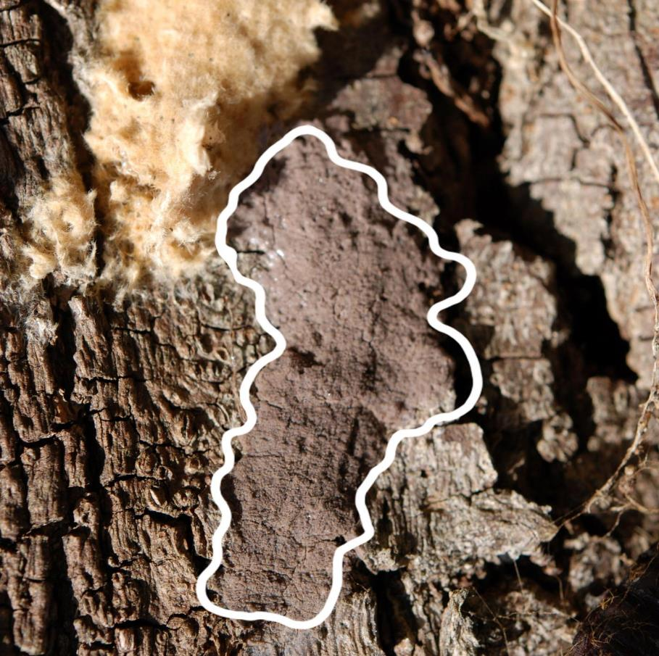
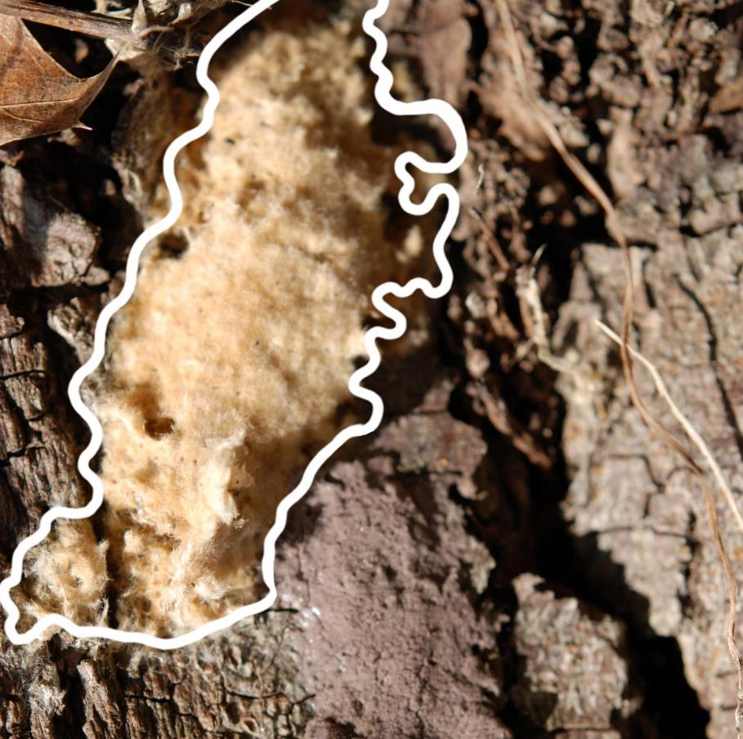
Spotted Lanternfly and Gypsy Moth Egg Masses
Spotted Lanternfly
Gypsy Moth
Notes:
Gypsy moth's egg masses have a similar appearance to spotted lanternfly. Many of the same surfaces are used by both species. The covering for gypsy moth is more fibrous and generally tanner in color. Gypsy moth eggs are more spherical than spotted lanternfly eggs.
Feel free to destroy gypsy moth egg masses too!

Slide 19
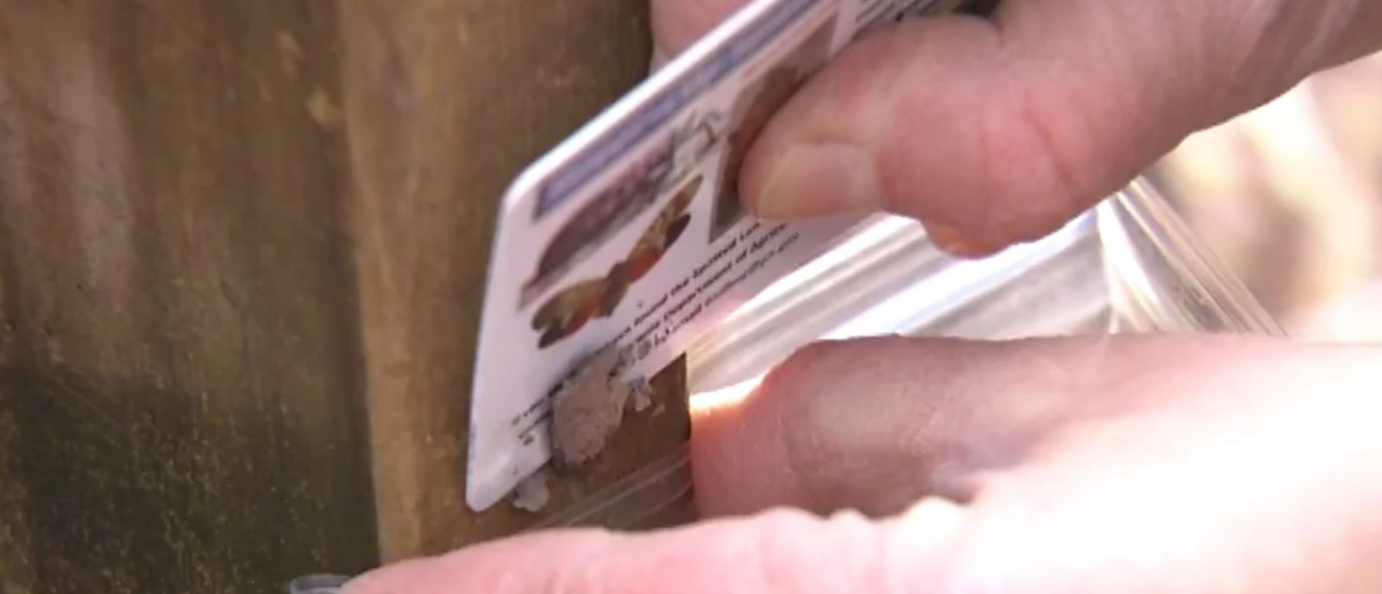
Scrape and destroy egg masses.
Notes:
What should you do when you find egg masses?
You can practice mechanical control by scraping and destroying egg masses. If you scrape the eggs into a container of rubbing alcohol, that will kill them. Then double-bag them and throw them away. You can also smash the eggs.
Watch this video to see how. (click or ctrl-click photo to follow link to Youtube video)

Slide 20
Image Credits
Unless otherwise noted, all images are courtesy of Penn State.
3. Pennsylvania Department of Agriculture, Bugwood.org has been modified (cropped) and is licensed under a CC BY 3.0 license
12 – 13. Kenneth R. Law, USDA APHIS PPW, Bugwood.org has been modified (cropped, edited) and is licensed under a CC BY 3.0 license
14 – 15. "20180830-APHIS-LSC-1137" by United States Department of Agriculture / usdagov on flickr.com has been modified (cropped, edited) and is in the public domain

