Slide 1
Spotted Lanternfly Permit Training Part 3: What You Can Do

Slide 2
Help stop the spread of spotted lanternfly by following biosecurity best practices.
Notes:
The most important action in the fight against the spotted lanternfly is to stop it from spreading—both within the quarantine zone and especially beyond the quarantine zone. This is where you and your fellow workers play a critical role.

Slide 3
Be aware of the life stages present at a given time of the year.
Notes:
Be aware of the life stages of the insect that could be present so that you know what to look for when you inspect vehicles and equipment.

Slide 4
Know when you are in an infested area.
Notes:
Know when you are in an infested area. Check the PDA spotted lanternfly website to see if you are in the quarantine zone. Remember that spotted lanternfly are not uniformly distributed within the quarantine zone—some areas are heavily infested while other areas have few if any spotted lanternfly.
If you live on an infested property or visit infested properties for work, be aware that you, your vehicle, and your equipment can harbor hitchhiking insects. Check for them frequently.

Slide 5
Biosecurity Best Practices
Do not park under trees or tree lines.
Do not leave vehicles open.
If possible, store vehicles and equipment inside.
Notes:
Do not park under trees or tree lines, if possible. Spotted lanternflies tend to congregate in trees. Not only does parking near trees increase the possibility of hitchhiking, but the insects will coat anything below them, including your vehicle and equipment, with sticky honeydew.

Slide 6
Biosecurity Best Practices
In heavily infested areas, tuck pant legs into socks.
Make sure none are resting on your person.
Notes:
Do not leave vehicles open-- shut windows, trunks, hatches, and tailgates. Insects can and will enter any open portals. If possible, store vehicles and equipment inside.
Be sure to scan the interior of the vehicle and kill any insects you find before leaving the area.
If you are in a heavily infested area, tuck your pant legs into your socks to prevent adults from crawling inside your clothing.
Before entering your vehicle, make sure that none are resting on your person.

Slide 7
Swat or smash as many as you can!
Notes:
Remember that spotted lanternflies will not harm people or animals, so feel free to swat and smash as many as you can, wherever you are!

Slide 8
Chip woody debris (1 inch chips)
Notes:
Chipped woody debris is safe to move. Putting wood through a chipper to produce 1 inch chips has been proven to disrupt the egg masses so that they do not hatch.

Slide 9
Before moving equipment and supplies, inspect for insects and egg masses.
Notes:
Before moving equipment or supplies from an infested area, regardless of whether they were stored near a tree line, inspect for and destroy any egg masses.

Slide 10
Scrape and destroy egg masses.
Notes:
Spotted lanternflies lay their egg masses on just about any handy surface - fence posts, cinder blocks, rusty metal, and more.
From mid-September through spring, spotted lanternfly egg masses are the number one way this pest is transported. Therefore, it is important that you search for and destroy egg masses on equipment and other items before you move them.

Slide 11
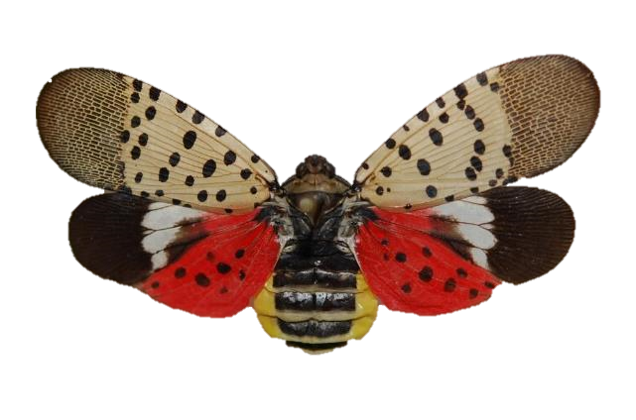
Report Sightings of Spotted Lanternfly
Visit the Penn State Extension Website:
https://extension.psu.edu/spotted-lanternfly
Or Contact the Spotted Lanternfly Hotline:
1-888-4BAD-FLY (1-888-422-3359)
Notes:
The Pennsylvania Department of Agriculture and Penn State Extension are closely tracking where spotted lanternflies are found. If you see what you think is a spotted lanternfly or spotted lanternfly egg mass, please take a picture of it if you can, kill it, and report it on the Penn State Extension Website or call the Spotted Lanternfly Hotline.
If you find it outside of the quarantine zone, it would be helpful if you preserve it in alcohol for easier verification
.

Slide 12
Image Credits
Unless otherwise noted, all images are courtesy of Penn State.
4 – 5. Keri Griffin / Penn State
6. rck_953 / bigstockphoto.com
6.2. Becca Robertson / Penn State
7. "20180829-APHIS-LSC-1195" by United States Department of Agriculture / usdagov on flickr.com has been modified (cropped) and is in the public domain
8. "DSC_3694" by Dean WM. on flickr.com has been modified (cropped) and is licensed under a CC BY 2.0 license
9. "20180831-APHIS-LSC-0373" by United States Department of Agriculture / usdagov on flickr.com has been modified (cropped) and is in the public domain
11. Lawrence Barringer, Pennsylvania Department of Agriculture, Bugwood.org has been modified (cropped, edited) and is licensed under a CC BY 3.0 license

